Slide 1

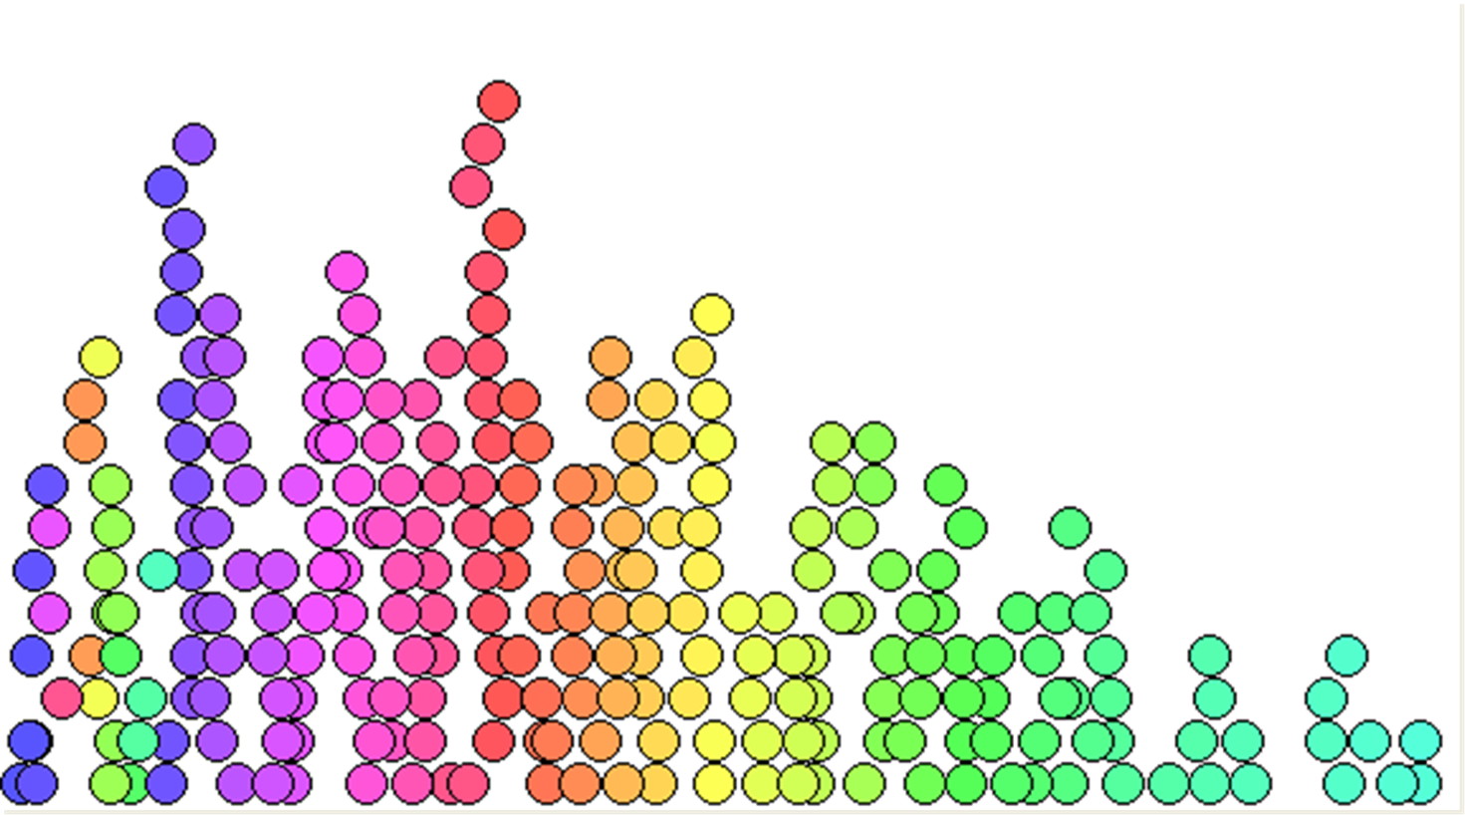
Data Modeling:
A Model Eliciting Activity
Anne Patel
Doctoral research study

Slide 2
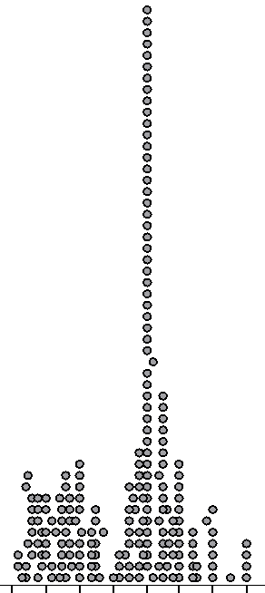
I notice…
I wonder….
What are the possible factors that explain the variation in this chance distribution?
Are there alternative explanations?

Slide 3
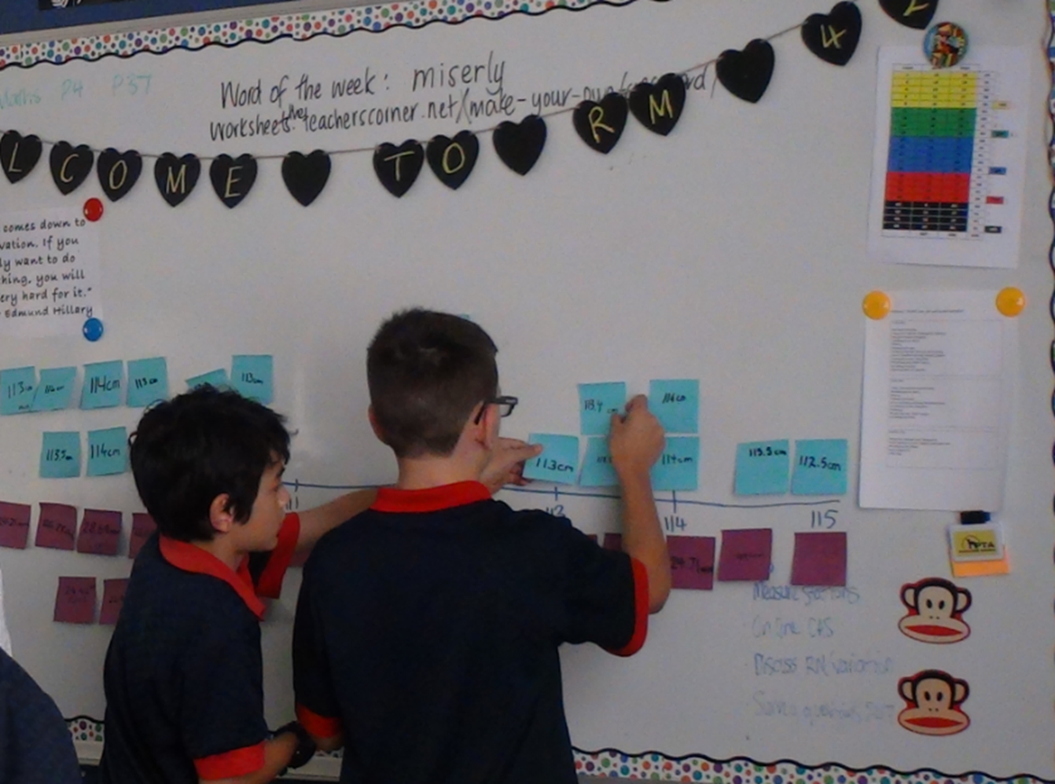

Slide 4
Prior modeling experiences in TinkerPlots:
Transitioned from physical spinners to virtual spinners to explore large numbers of trials (more than can be physically done by hand)
Modeling repeated measures.
Students measured two characteristics of a moonhopper
They discussed the variation in both sets of data
They discussed the causes of the variation they observed in the data
They built an additive model that produced simulated data that mimicked the real data.
They had to judge if their model was a “good” model

Slide 5
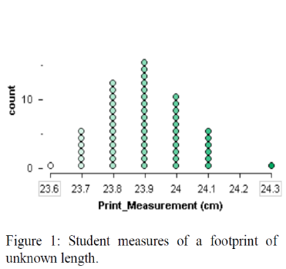

TinkerPlots Sampler Microworld
New technology (Konold & Miller, 2011)
Making a Repeated measures model in the Sampler
Notes:
In an attempt to deal with these issues some statistics education researchers have turned to a modelling approach to develop students inferential thinking in new ways. A modelling approach attempts to put the chance back into data and the data back into chance. The TinkerPlots Sampler uses linked random generating devices to produce simulated data that mimics the phenomenon and behaviour of real data. This model was built to simulate measurements taken of a single object, in this case it was the circumference of someone's head. The signal from the data was that the true but unknown value was 23.9cm, but there was of course variation or noise around this signal. This is accounted for in the 4 other spinners that mimic the variation seen in the real data. So an output of the model could be 23.9cm, no change, this means getting zero on every spinner or as high as 24.3cm or as low as 23.5cm. Once models are built and validated against the real world situation they can be used for understanding the behavior of the system or predict future outcomes. This approach lies at the heart of scientific thinking, which has the goal of unpacking and understanding factors that contribute to phenomena seen in data. This is were the power of statistical models to answer “what if” questions becomes apparent. There is also an educational desire to enculturate students into the practice and thinking of applied mathematicians and statisticians.

Slide 6
MEA: Variation in a process
The hook… Readiness questions….
The task… Check students know what is required….
Advise… this task will be completed in groups of 2-3 students independent of the teacher. Resources will by provide and advice if you get really stuck but you should aim to complete the whole task unassisted.
Stand back and observe the students’ reasoning and group work. Be aware that some groups will not produce a working model.
That is fine! That is what Follow Up Tasks are for….

Slide 7
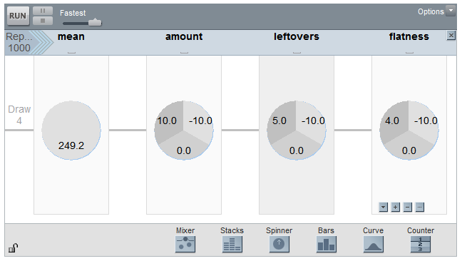
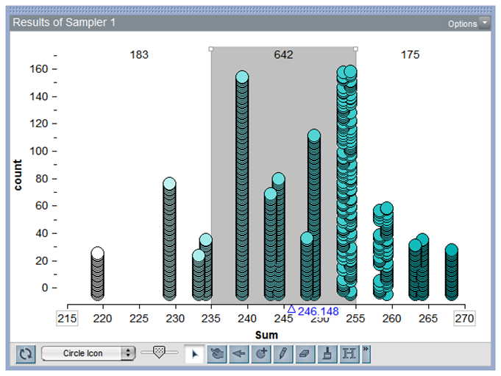
Krista & Mika’s Model

Slide 8
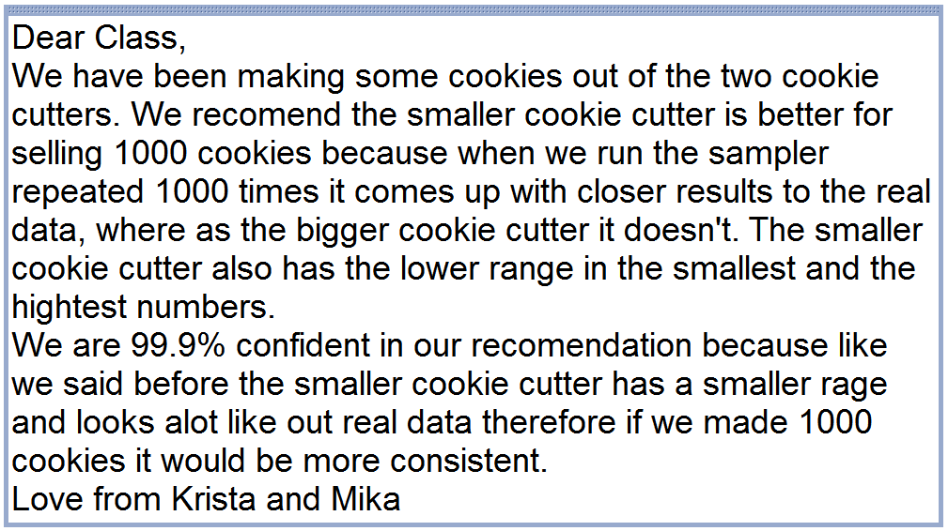

Slide 9
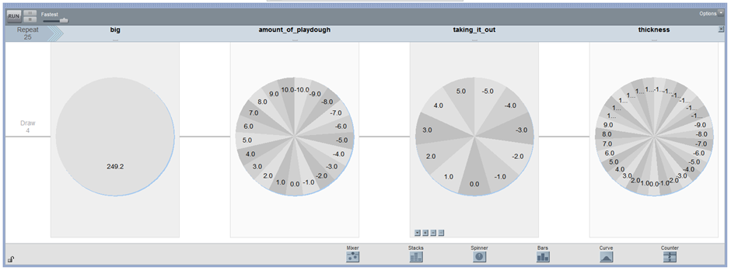
Ali & Leo’s model

Slide 10
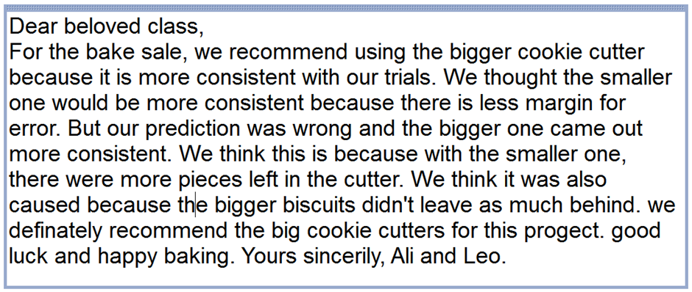

Slide 11
Statistical Modelling Framework:
Understanding the problem
1. Understanding the situation (Real world)
2. Understanding real data collected (Real world)
Seeing and applying structure
3. Forming structure for model (Real world – Model world)
Modelling
4. Testing the model (Model world)
5. Refining the model (Model world – Real world)
Analysing simulated data
6. Interpreting results of simulated data (Model world)
Communicating
7. Communicating findings (Model world – Real world)
8. Using model to explore problem further in context.
(Real world - Model world - Real world)
Notes:
This is a summary of the initial Statistical modelling framework that was produced from the analysis of a single pair of student data for the bag weight MEA. You have the complete framework with all the cognitive activities seen or not seen from the students, the cognitive activities included here but not observed by researchers when the students completed the modelling task is based on the research literature. The students did most of these things, it was the communication section that we saw the least evidence of these types of cognitive activities, perhaps not surprising, seeing as how it was their second attempt at an MEA, and explaining a what if situation based on a model constructed of random generating devices.

Slide 12
Further reading about a models and modeling approach:
Konold, C. & Kazak, S. (2008). Reconnecting data and chance. Technology Innovations in Statistics Education, 2(1). http://repositories.cdlib.org/uclastat/cts/tise/vol2/iss1/art1.
Lehrer, R. (2015). Developing practices of model-based informal inference. In Proceedings of the Ninth International Research Forum on Statistical Reasoning, Thinking, and Literacy (SRTL9, 26 July–3 August, 2015) (pp. 76–86). Paderborn, Germany: University of Paderborn.
Lesh, R., & Doerr, H. (Eds.). (2003). Beyond constructivism: Models and modeling perspectives on mathematics problem solving, learning, and teaching. Mahwah, NJ: Lawrence Erlbaum Associates.
Yoon, C., Patel, A., Radonich, P., & Sullivan, N. (2011). Learning environments with mathematical modeling activities. Teacher Learning Research Initiative. Wellington, New Zealand: New Zealand Council for Educational Research. Retrieved from: http://www.tlri.org.nz/sites/default/files/projects/9274_finalreport.pdf

