Slide 1
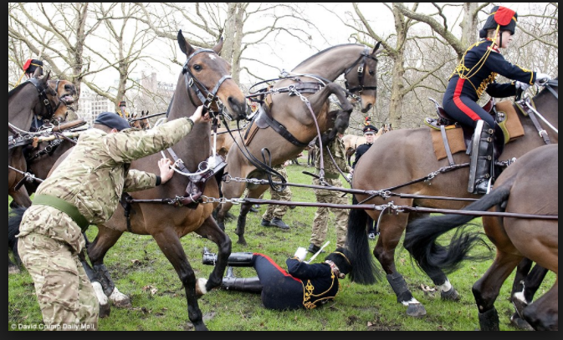
Unfolding Secondary tki Activities for L3 Probabilities
- A Calc teacher’s learning journey for teaching L3 Stat
Sun Mee Kim
Westlake Girls Highschool

Slide 2
Senior Secondary Guide
We would need,
Graphics Calculator
Pen
Device connected
Indicators
Activities

Slide 3
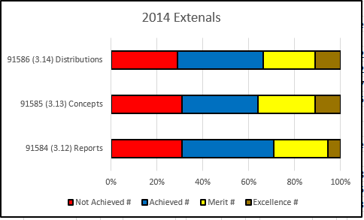
What do we notice?
Notes:
About 10 000 paper nationwise

Slide 4
Assessment Report 2016

Slide 5
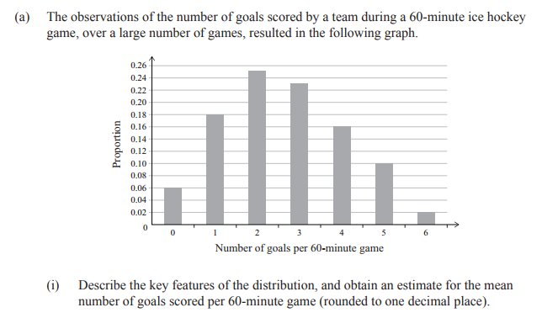
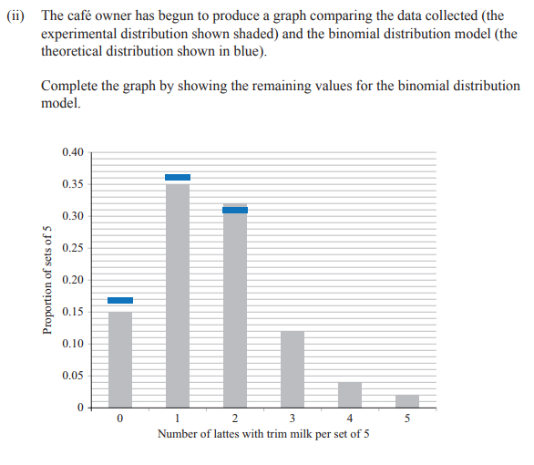
Exam Questions
2014 2015

Slide 6
Text Book - Discrete Probability Distributions
Binomial Distribution (Chapter 15):
26 pages,
2 graphs (1 in note, 1 in investigation, none in Ex.)
3 tables (1 in the note, 2 in Ex. -> all on calculating mean or SD )
Poisson Distribution (Chapter 16)
17 pages
2 graphs (both in investigation)
4 tables (1 in investigation, 3 in Ex. -> all on calculating mean or SD )

Slide 7
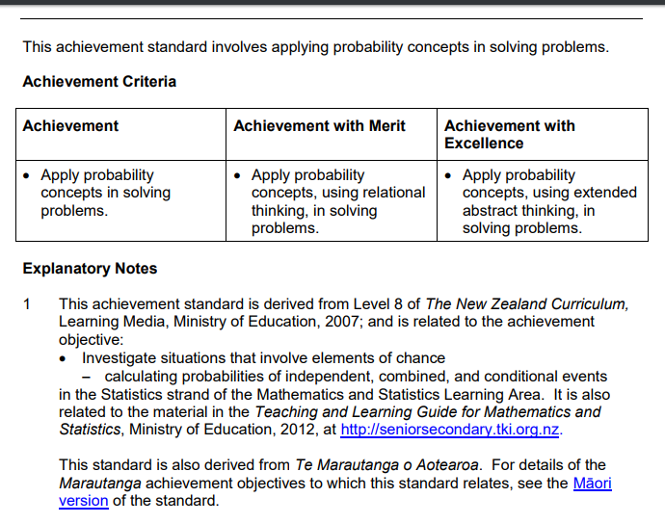
http://seniorsecondary.tki.org.nz/
Go to Standard then find the AO!

Slide 8
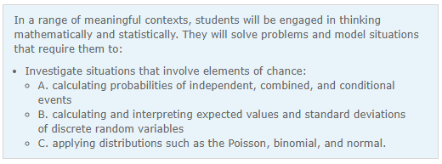
What’s in the AOs?
Skim Read and highlight “Unsure”
Notes:
Scan through the list of AO’s and identify what you are not sure.

Slide 9
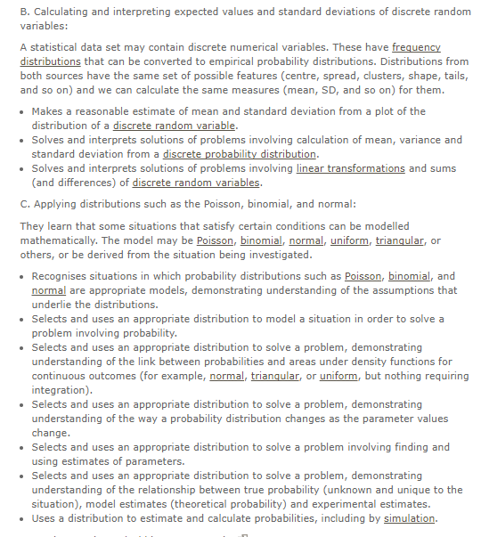
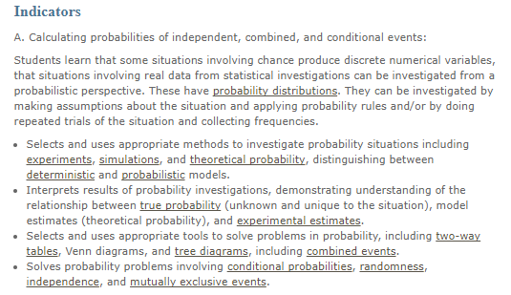
https://learnandteachstatistics.wordpress.com/2013/12/16/deterministic-and-prob-models/

Slide 10
Matching Activity) Indicators and NCEA Questions
Might be a good idea to dissect the questions and decide which indicator is being assessment in each questions.
For teacher PLD.

Slide 11
What does it mean in terms of the Teaching ?
→ Introductory Activity : Experiment and/or
Simulation
→ Start from the Graphs?
→ Lots of Graphs in context

Slide 12
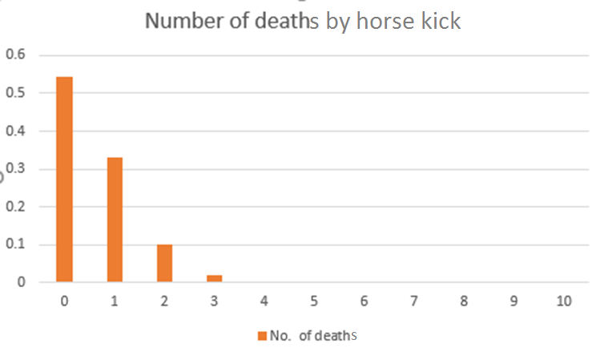
What do you notice?/ What do you wonder?
The Poisson Distribution: https://www.umass.edu/wsp/resources/poisson/#features
What’s going on this graph: https://www.nytimes.com/2017/09/06/learning/announcing-a-new-monthly-feature-whats-going-on-in-this-graph.html?_r=1
Making sense of Noticing and Wondering: https://www.youtube.com/watch?v=lz7aELjGy_Y&index=3&list=LL0iVPFad3gLyycBGsalAYBw

Slide 14
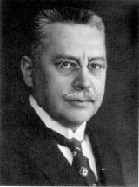
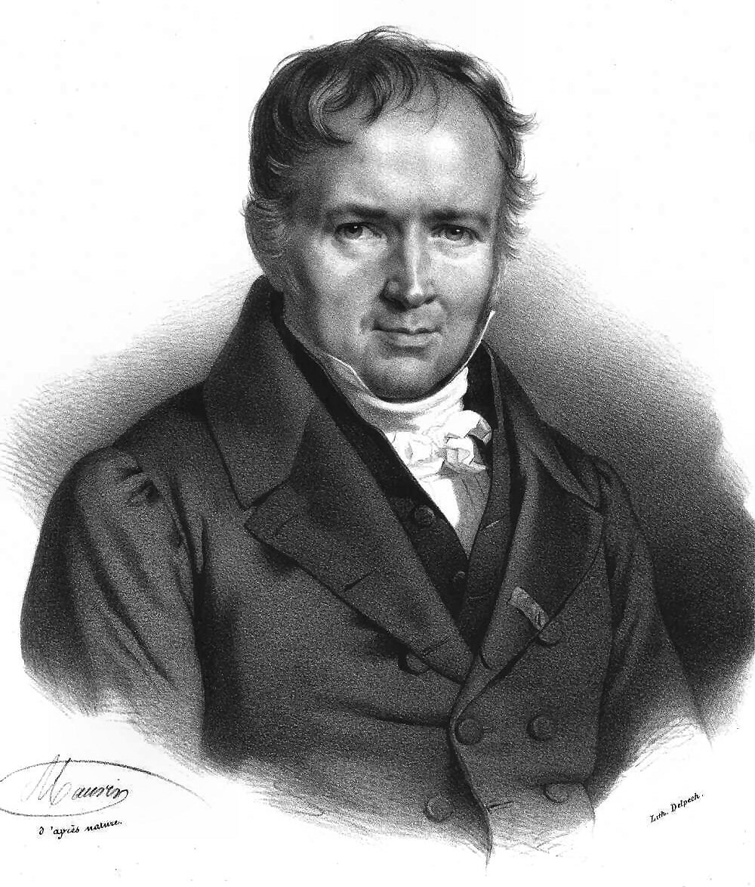
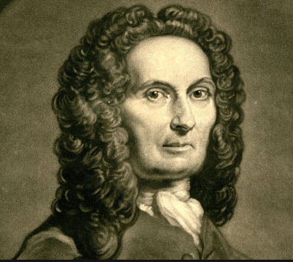
Bortkiewicz
Poisson
De Moivre

Slide 15
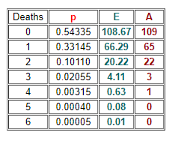
Fatal Horse Kicks
Ten army corps were observed over 20 years, giving a total of 200 observations of one corps for a one year period.
The total deaths from horse kicks were 122.
Rate = 122/ 200 = 0.61
Deaths | Model Estimate | Expected Number | Actual deaths
0 |  |  | 109
1 |  |  | 65
2 |  |  | 22
3 |  |  | 3
4 |  |  | 1
5 |  |  | 0
6 |  |  | 0

Slide 16
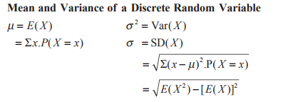
Yummy Experiment Introduction to Poisson Distribution Model
Dot Plot /Bar Graph
-> add Experimental Estimate (Relative Frequency) axis
-> turn it into a probability distribution graph
frequency
Relative Frequency
What do you notice?
Estimate the Mean , SD
Calculate the Mean, SD
# of chocolate buttons
Do some calculations
Notes:
What is the Variable of interest?
What values X can take?
What do you wonder? How many buttons for how many cookies?

Slide 17
Poisson Model Model Estimates vs Experimental Estimates
One and only parameter
λ =
x
Frequency
Experimental Estimates
Model Estimates
Sketch the model estimates over the experimental estimate.
What do you notice? Discuss the Fit of the model “SCS CC”
Mean = variance?

Slide 18
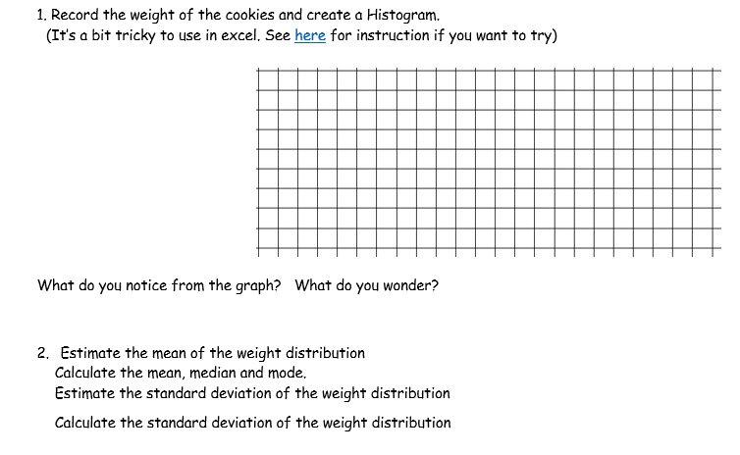
Yummy Experiment Introduction to Normal Distribution Model

Slide 19
“Cards, Dice and Distribution”
Mind reader : with 12 picture cards for Binomial
Double 6s : for Poisson

Slide 20
Conclusion
Introductory Activity for each distribution for an opportunity draw table, graph. Then notice things and compare with the model.
SSG & Professional Development
Nzmaths PLC, FB Groups
Censusat school, Nayland, MathsNZ student
Dr Nic’s blog, teaching statistics is awesome
Google
Perfect Textbook??I

Slide 21
Thank you!

