Slide 1
The Joy of data analysis and critical thinking - a Welsh perspective
Rhys Jones PTF, University of Auckland

Slide 2

Bore da pawb
Croeso i Brifysgol Auckland

Slide 3


Slide 4





Slide 5
What are we looking for among prospective students? (admissions tutor – Cardiff University)
Independent and critical thinking
  Identify, construct and evaluate arguments
  Identify the relevance and importance of ideas
  Analyse problems systematically
  Reflect on one’s own beliefs and values
Independence
Reflexivity
Notes:
As an admission tutor, these are the skills we are looking for in new students
Will benefit students in adjusting to higher education

Slide 6
Transition to University
‘Teaching the test’
‘Spoon feeding’
Dependent learning
Self-reliance
Self-motivated
Self-management
Self-reflection
Notes:
In reality this emphasis on self-development may be overstated as many student learn to acquire these skills through peer groups.

Slide 7
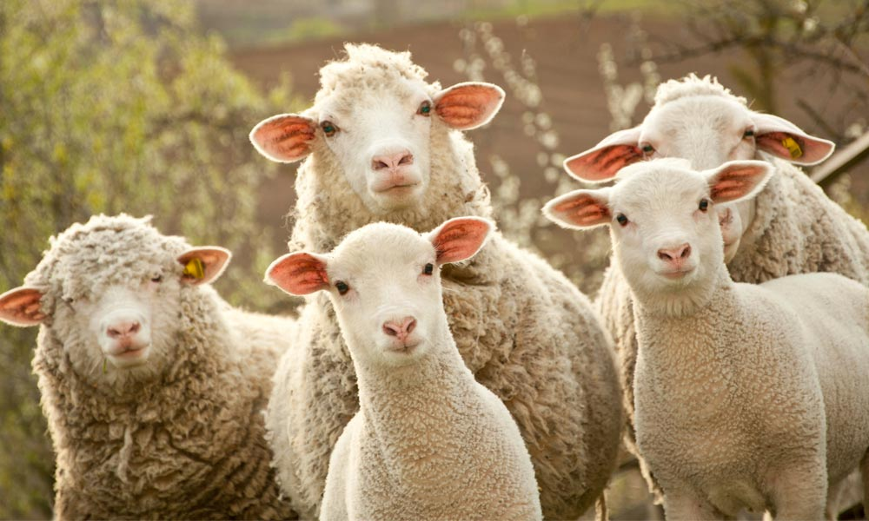

Slide 9

Essential and Employability skills
(Years 12 and 13)
^{Literacy}
^{Numeracy}
^{Digital Literacy}
Critical Thinking and Problem Solving
^{Creativity and Innovation}
^{Planning and Organisation}
^{Personal Effectiveness}

Slide 10
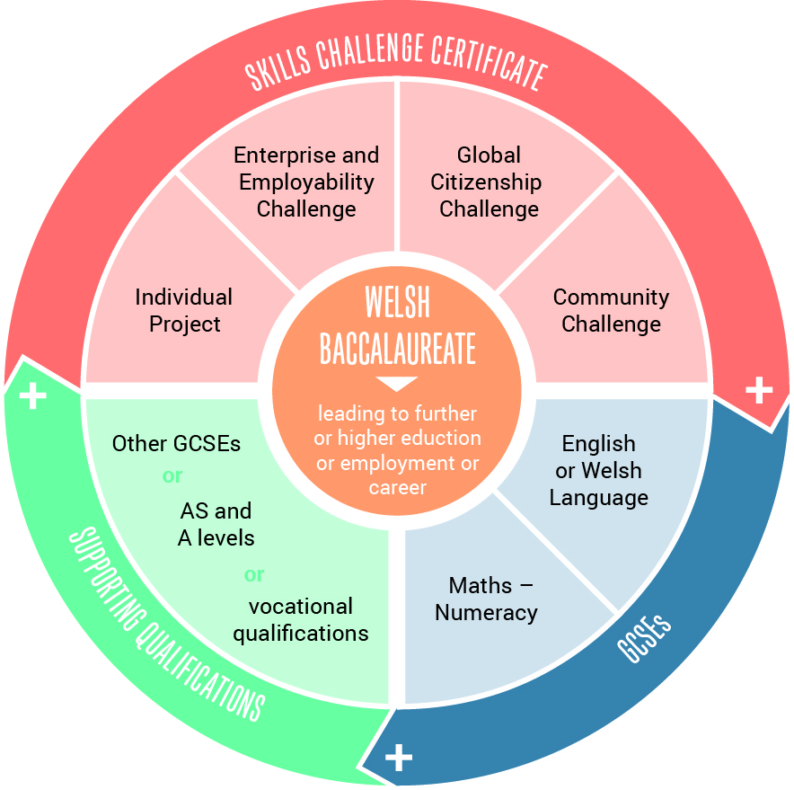
Structure

Slide 11
Individual Project (50% of WBQ)
Research a contemporary issue
Emphasis on future educational or career aspirations
A written account (3,000 – 5,000 words in length) or an artefact/product supported by written evidence (1,500 – 3,000 words).
120 hours (guided learner hours)

Slide 12
Learning Outcome | Band 1 | Band 2 | Band 3
LO1 Understand how to identify the focus and scope of an individual project | Introduction, aims and objectives
 | relevant | appropriate and realistic | logical, appropriate and realistic
LO2 Be able to select and plan research methods, resources and materials | Rationale
 | credible | detailed, reasoned and effective | comprehensive, well-reasoned and effective

Slide 13
Learning Outcome | Band 1 | Band 2 | Band 3
LO3 Be able to select, collate, reference and assess the credibility of information and numerical data | Gathering of credible information (Combines 2 Assessment Criteria)
 | Appropriate research Relevant sources Detailed evaluation of credibility of sources | Detailed and effective research Appropriate sources and detailed Effective evaluation of credibility of sources | Detailed effective and comprehensive research, Appropriate and complex sources, Detailed, effective and comprehensive evaluation of credibility of sources

Slide 14
Learning Outcome | Band 1 | Band 2 | Band 3
LO4 Be able to analyse the numerical data and display using digital techniques | Using numerical information
 | Appropriate analysis; Relevant use of digital techniques; Mostly successful interpretation | Detailed and effective analysis; Appropriate use of digital techniques; Successful interpretation | Detailed effective and comprehensive analysis; Appropriate and effective use of digital techniques; Effective interpretation

Slide 15

How would you analyse dance?
Notes:
Three broad categories of dance theory, as you may find them described in universities or dance institutes, are:
philosophy (concerning the aesthetic meanings behind dance, or semiotics)
choreology (movement analysis and description)
sociology (regarding the role of dance in society and culture)

Slide 16
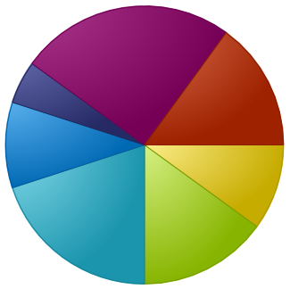
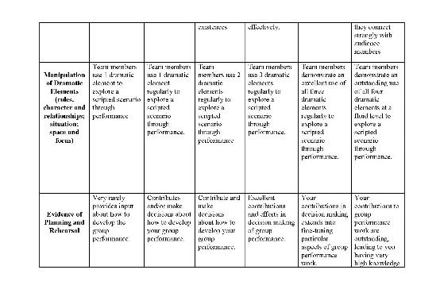
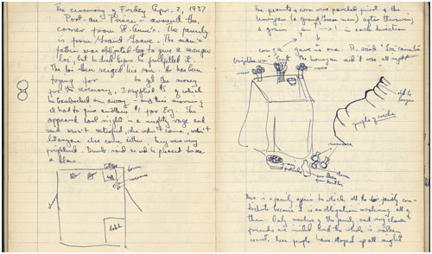
Which method produces the most useful data?
Pie chart?
Tables?
Field notes?
Notes:
Three broad categories of dance theory, as you may find them described in universities or dance institutes, are:
philosophy (concerning the aesthetic meanings behind dance, or semiotics)
choreology (movement analysis and description)
sociology (regarding the role of dance in society and culture)

Slide 17
Teacher management of the course
Students to develop skills, knowledge and understanding
^{Teacher backgrounds diverse}
Internal assessment and moderation
^{External moderation}

Slide 18
Aims of the Welsh Baccalaureate (WBQ) Conference (2015, 2016, 2017)
Response to teachers needs (pre conference survey)
Cardiff University (CU) researchers sharing expertise
Build on teachers critical thinking and data analysis skills
Build confidence in teachers of the WBQ
Awareness of engagement activities at CU (Lunchtime Forum)
Student independent thinking – becoming researchers
Preparation for HE

Slide 20


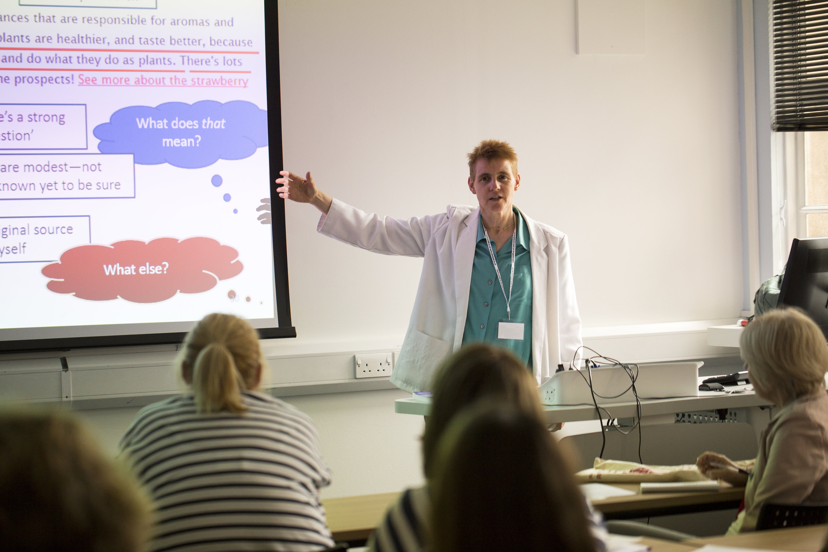
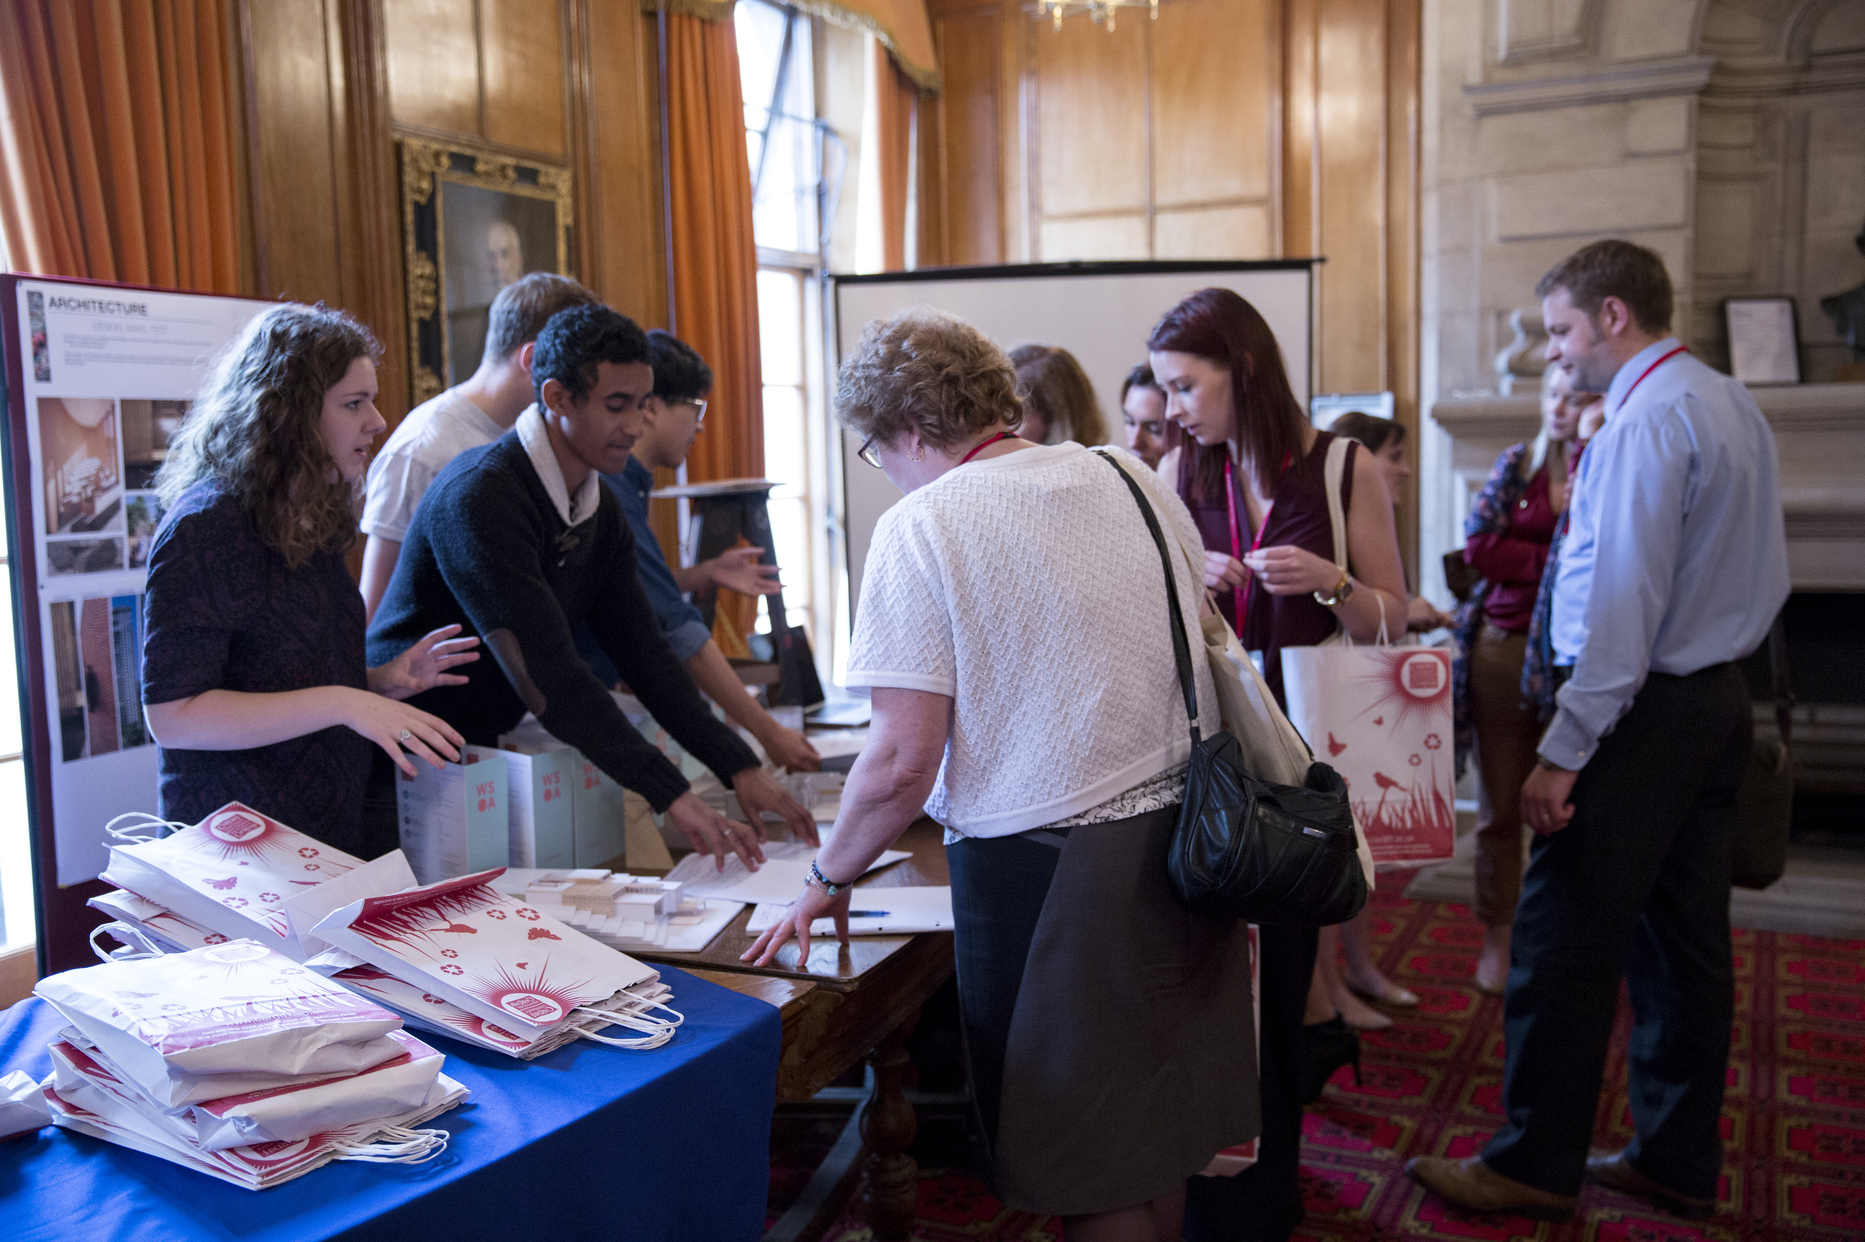
WBQ working groups

Slide 21
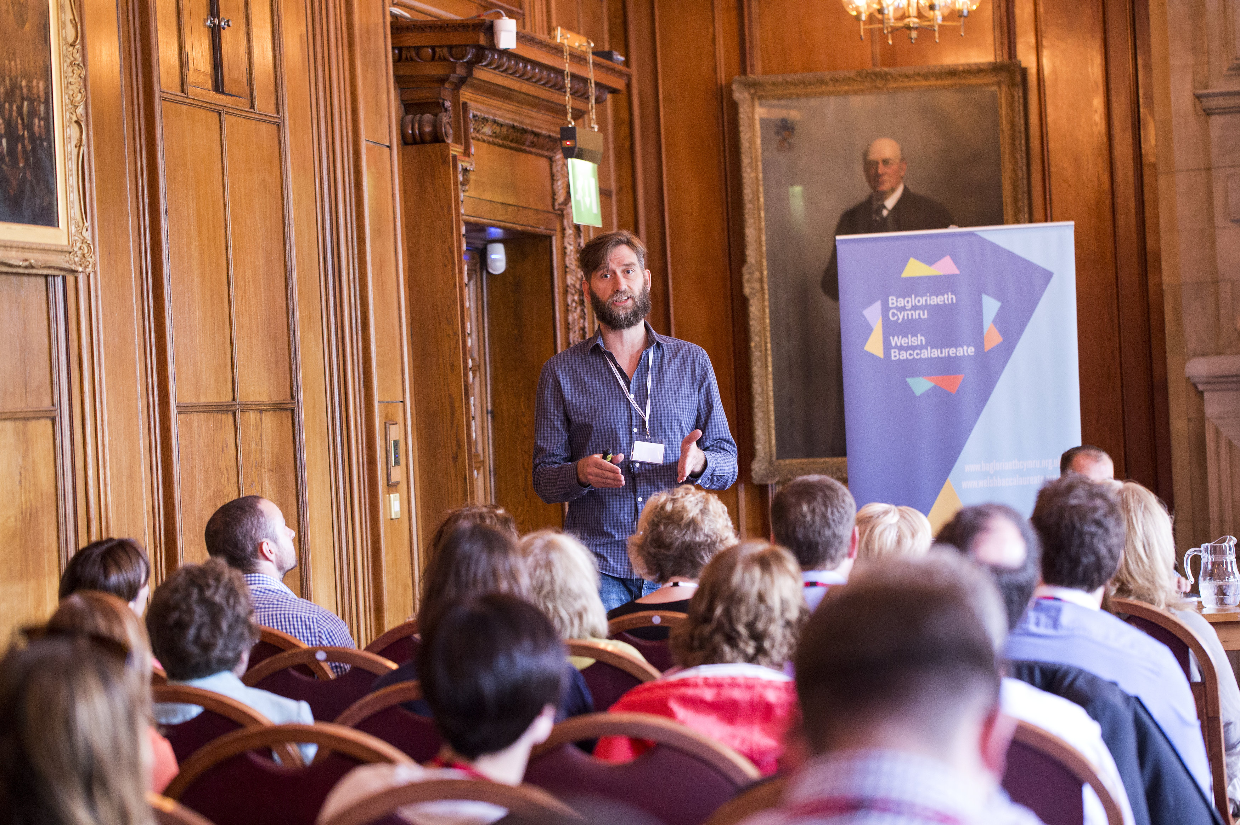


The BIG DAY!

Slide 22
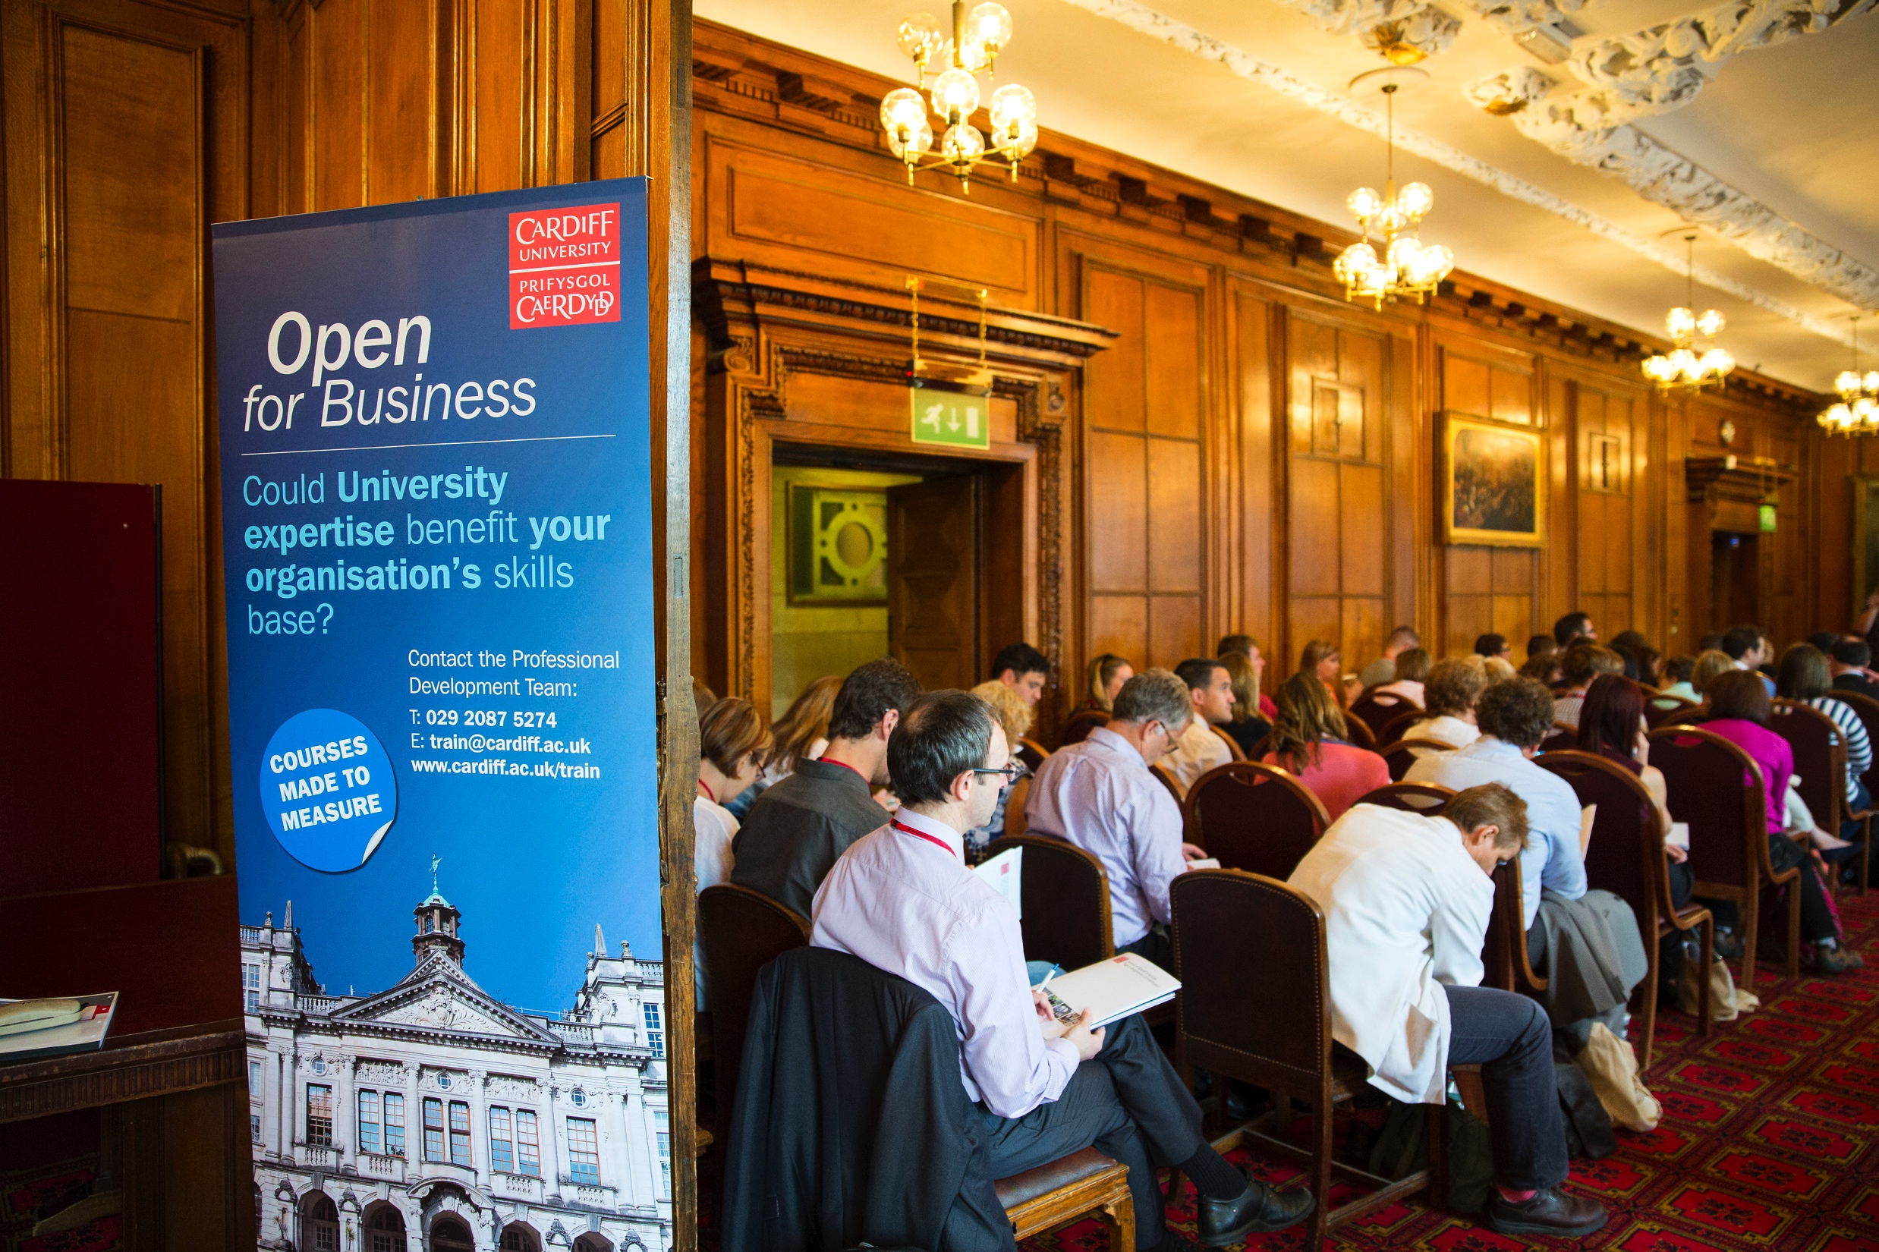

Slide 23
https://www.cardiff.ac.uk/conferences/welsh-baccalaureate-conference-2017/sessions.

Slide 24
Analysis of data introduction (units sometimes not included)
What types of data can you collect?
Group activity 1: Get into groups of 3 or 4 and ask each other the following questions (ensure you construct a suitable table to collate the data):
Can you roll your tongue?
Are you male or female?
How old are you (in months)?
How long is your arm (in cm)?
What is your height (in cm)?
Can you ride a bicycle?
What’s your favourite food?
Once you have collected your data, collect data from other groups (sampling method).

Slide 25
Table | These are used to organise exact amounts of data and to display numerical information. They do not show visual comparisons. As a result, they can take longer to read and understand. It can also be difficult to examine overall trends and make comparisons.
Line graph | These are used to display data or information that changes continuously over time. They allow us to see overall trends such as an increase or decrease in data over time.
Bar graph | These are used to compare facts. They provide a visual display for comparing quantities in different categories or groups. They are used for discrete data. They help us to see relationships quickly. However, they can be difficult to read accurately. A change in the scale may alter the visual perception of the data.
Pie Chart | These are used to compare the parts of a whole. They are best used for displaying one set of data. If the values of the parts are quite similar they can be difficult to read and understand
Histogram | With these graphs the data represents continuous rather than discrete categories. However, because a continuous category may have a large number of possible values, the data is often grouped to reduce the number of data points. For example, instead of drawing a bar for each individual age between 0 and 65, the data could be grouped into a series of continuous age ranges such as 16-24, 25-34, 35-44 etc. The area of the bar is proportional to the size of the category represented and not just its height
Box and Whisker | This is used to display information about the range, the median and the quartiles. It is usually drawn alongside a number line.
Scatter graph | These graphs are drawn to find patterns in sets of data (if present).They show the relationship of one variable to another. The relationship between the two variables is called their correlation. A line of best fit is drawn through the data to show the correlation.

Slide 26
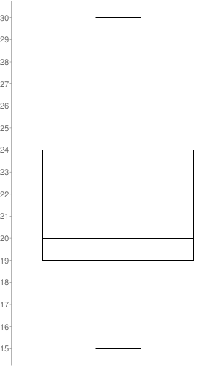

Slide 27
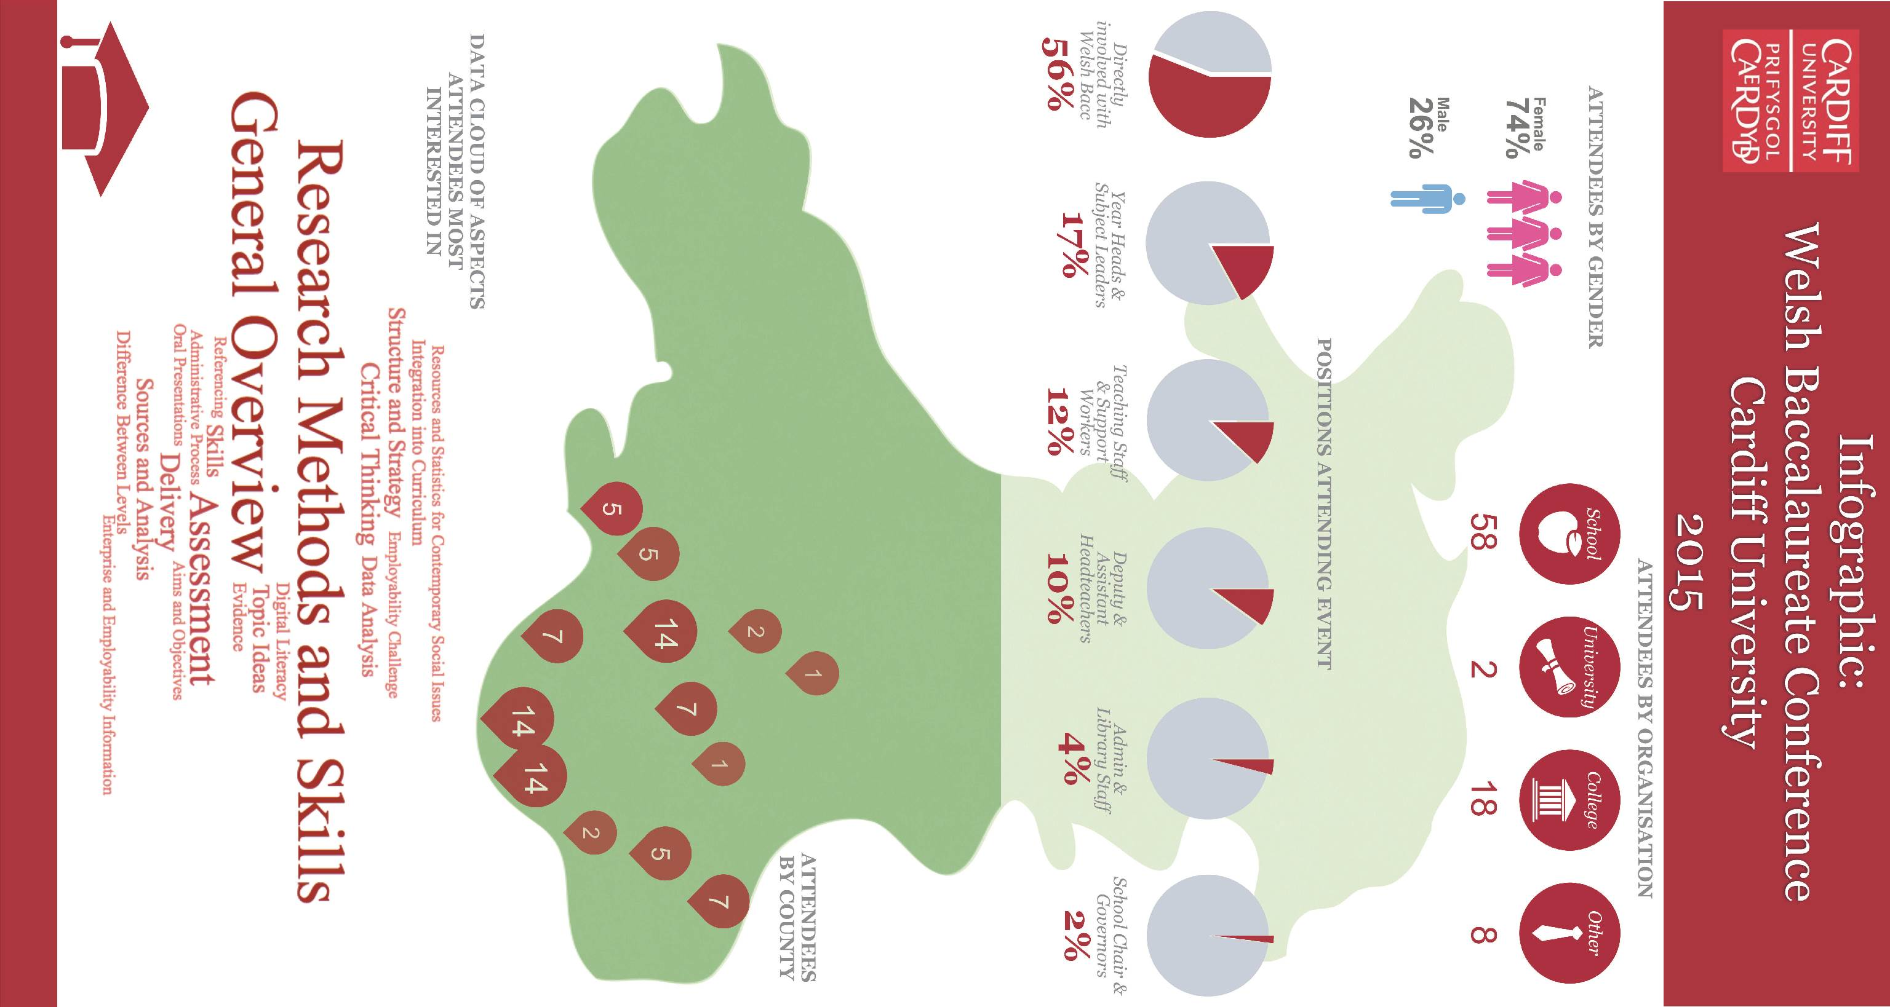
Evaluation
2015

Slide 28
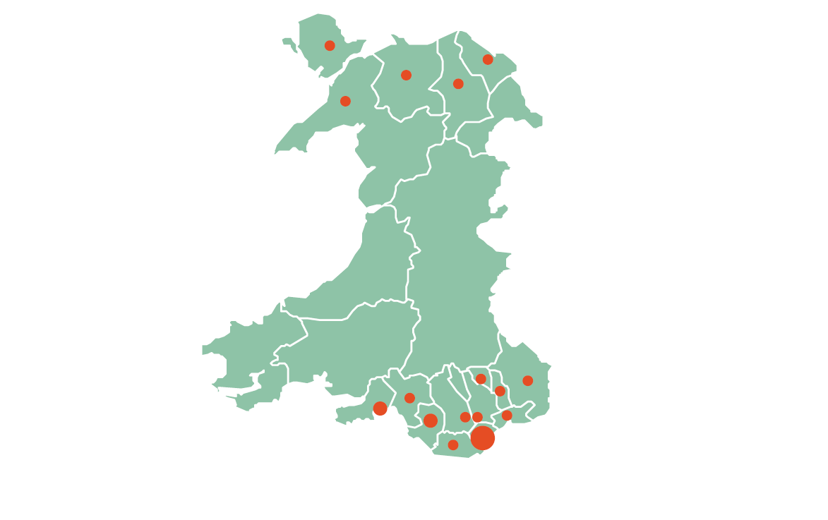
Evaluation 2016

Slide 29
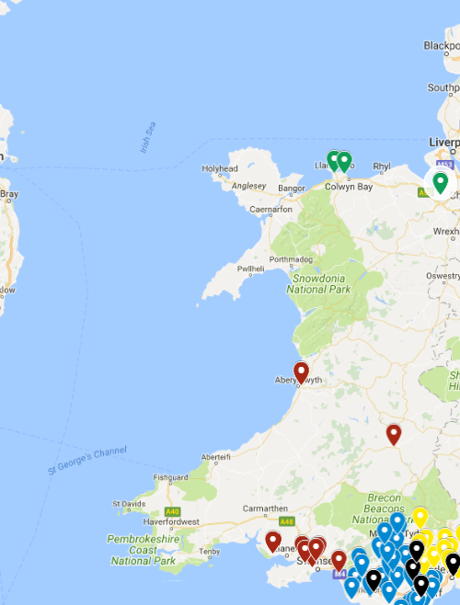
Evaluation 2017

Slide 30
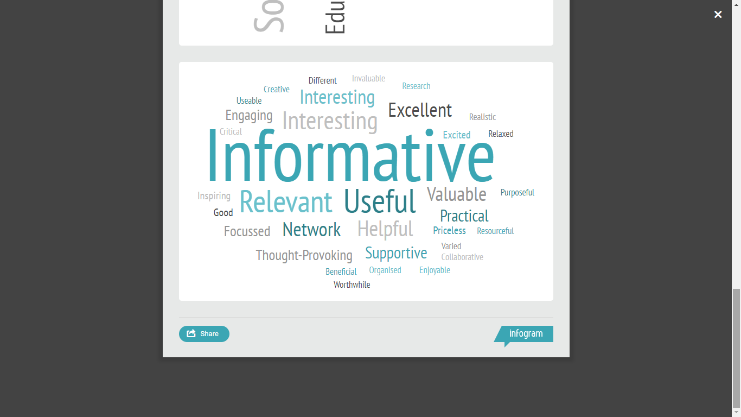

Slide 31
The majority of delegates found the workshops very relevant or relevant
Preference for workshops which provided teaching resources or practical activities that could be used in the classroom
“The fun times workshop provided practical examples that can be used in schools”
“Really helpful to be able to visualise using resources sessions”
“All of the speakers contributed something to the conference that I feel I can use in the classroom”

Slide 32
Hi Rhys,
Thank you very much for another excellent day delivering just what is needed for the Advanced Personal Investigation.
The workshops hit the nail on the head for teachers and gave just the right level of skills, knowledge and direction for schools and colleges to achieve A* with their learners if the work is delivered properly with enthusiasm.
It was an excellent day.
Regards,
Annwyl Rhys,
The resources are fantastic - thank you very much! It'll be a busy summer for me putting together a coherent learning programme for the individual investigation, and these presentations will be a great help.
Thanks to all,
Cofion cynnes,

Slide 33
Press releases
National news teams attended and interviewed teachers in 2015
National Newspaper reports 2015-2017
VC commented on event 2016
Education minister for Wales commented on the event 2015 and 2016
University newsletter
Snow ball effect

Slide 34
The Future
Event was eventually funded by Welsh Government (2017)
Funding to create masters level modules in research skills for teachers (Pilot Scheme in 2018)
NNEM – 20 teachers across Wales (primary and secondary) seconded to engage with mathematics (and stats) education research
Continue to work collaboratively across departments – cross-curricula activities linked to data analysis and critical thinking skills
Opportunities here in NZ (working with teachers)

Slide 35
Questions?
DIOLCH YN FAWR!
Thank you for listening!
Rhys Jones
Professional Teaching Fellow
Department of Statistics
University of Auckland
Auckland, New Zealand
Email address: rhys.jones@auckland.ac.nz
Room 316, Building 303, Science Centre

