Slide 1
Personalised programmes in Year 12 & 13 Statistics
Liz Sneddon
email: esneddon@ormiston.school.nz
Link to presentation: http://bit.ly/2hTRjGU

Slide 2
Why personalise?

Slide 3
What does personalising mean?

Slide 4
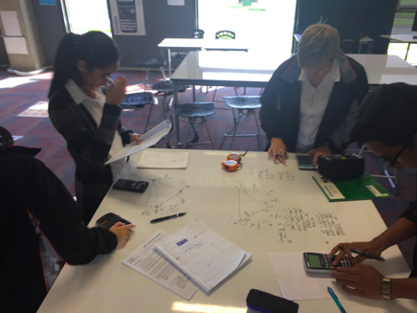
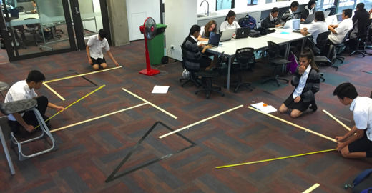
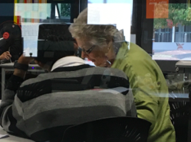
Personalisation in action

Slide 5
My journey with Year 12 Statistics ...
I started by giving students a choice of whether to do the Probability external, or swap to an extra internal (Sequences & Series).
I then started personalising a programme for individual students throughout the year.
This year I rolled out personalised learning for all Year 11 students, and will extend this to Year 12 in 2018.

Slide 6
What development was needed?
Personally:
Confidence in curriculum knowledge
Understanding the Achievement Standards
Confidence to give it a go

Slide 7
What development was needed?
For other teachers:
Support, guidance and confidence from someone who has done it before
Confidence to give it a go
Team work

Slide 8
What resources did I need?
Workbooks
Videos
Learning guides (schemes)
Tracking progress
Google Classroom & Sites

Slide 9
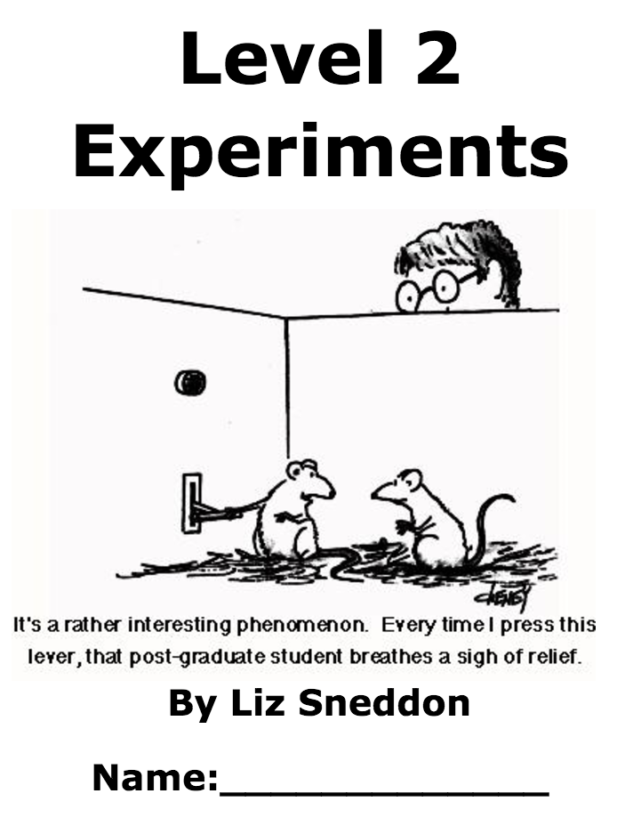
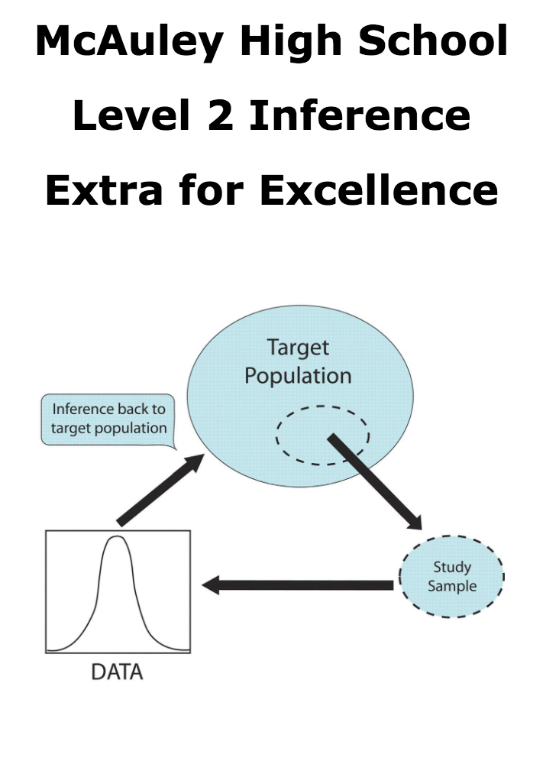
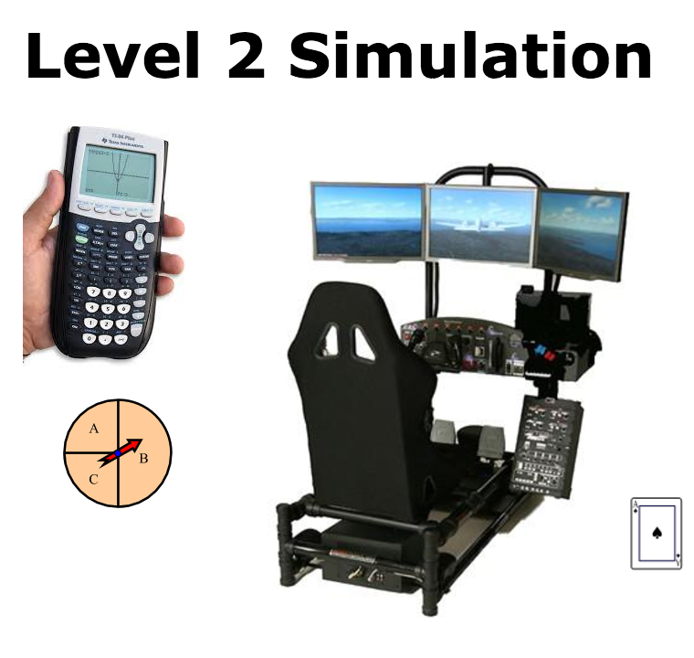
Workbooks
I’ve used either:
Commercially available workbooks, or
Workbooks i created.

Slide 10
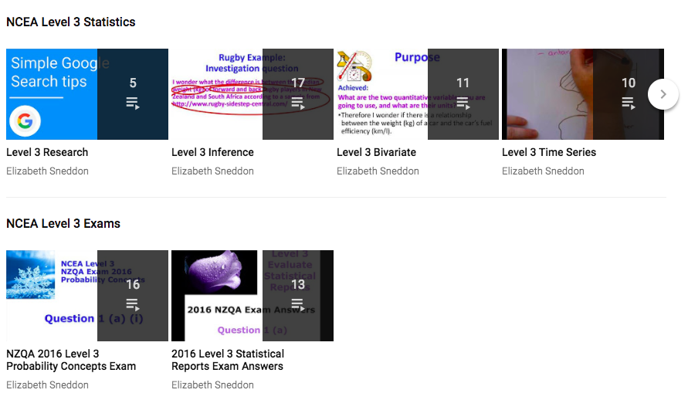
Videos
My own youtube channel
Make playlists
Either videos from others
Wild About Statistics
StatsLC
Others
Or videos I made
Internals:
Key ideas
Externals:
Key ideas
Exam answers

Slide 11
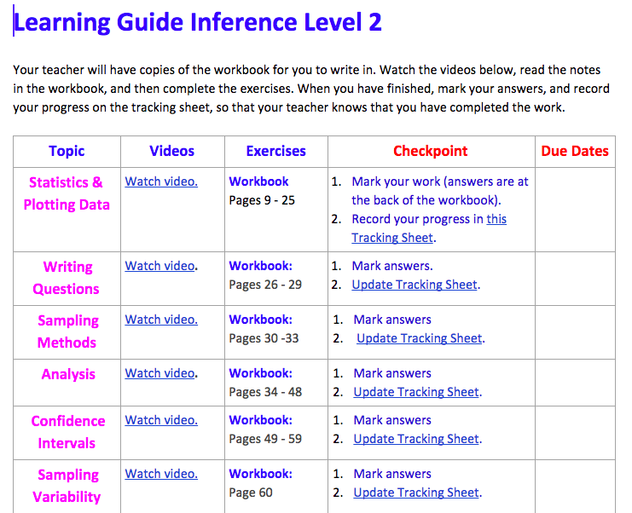
Learning
guides
Skills
Key ideas
Practice assessment
Assessment

Slide 12
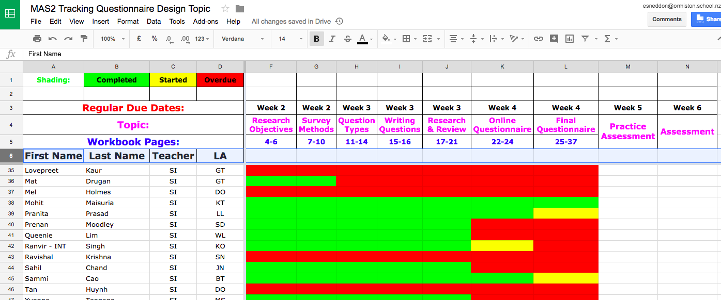
Tracking progress

Slide 13
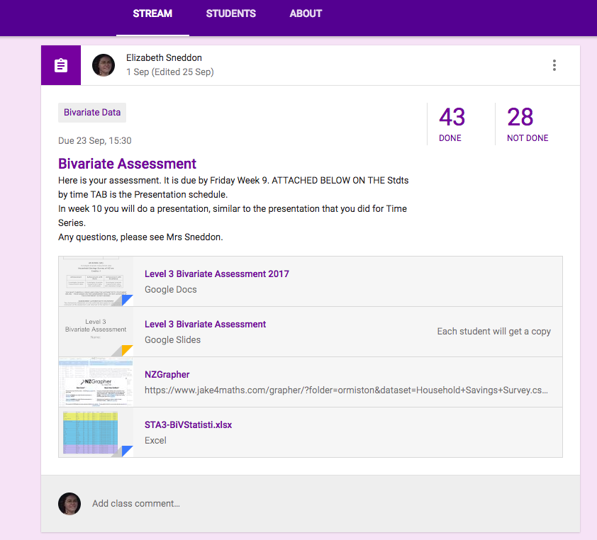
Google
Classroom
Announcements
Practice Assessments
Assessments

Slide 14
Google Sites
Usage:
Store resources
Learning guides
Links
Started with a Google doc
Then created a Site

Slide 15
Anywhere, Anytime Assessments
A range of contexts to engage students
Get students to collect their own data
Random samples
Authenticity

Slide 16
Authenticity of assessments
This year we assessed two Level 3 standards using a presentation - Time series and Bivariate.
This was extremely effective, as you do marking, moderation and resubs all at once.
It also means that you can ask the student to clarify their understanding, which is a great way to check authenticity.

Slide 17
Checkpoints
Another option:

Slide 18
A suggestion from Anna Martin
Discussion on research
Journal of analysis
Executive summary or Infographic (which students can then present).

Slide 19
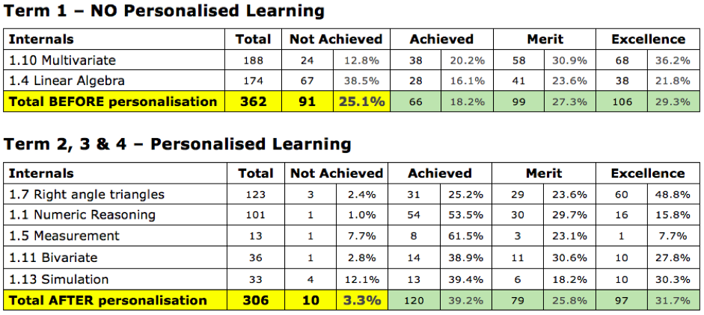
Results from Year 11, 2017

Slide 20
Year 12 Programme 2018
Guided by pre-requisites
Recommended pathways
Choice of pace
Choice of topic for assessments

Slide 21
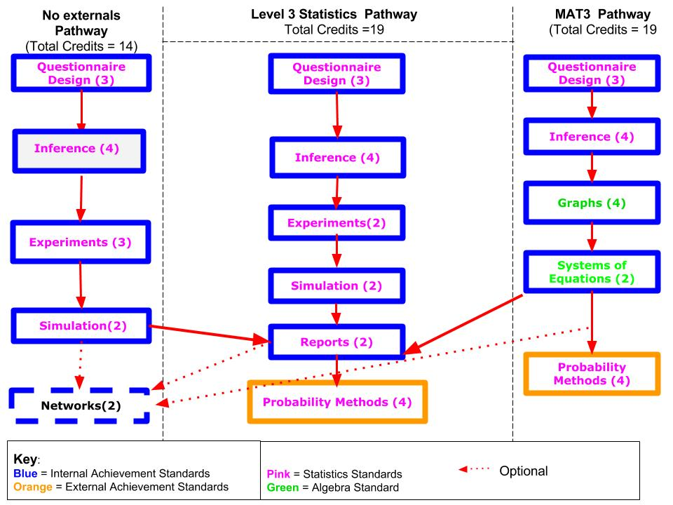
Year 12 Programme 2018

Slide 22
Year 12 Stats 2018
Cross curricular:
Business - Questionnaire design, Inference.
Students doing business design their own product.
Students not taking business can choose a product (e.g. milo, coke, etc)
PE / Health - Inference, Experiments.
Fitness testing in week 1, 4, 8

Slide 23
Year 13 Programme 2018
Goals:
UE subject (14 credits)
Course Endorsement (External)

Slide 24
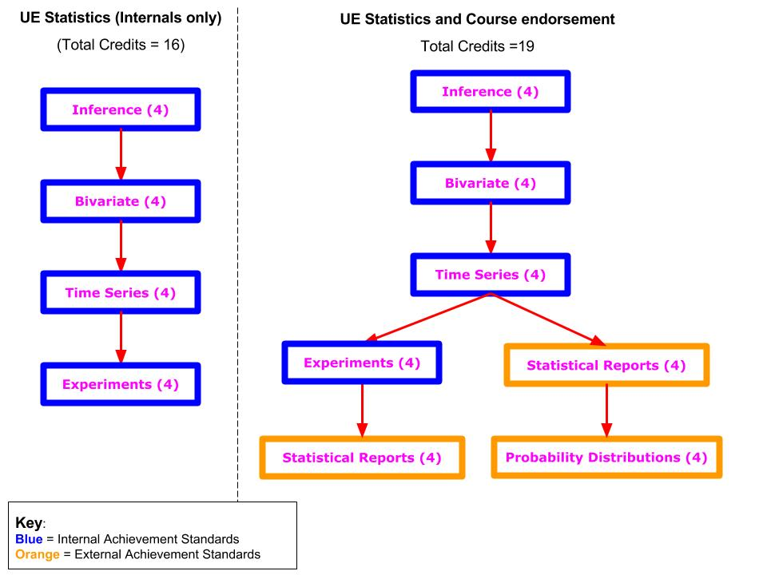
Year 13 Programme 2018

Slide 25
Plan for Year 13 in 2018
Have a few contexts available to students. They will then choose one context and learn, practice and assess each of their internals.
Key idea is that the students have one general context, that they can research around, rather than having 4 different contexts (one for each internal).

Slide 26
Contexts for Bivariate and Inference:
PE / Health - fitness testing at the start of term 1, and by week 9 to compare change in fitness level.
Books - word length, pages, category ...
Food from the supermarket - choose a category (e.g snack bars): calories, vitamins, brand, …
Pictures: pixels, colours, ... (Anna Ferguson)
Pets: age, weight, category, height … (Anna Ferguson)

Slide 27
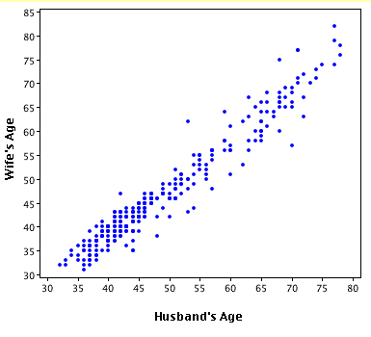
Contexts for Bivariate and Inference:
Or give the students a data set and get them to take a sample
Rollercoasters
SURF
Jake Wills (shared datasets)

Slide 28
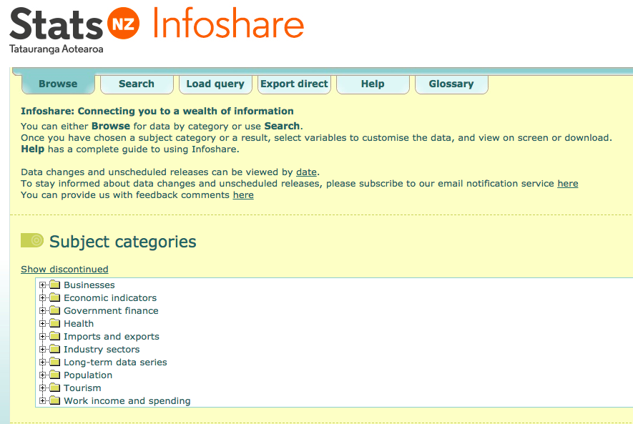
Contexts for Time Series
StatsNZ Infoshare
Immigration
Population
Tourism
Work, income and spending

Slide 29
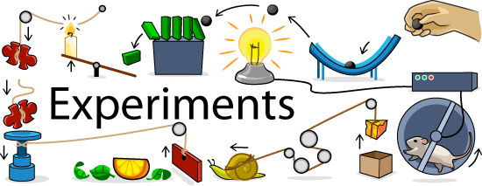
Contexts for Experiments
Based on a similar topic:
Food / drink
Marketing
Media
Pets / Family
Music / Feelings
Sphero racing

Slide 30
Sharing of ideas and contact details
We would love to hear about any ideas you have.
Link to our shared folder: http://bit.ly/2zSLEvx
Contact details:
esneddon@ormiston.school.nz

