Slide 1
Big ideas in statistics
Teaching for understanding

Slide 2
Why?
Notes:
Why learn statistics? Why use statistics? In statistics, the “why” is always important.
The purpose might not be for you. Statisticians work with other people, so the purpose can be for someone else.

Slide 3
Statistics helps us to make sense of a complex and messy world.
For making decisions
For understanding the world around us

Slide 4
Why teach randomness?
Notes:
Randomness is a big idea. You need to teach it explicitly. Fooling the teacher, with the take home message “Randomness is lumpy”.
Teaching randomness is another workshop, but resources are available on Census@School.

Slide 5
Why do we have statistical measures?
Talk to your neighbour about what your students would say about why we calculate mean, median, IQR etc.

Slide 6
Why do we calculate statistics?
Talk to your neighbour on the other side about what you do to teach students to understand why we calculate statistical measures.
Notes:
Then ask to share ideas.
Make the “why” an explicit discussion.

Slide 7
What is an average?
Notes:
Ask for definitions. One best number
Understanding centre and spread handout.

Slide 8
Understanding measures of centre
Go to the learning statistics is awesome website (you can google it) and choose dots.
http://learning.statistics-is-awesome.org/dots/
Turn on the mean button and drag down at least 10 dots. Make a distribution with the mean 4 times bigger than the median eg median 3 and mean 12.
Notes:
Time to play. When they have a distribution, look at other people’s distributions. If the scale is changed so that the median (3) is 70 000 GBP and the mean (12) is 280 000 GBP, we now have a graph of the income distribution in the borough of Kensington and Chelsea, where the fire this year was due to the council refusing to pay for more expensive cladding for the Grenfel Tower building.

Slide 9
Understanding measures of spread
What is spread anyway?
Notes:
Gather ideas.
Hand out graphs sets and match the graphs to the dot plots.
How would this help students understand spread?
Discuss what spread is: How variable the data is or how far from the centre the individuals tend to be. More spread means more individuals further from the centre.

Slide 10
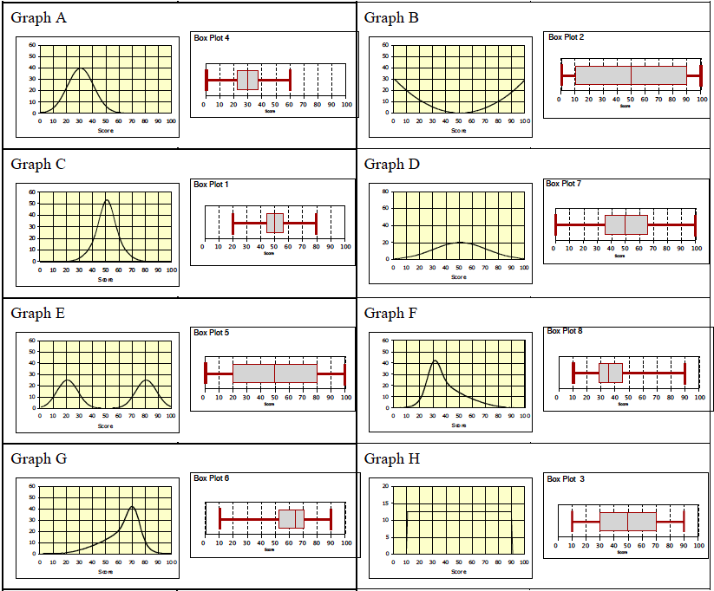
Notes:
Answers to graph matching. The graphs are very different.
Centre is not enough to understand a distribution. Look at graphs B, C, D, E and H.
Emphasize “not spread like peanut butter”.
Back to dots to look at spread using box plots.

Slide 11
Shift, overlap Shape, unusual features
Notes:
What do you notice? A lot of judgement calls. Our brains can be easily fooled, so use the statistical measures to guide us.
When we compare variability, we compare one as a % of the other, not the absolute difference in variability (IQR or SD). Eg woman have twice the variability in max speed driven compared to men, for first year Auckland University students.
I don’t like range.

Slide 12
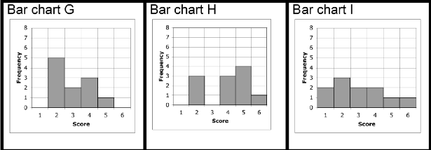
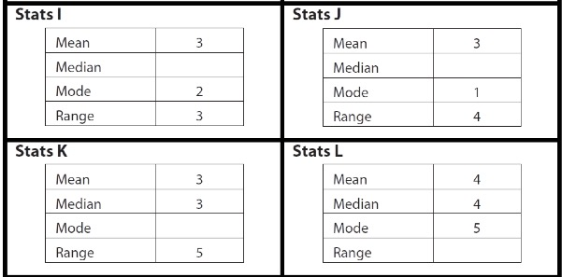
Notes:
Match the graphs to the statistics and fill in the blanks. Do this instead of a lesson doing calculations just for practice. Full resources available.

Slide 13
Variation
How many different kinds of statistical variation are there?
Notes:
Gather ideas on the board.
Natural (individual to individual) variation: variation we see within a sample or a population, spread, measured with IQR or SD
Variation between groups in a population: measured by differences in mean etc, relative size of spread
Sampling variation: the way samples are different from each other, and from the population they come from, measured with confidence intervals (MOE)
Induced variation: the variation we cause by an experiment, measured with randomisation test
Bias is variation caused by the statistical measurement, can’t be measured
Random measurement error caused by how precisely we measure, hard to measure
How many of these do our students need to know?

Slide 14
Big ideas about inference and variation
Notes:
Thanks to Jake Wills who gave me the idea for doing this.
Large pile of oranges (about 60)
Small pile of mandarins (about 20)
Really important that you actually have oranges and mandarins (string bag). You can ask students to each bring in a piece of fruit and then supplement.
What statistical ideas could you discuss?
We are going to have orange week again next year.

Slide 15
Are they from the same population?
What are we comparing?
Can we make a comparative inference if the sampling process wasn’t random?
Is there variation within each sample? Can we measure the variation?
If we took new samples from the population, what would we notice?
Is it fair to compare samples of different sizes?
What can we find out about the population of citrus fruit by looking at the sample of oranges?
What can we find out about the population of citrus fruit by looking at the sample of mandarins?
What can we find out about the difference between the size of oranges and mandarins back in the population?
Notes:
Thanks to Jake Wills who gave me the idea for doing this.
Large pile of oranges (about 60)
Small pile of mandarins (about 20)
Really important that you actually have oranges and mandarins (string bag). You can ask students to each bring in a piece of fruit and then supplement.
Discuss whether you can compare these two samples.
Are they from the same population? (I say that they are both from the population of citrus fruit sold by Countdown the previous day).
Does the sample have to be completely random to make a comparison? There is some bias, but that doesn’t mean the comparison isn’t valid. We need to make a judgement call about how much bias there might be in any inference we make.

Slide 16
There are lots more big ideas that people struggle to understand.
Census@school has lots of resources to help teach for understanding.
http://new.censusatschool.org.nz/resource/statistical-concepts-unpacked/
http://new.censusatschool.org.nz/resource/year-10-probability-unit-plan/
http://new.censusatschool.org.nz/resource/apply-probability-concepts-in-solving-problems/
Notes:
Sampling error and non-sampling error
Correlation and causation
PPDAC cycle
Etc…

Slide 17
Teaching for understanding
Encourage students to ask why and discuss concepts
Connect to the real world
Connect different ways of representing the same idea
Use problem-solving activities rather than rote practice.
Use teaching activities which encourage students to confront their misconceptions.

Slide 18
