Slide 1
Panel discussion on Scholarship Statistics
Marie Fitch (chair) (University of Auckland)
Dave Phillipps (Lincoln High School)
Tony Stanton (Rutherford College)
Mark Hooper (Otago Boys’ High School)

Slide 2
Teaching Scholarship Statistics
Dave Phillipps
dph@lincoln.school.nz

Slide 3
How I Start
Tool: Media clip
(usually a TV News clip)
Goal 1: Get them thinking, critiquing
What messages do you see as an ordinary TV watcher?
What does the statistical evidence say?
Goal 2: Get them arguing with each other!
Notes:
Watch clip – what did you notice? Any issues? Where would you take this?
Idea is to get them looking/thinking deeper; prepared to put forward their ideas, prepared to challenge other people’s ideas

Slide 4
How I Start
Follow-up: Get them searching for their own media reports
Goal 1: Think statistics
Goal 2: Argue/Challenge!
We want them to broaden their lenses
Notes:
Now get them to do it themselves, bring stuff in.
We want statistical thinking, critical evaluation to become natural
You know you’ve succeeded when the first thing out of their mouth in the normal stats class is “did you see….?” OR “ How thick does the media think we are…?” (watch how you answer that last one!)

Slide 5
Then What?
Then they’re ready to start!
Notes:
Why hit the scholarship questions or technical stuff before they are thinking statistically?!
This is why we have a dedicated scholarship time slot each week! They need to be talking, sharing, debating

Slide 6
The Plan
1. Identify what they cover in their normal class
Time Series (will need more)
Bivariate Data (will need more)
Inference (reiterate & develop)
Probability (no extra needed)
Distributions (no extra needed)
Notes:
Time Series (the fun stuff!)
Linking & comparing different graphs from the same investigation
Using a variety of features to tell the whole story (Time Series.docx)
Prediction models
Understanding indexes (eg. CPI)
Bivariate Data Analysis
Linking & comparing different graphs from the same context including multiple variables
Variety of trend models and when to use them
Big focus on causality and confounding variables

Slide 7
The Plan
2. Identify what they still need to cover
Inference
Formal Confidence Intervals vs. Bootstrapping
Look for whole story – making links to other information given
Experimental Design
Evaluating Statistical Reports
Sampling Methods; Margin of error; Sampling and non-sampling errors

Slide 8
The Plan
3. Practice, Practice, Practice….
Exposure to different question types is essential
Understanding marking
Collaboration
Balance between statistical & contextual
It’s not an essay!!!
Notes:
Get them trying, sharing and then challenging each other – expand those lenses!!

Slide 9
Advice from Dave
Use the media
World Knowledge
Link Multiple Related Resources
DISCUSS!
CHALLENGE!
ARGUE!
Notes:
Key messages

Slide 10
My Success Criteria
Scholarships?
Yes, of course!
Statistical Thinkers?
Definitely!
Social/World Awareness?
Yes, please!

Slide 11
Scholarship Statistics
How to recognise and answer commonly occurring questions
by Tony Stanton

Slide 12
Scholarship Statistics How to recognise and answer commonly occurring questions Overview
At Rutherford we usually have 5-10 students sitting Scholarship statistics each year out of four statistics classes
I run workshops with them after school once per week
I use Google classroom to organise the work and provide resources for the students to use
We mainly use NZQA exam papers, Sincos exam papers and AME revision books

Slide 13
Scholarship Statistics How to recognise and answer commonly occurring questions Overview
We work our way through the content topic by topic, starting with the topics that we cover first in class
I would normally set the students a question to work on, then we would discuss the answers and then check how it would be marked (according to the mark schedule)
As we go through the topics we find that there are a number of questions that commonly occur from year to year and that the methods for answering these questions are often quite similar

Slide 14
Time Series Commonly occurring questions
For example in Time Series the types of questions that commonly occur are:
Describe and compare data from a time series graph (Q1a 2013, Q4a 2013, Q3a 2014 and Q1a 2015)
Make a forecast using time series data and comment on validity (Q4b 2013, Q3b 2014 and Q1c 2015)
Index time series (Q4c 2013, Q3d 2014, Q1b 2015)

Slide 15
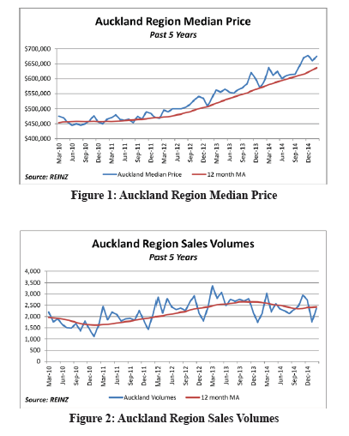
Time Series Describe and compare data from a time series graph NZQA 2015

Slide 16
Time Series Commonly occurring questions
Once we have identified a question that occurs commonly, the students would have a go at answering it
The following is the top scholar exemplar from NZQA 2015

Slide 17
Time Series Describe and compare data from a time series graph NZQA 2015

Slide 18
Time Series Commonly occurring questions
We can also used worked answers like this example from the AME workbook

Slide 19
Time Series Describe and compare data from a time series graph NZQA 2015

Slide 20
Time Series Commonly occurring questions
Next we would mark according to the mark schedule and try to identify what the marker is looking for in the answers

Slide 21
Time Series Describe and compare data from a time series graph NZQA 2015

Slide 22
Time Series Describe and compare data from a time series graph Key discussion points
Finally we would try to note key discussion points
For example, for describe and compare data from a time series graph we need to discuss:
Trend – where and when the trend starts and ends (give numerical values) and any significant changes within the trend
Seasonal effects – where the peaks and troughs are and how much they differ from the trend
Residuals – not required to comment on these specifically
Any other features of note – e.g. outliers, ramps, cyclical variation

Slide 23
Time Series Commonly occurring questions
This can then be applied to another similar question from a different year

Slide 24
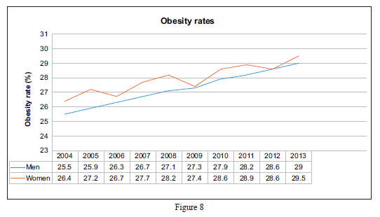
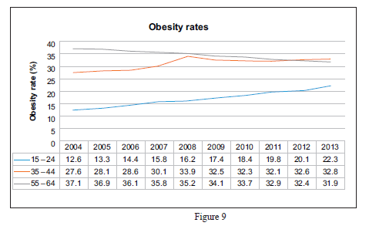
Time series Describe and compare data from a time series graph NZQA 2014

Slide 25
Time Series Commonly occurring questions
And we can see the patterns in how the question is marked and what key features the markers are required to look for

Slide 26
Time Series Describe and compare data from a time series graph NZQA 2014

Slide 27
Time Series Commonly occurring questions
And this will hopefully prepare the students for similar types of questions in their current exam

Slide 28
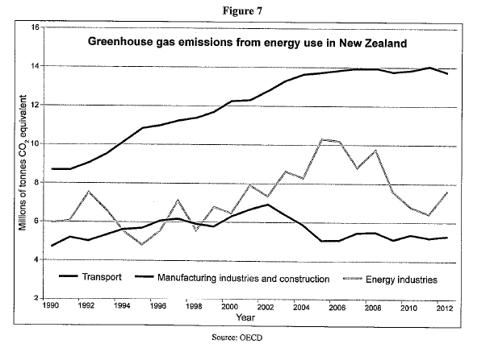
Time Series Describe and compare data from a time series graph NZQA 2016

Slide 29
Scholarship Statistics How to recognise and answer commonly occurring questions Summary
By working through past NZQA papers we can identify questions which occur commonly from year to year
Some questions can be answered using a similar format and we can sometimes identify key points from the mark schedule
This process of identifying and discussing questions can then be extended to the less common questions that are sometimes unique to particular exams

Slide 30
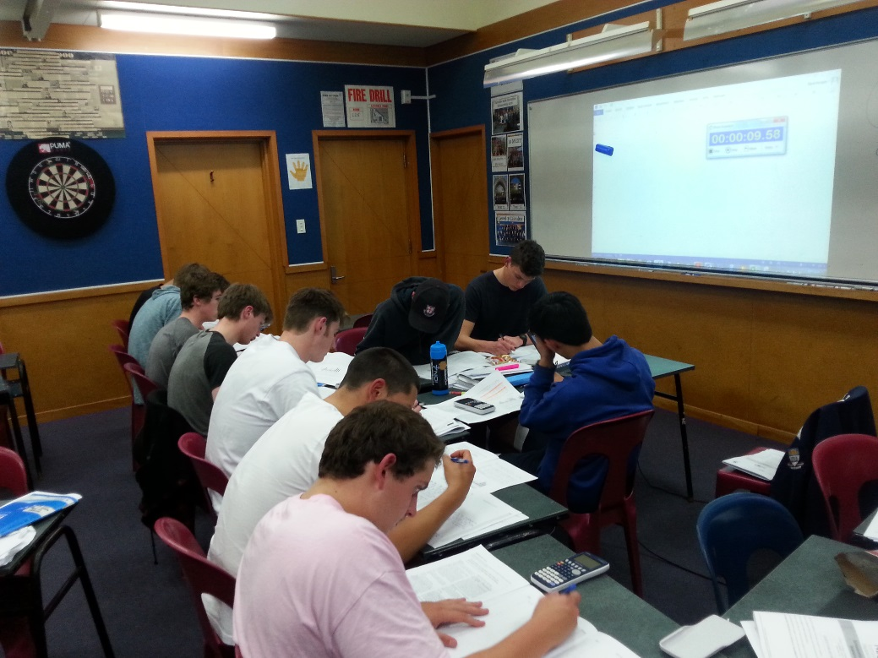
Scholarship Stats Mark Hooper, Otago Boys’ High School, Dunedin – Stats Day 2016
- Tiring Thursdays
- Silly Saturdays
Scholarship Stats at Otago Boys’ 2016

Slide 31
Scholarship Stats Mark Hooper, Otago Boys’ High School, Dunedin – Stats Day 2016
In house, share the load, flexible, lollies and chocolate
Otago Boys' High School has run in house tutorials for their Scholarship Statistics students for the last three years. This has allowed the content and context to be tailored to meet the needs and desires of our students. Flexible sessions with shared delivery from different teachers help breed the best collegiality. Utilising outside expertise from Otago University and local industry has also helped make statistical concepts and contexts seem relevant, modern and enticing. Mark will share the successes of what has worked well in the school's Scholarship Programme and the next steps for continual improvement.

Slide 32
Scholarship Stats Mark Hooper, Otago Boys’ High School, Dunedin – Stats Day 2016
In house ...
...17 out of 21

Slide 33
Scholarship Stats Mark Hooper, Otago Boys’ High School, Dunedin – Stats Day 2016
Share the load ...
... actual building capacity

Slide 34
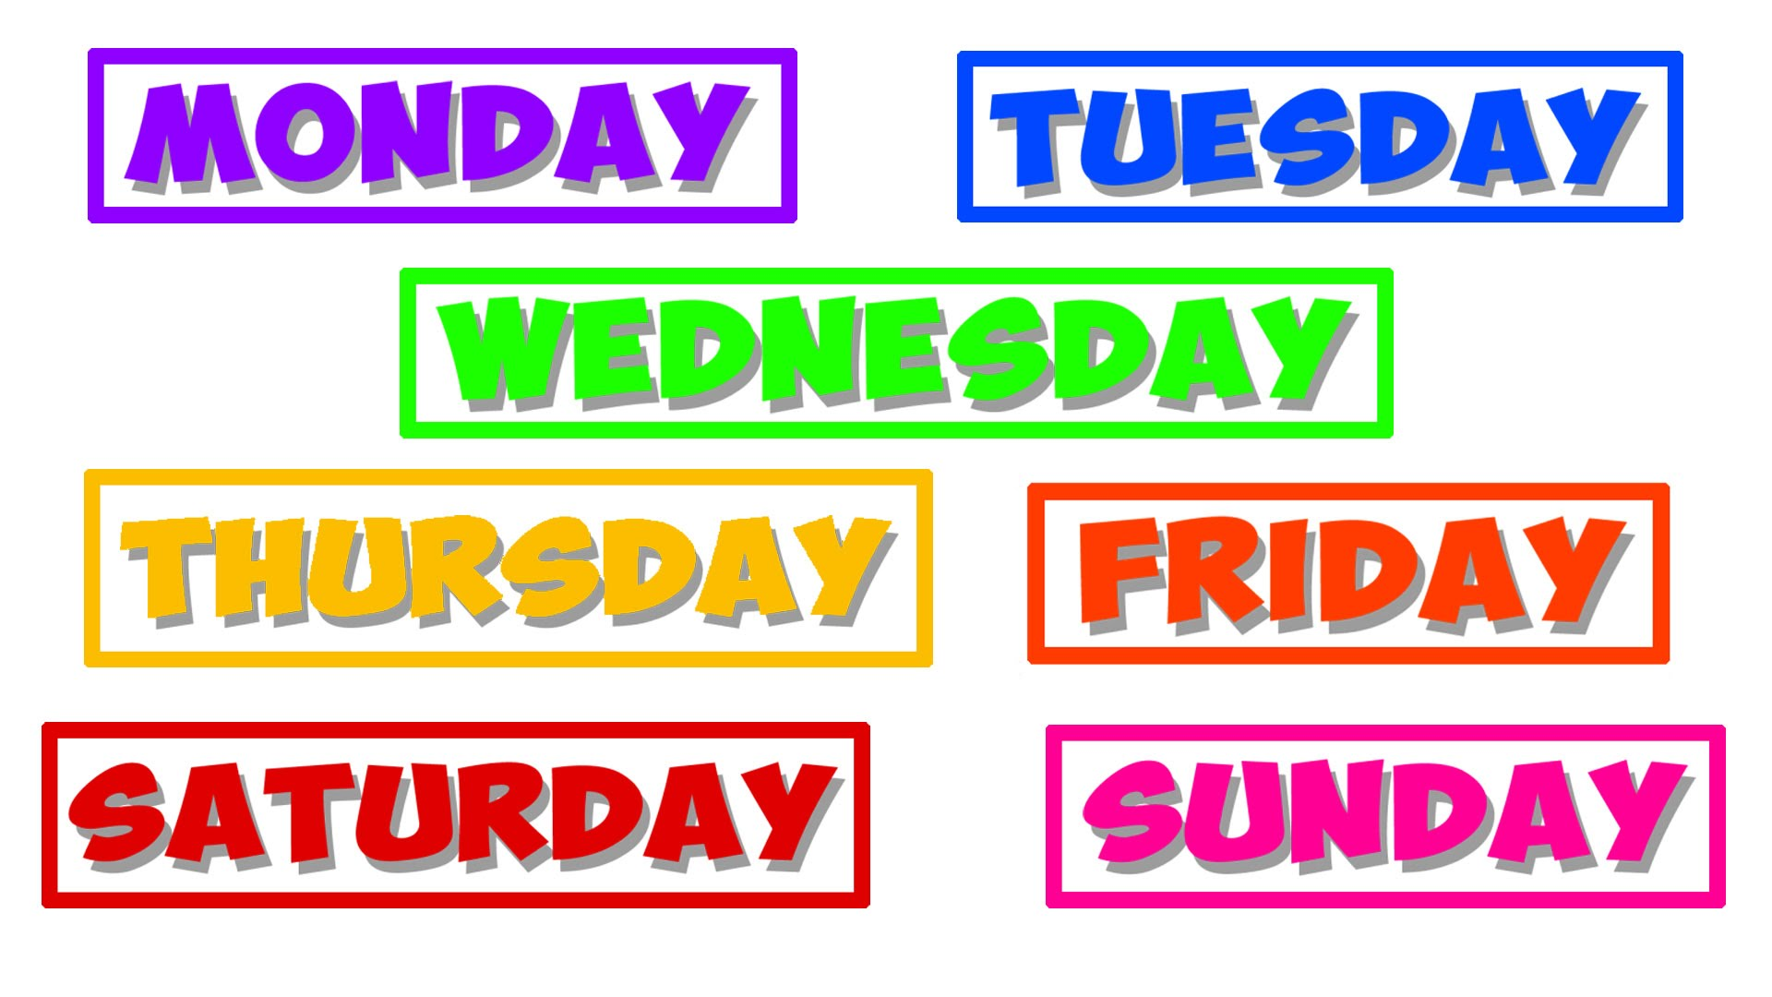
Scholarship Stats Mark Hooper, Otago Boys’ High School, Dunedin – Stats Day 2016
Flexible ...
...customer driven

Slide 35
Scholarship Stats Mark Hooper, Otago Boys’ High School, Dunedin – Stats Day 2016
Lollies and chocolate ...
... The only reason some came (some weeks!)

Slide 36
Scholarship Stats Mark Hooper, Otago Boys’ High School, Dunedin – Stats Day 2016
At lASt ...
Achievement Standard freedom...!??!!?

Slide 37
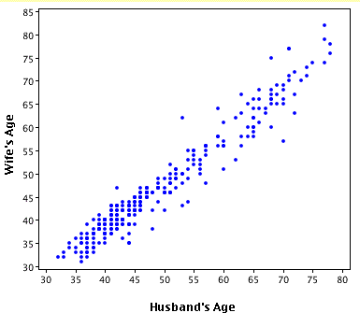
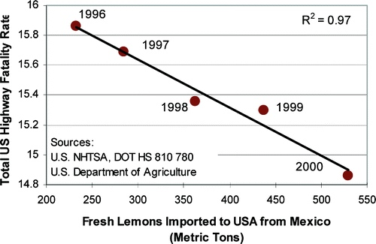
Scholarship Stats Mark Hooper, Otago Boys’ High School, Dunedin – Stats Day 2016

Slide 38
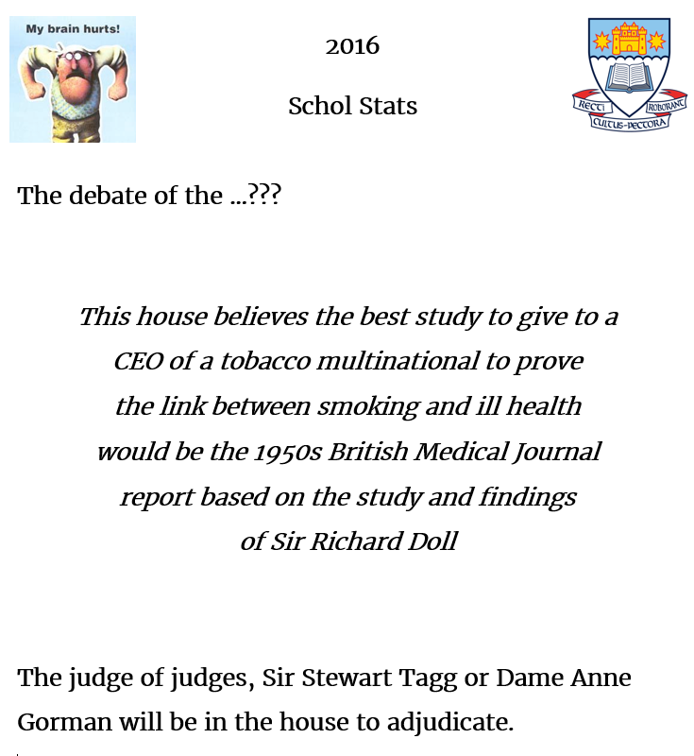
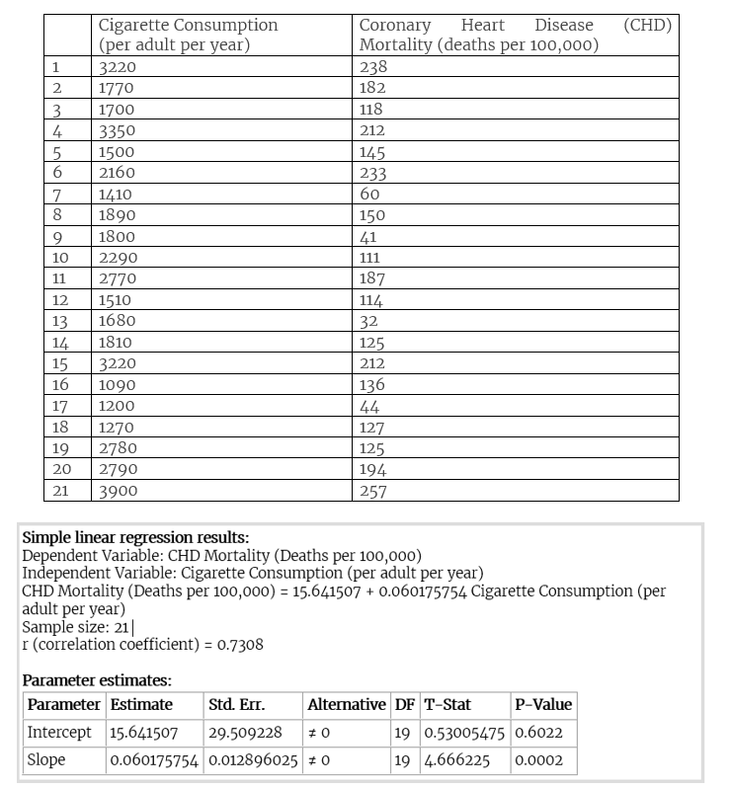
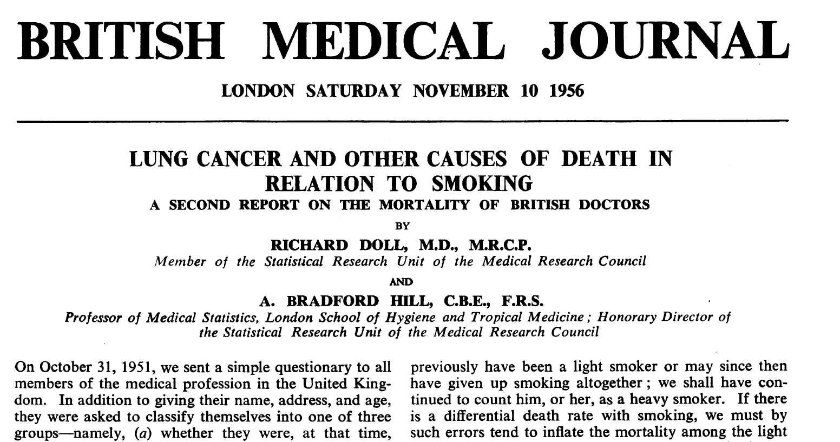
Scholarship Stats Mark Hooper, Otago Boys’ High School, Dunedin – Stats Day 2016

Slide 39
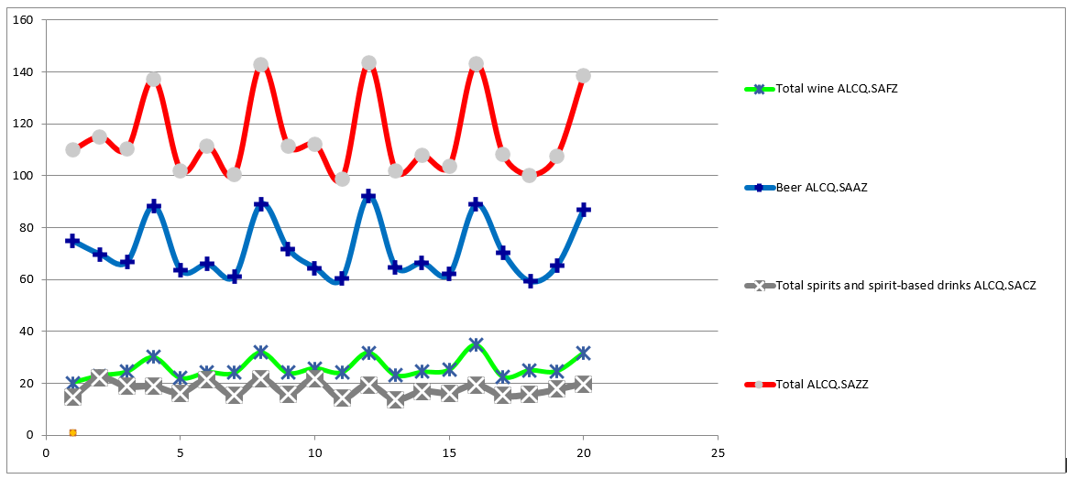
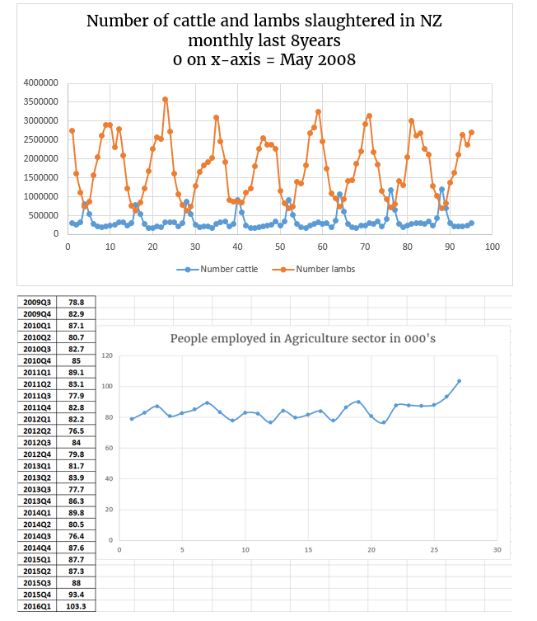
Scholarship Stats Mark Hooper, Otago Boys’ High School, Dunedin – Stats Day 2016

Slide 40
Scholarship Stats Mark Hooper, Otago Boys’ High School, Dunedin – Stats Day 2016

Slide 41
Scholarship Stats Mark Hooper, Otago Boys’ High School, Dunedin – Stats Day 2016

Slide 42
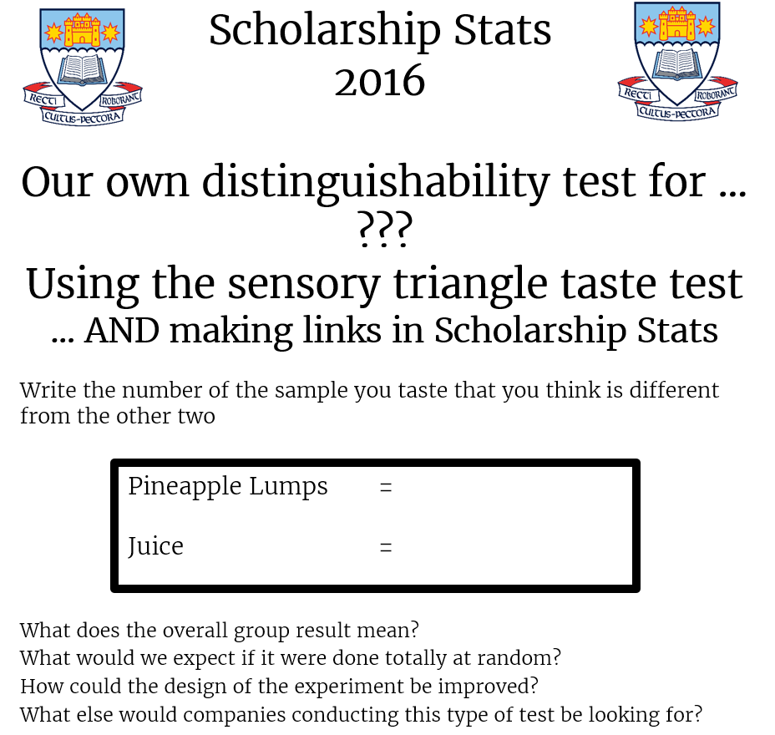
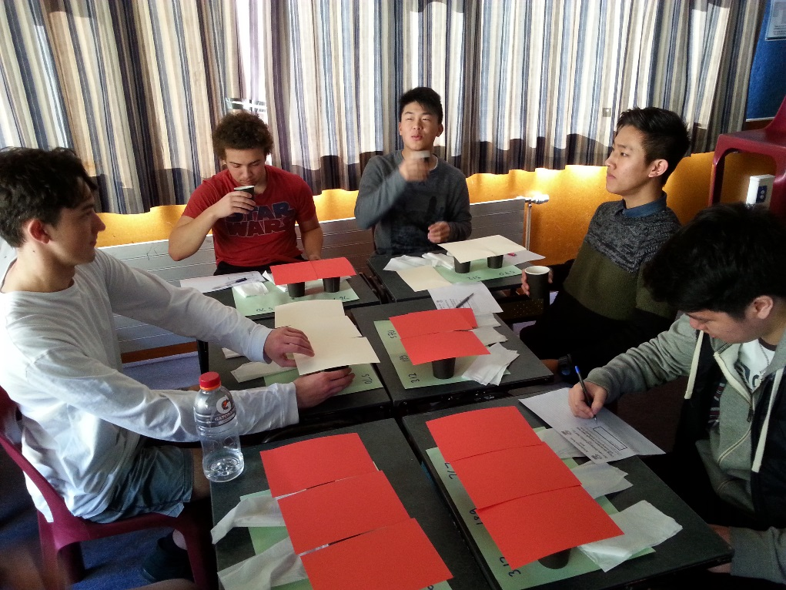
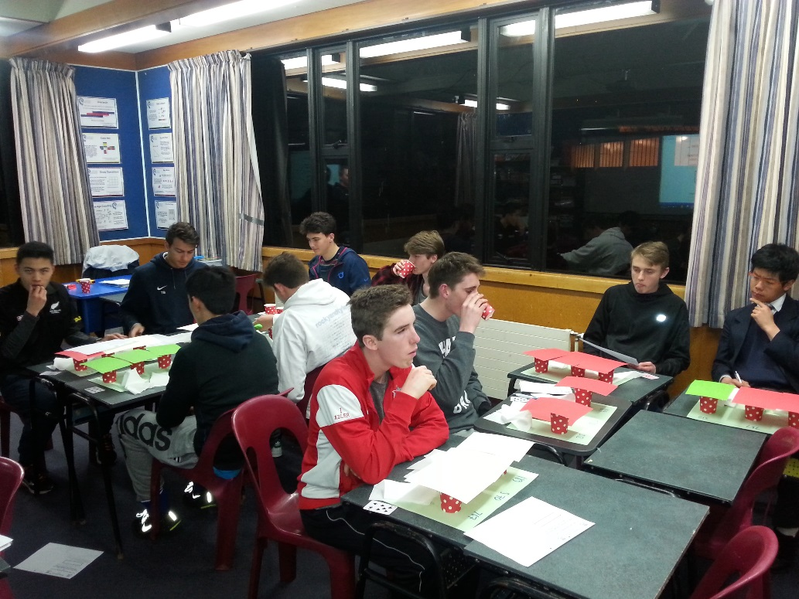
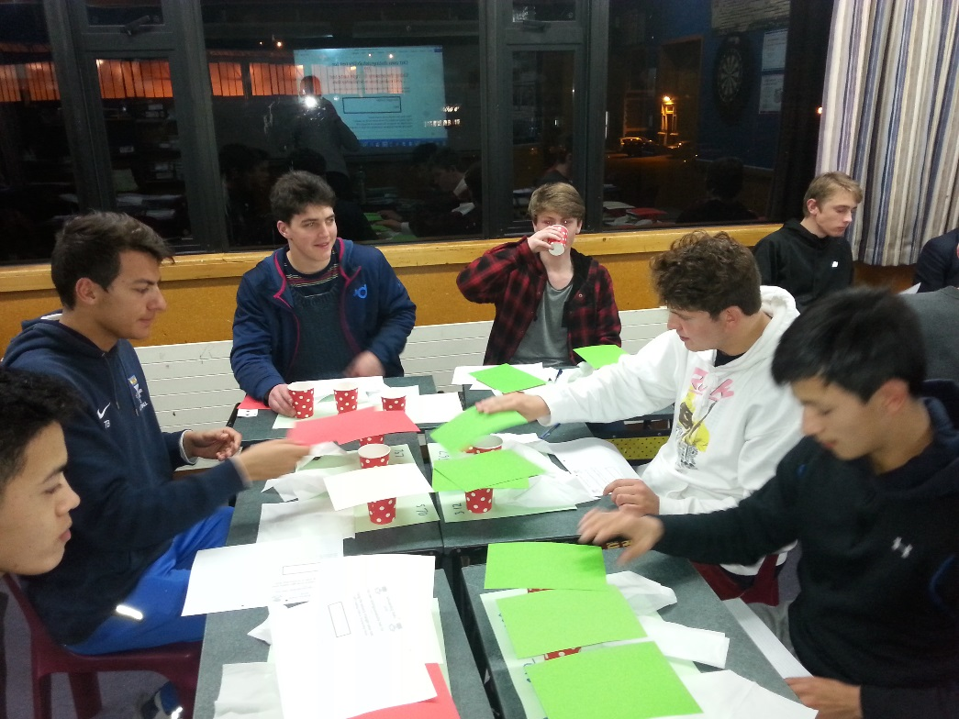
Scholarship Stats Mark Hooper, Otago Boys’ High School, Dunedin – Stats Day 2016

Slide 43
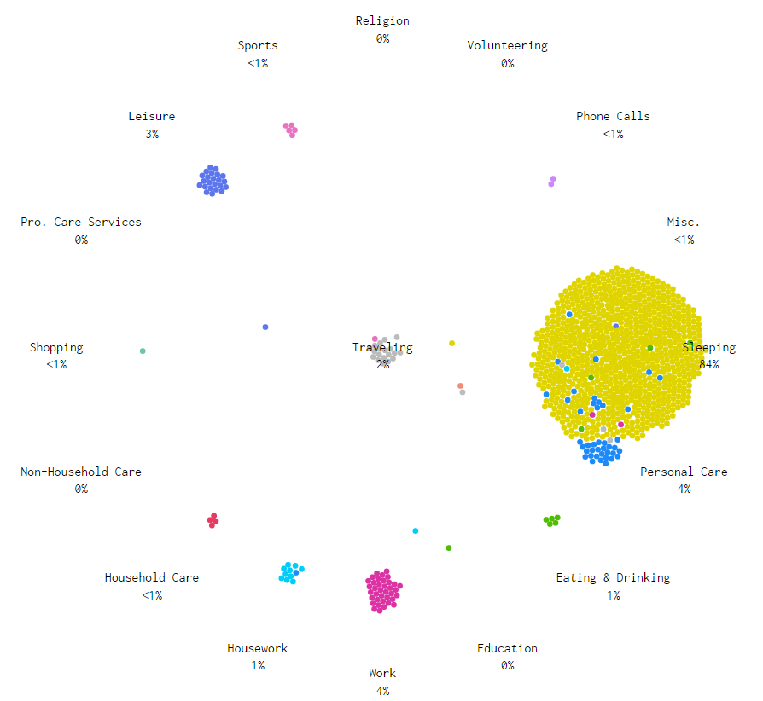
Scholarship Stats Mark Hooper, Otago Boys’ High School, Dunedin – Stats Day 2016
http://flowingdata.com/2015/12/15/a-day-in-the-life-of-americans/

Slide 44
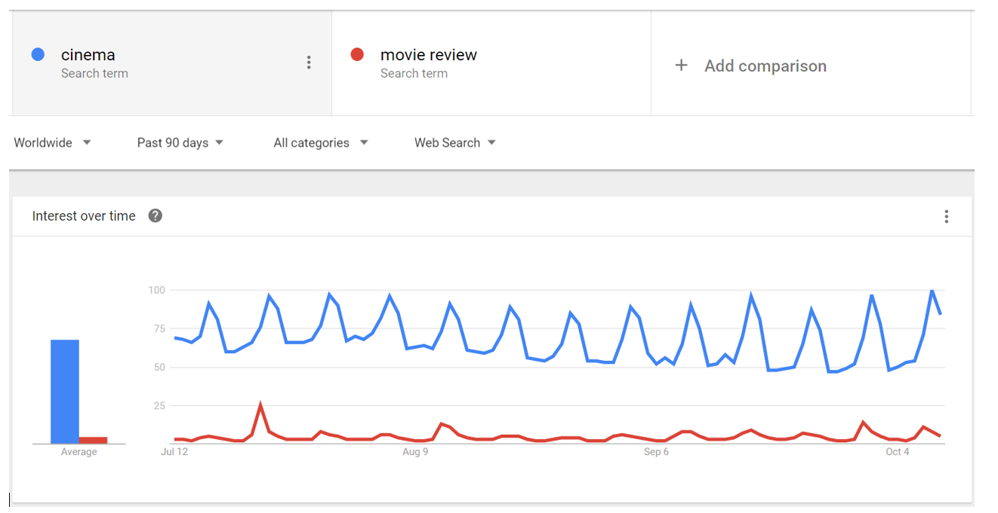
Scholarship Stats Mark Hooper, Otago Boys’ High School, Dunedin – Stats Day 2016

Slide 45
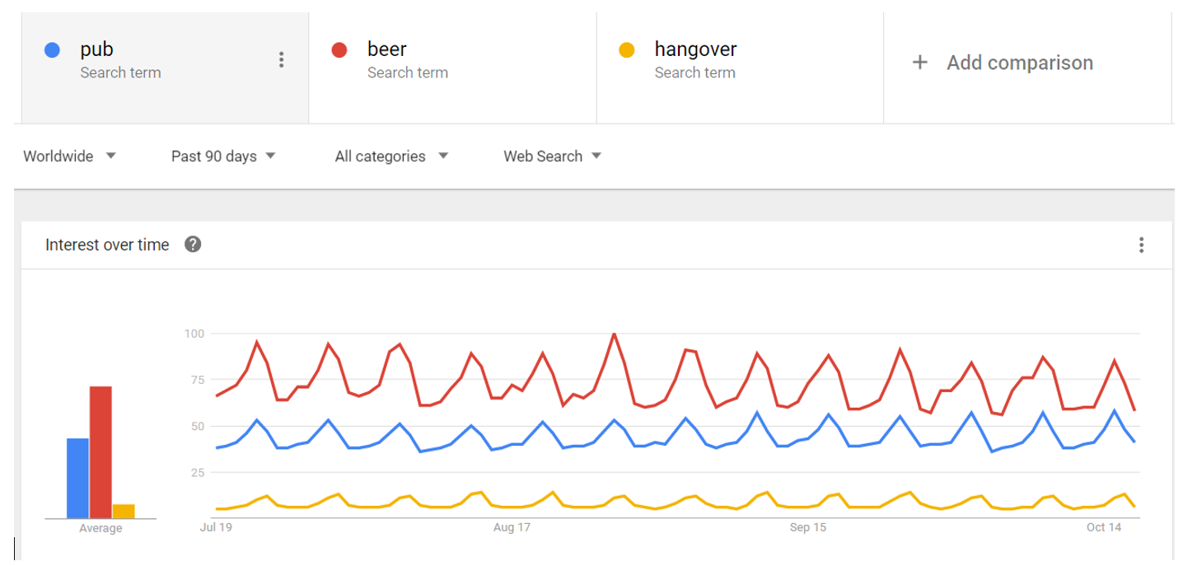
Scholarship Stats Mark Hooper, Otago Boys’ High School, Dunedin – Stats Day 2016

Slide 46
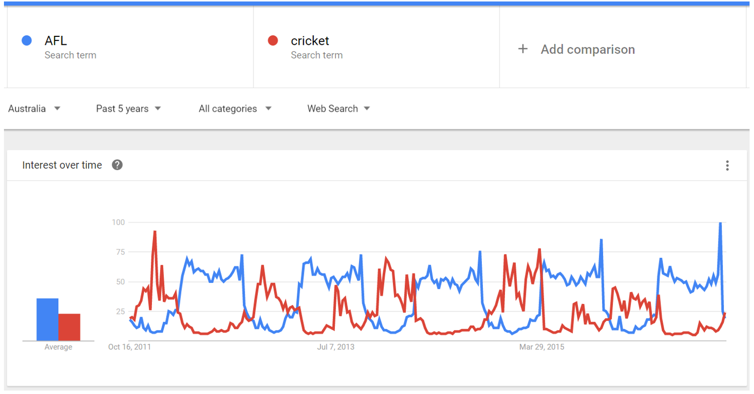
Scholarship Stats Mark Hooper, Otago Boys’ High School, Dunedin – Stats Day 2016

Slide 47
Scholarship Stats Mark Hooper, Otago Boys’ High School, Dunedin – Stats Day 2016

Slide 48
Scholarship Stats Mark Hooper, Otago Boys’ High School, Dunedin – Stats Day 2016

Slide 49
Discussion time!

