Slide 1
Panel discussion on bringing new statistics teachers up to speed
Jason Ellwood (chair) (Otumoetai College)
Michelle Dalrymple (Cashmere High School)
Marion Steel (Epsom Girls Grammar School)
Lars Thomsen (Christ’s College)

Slide 2
What are the needs?
Michelle Dalrymple
Cashmere High School
drd@cashmere.school.nz
@MichelleDRD
Panel discussion on bringing new statistics teachers up to speed
Notes:
What are the needs??? The diversity of teachers new to Statistics that we need to support... gathering views from a variety of our new to stats teachers and see what worked, what were the hardest things to pick up, what we could do more to support.

Slide 3
My context…
Cashmere High School
Decile 9, Co-ed, 1890 students, 15 staff in my faculty
A lot of staff turn-over
Usually 4-ish new staff to our faculty each year
A lot of institutional knowledge that needs to be transmitted
We have…
TiC topic = go-to person
Panel marking
Detailed unit plans –
some with suggested lesson sequences, some not…
Some with lots of resources (too many?), some not…
Talk through each unit BEFORE teaching as a faculty
try to highlight key things
Work through an activity
Assessment watch fors (usually nearer assessment)
Notes:
2 part time, 2 PCT2s, 1 PCT1
3 babies on their way…
I gathered some feedback from the newer staff…

Slide 4
Sarah
SUPPORTING STATISTICS
statistics glossary (from TKI)
Existing unit plans and activities (the detail provided was good)
Having colleagues who were teaching the same material – sharing work and discussions
Common tests showing similar results to others built confidence (identifies weaknesses)
PD encouraged
BACKGROUND
Experienced NZ teacher in French, Graphics, Technology (hard materials, textiles), etc
Familiar with NCEA
A little bit of junior maths (year 8)
Qualifications in architecture & anthropology
No statistics in degree, no statistics in teacher training
NEEDS
First time full maths load
First time in just ONE faculty
New school, new city
Curriculum support across ALL content and vocabulary
WOULD HAVE LIKED…
“Lots of “teacher experience” so picking up content was able to be a focus – didn’t need to worry about all the other things”
Notes:
371F90 Marie
http://sigfigcreator.thelegomovie.com/
Still working to present statistics from a less mathematical perspective…

Slide 5
Steven
SUPPORTING STATISTICS (and generally)
PCT mentor meetings
Discussions in workroom – being around people in open workspace – sit and absorb, ask Qs when needed
Workshopping units with staff, sharing trouble-spots, more time needed on, etc (get an idea of how unit is going to go before start)
Well-sorted folders great!
Good systems for support
Doing NCEA internals “as a student” and getting feedback
BACKGROUND
PE trained, PCT1
Completed stats papers during degree
No stats education in teacher training, just general NCEA-type stuff
Placements, mix of PE & Maths, no stats on placements
NEEDS
Lots of curriculum support (maths & stats)
Relied on textbooks
A lot of guidance re requirements on each standard
Organisational support
WOULD HAVE LIKED…
All folders sorted nicely! (some had overwhelming amount of info in a mess, links not obvious with where they go)
Notes:
371FA4 Ben
Has struggled to pick up some of the key ideas (like interpreting a confidence interval)

Slide 6
Modge
SUPPORTING STATISTICS
Plenty of resources available on the system
Conversations & collegiality in the faculty
Structure within the faculty (TiC topic, TiC course) – meant knew who was the right person to talk to
Workshop units at faculty meetings
Very friendly, checked in regularly with me lots, well supported by faculty
BACKGROUND
PE trained, PCT2
One year maths experience
Statistics in degree
Little exposure to teaching statistics in training
NEEDS
Adjustment to new school
Continue to develop curriculum links
Continue development around proficiency as a teacher
PCT2 support
WOULD HAVE LIKED…
Some topics not developed fully
Notes:
371FAE Josh

Slide 7
Jane
SUPPORTING STATISTICS
Conversations in the workroom and with buddy (strong stats leaders in the faculty)
System resources too overwhelming – conversations better
Learning iNZight
BACKGROUND
From South Africa
“Old school” maths teaching – heavily exam orientated, very little stats, only calculation based
Fixed old furniture, very little access to technology
Teacher centred learning from a small number of textbooks
NO faculty workroom (only main staff workroom)
NEEDS
Technology support (laptop for EVERYTHING)
Knowing where to start with all the new material (curriculum, content & assessment)
NCEA!
Curriculum levels
Cultural adjustment
Greetings
Relational focus in class with students
Formality
Outside of school too…
WOULD HAVE LIKED…
Big picture/links/where this is all heading
Exemplar examples of good higher level comments/statistical insight
Notes:
371FAA Sharene
Still working to present statistics from a less mathematical perspective…

Slide 8
Hazel
SUPPORTING STATISTICS
Going through topic with leader at start of topic (more than full staff workshop)
Sharing of resources – conversations in workroom & on system
Buddy (or whoever was in workroom) to check in with that on the right track
Units with suggested lesson order
BACKGROUND
Experienced science teacher
Familiar with NCEA
Maths trained a loooong time ago
Little knowledge of current maths & stats curriculum
A little cross-over from science
NEEDS
Transitioning to new school support
Curriculum content knowledge (especially stats!)
Advice on alternative strategies/methods to explain concepts to students
“holistic” marking support
WOULD HAVE LIKED…
Lots of conversations that weren’t captured for future use
Making sure all units have a suggested lesson order
Traps for assessment signposted – encouragement to try assessment and work through with previous marker
Notes:
C22C6 Amy P
Moving to holistic marking and judging the paper as a whole

Slide 9
Andrew
SUPPORTING STATISTICS
Units with suggested lesson order and detailed lessons
One-on-one planning
BACKGROUND
Mature first year teacher
Statistician & diplomat
Maths trained, not much (if any) stats on placement
NEEDS
Lots of curriculum support (maths & stats)
Relied on textbooks
A lot of guidance re requirements on each standard, and appropriate planning
General teaching for classes
WOULD HAVE LIKED…
A textbook that had all the new stats in it how Cashmere does things
Notes:
374698 Andrew
Made me realise what a big gap we need to bridge in regard to statistics when new teachers arrive with us.

Slide 10
Sooo…
Things we do well to support our teachers
Collegial faculty supporting each other
Details in unit plan
Things we still need to work on
Capturing the conversations
Make sure all unit plans have details, in a user-friendly way, that’s not just an overwhelming amount of information
Where to from here?
We’re lucky that we’re a big faculty – how do we replicate the collegial support by experts as a statistical education community?

Slide 11
Our next generation of teachers…
Next time you watch a student, and think to yourself…
“they’d make a great teacher”… TELL THEM! ENCOURAGE THEM! Give them opportunities for work experience!
We have the best job in the world… lets spread the word

Slide 12
Bringing new statistics teachers up to speed
What helps?
Marion steel

Slide 13
Don’t assume any prior knowledge
Be explicit about every statistical word and concept they need to know or teach.

Slide 14
“There are aspects of statistics that are so basic to the way we think in the subject that no one abstracts, enunciates and examines them… It may be a root cause of some of the problems we face in statistics education. “Variation” was one of these un-enunciated givens until quite recently... “Distribution” is another fundamental given of statistical reasoning. I can find a great deal written about specialized usages and definitions of “distribution” but almost nothing about “distribution” itself as an underlying conceptual structure.”
https://www.stat.auckland.ac.nz/~iase/serj/SERJ5(2)_Wild.pdf

Slide 15
VOCABULARY and Concepts
Statistical unit
Variable
Variation
Distribution
Centre
Spread
Shape
Notes:
Statistical unit: individual (but can also be a group (eg family) or the same individual or group measured at different times or places)
Variable: characteristic, number or quantity of the statistical unit which can be measured or counted
Variation: different statistical units have different values of a variable
Distribution: the pattern of variation in a variable.
Centre: One best number to describe a group.
Spread: A measure of variation in a variable for a group. How far the statistical units tend to be from the centre of a group.
Shape: the overall shape of the distribution.
Can they explain these ideas to you? (good use of your mentoring hour for beginning teachers).

Slide 16
Make learning intentions very explicit
Eg The big idea is:
That a sample can give them useful information about the centre and spread of the population and perhaps about the shape of the population distribution, but not about largest or smallest individuals in the population.

Slide 17
Understand the use of the PPDAC cycle to find out about the world around us
Understand the difference between a sample and a population
Ask a question about a population which can be answered by looking at a sample distribution (“I wonder…”)
Understand that a sample can give information about population centre, spread and shape, but not about max, min or range
Understand that samples vary and that each sample will be somewhat different
Understand that samples from the same population will be similar in their centre and spread
Describe the centre of a dot plot distribution (“I notice…”)
Describe the spread of a dot plot distribution (“I notice…”)
Describe the shape of a dot plot distribution (“I notice…”)
Make an inference about a population based on observing a sample distribution
Understand that their conclusion about the population may be unreliable

Slide 18
teachers should do the statistics assessment themselves
Especially important for teachers new to statistics.
Ideally, they should do the assessment and get feedback on it before they start teaching the unit.

Slide 19
We are all beginners, it just takes some of us longer to realise it.
Chuck Miller

Slide 20
Bringing new statistics teachers up to speed
Lars Thomsen, Christ’s College

Slide 21
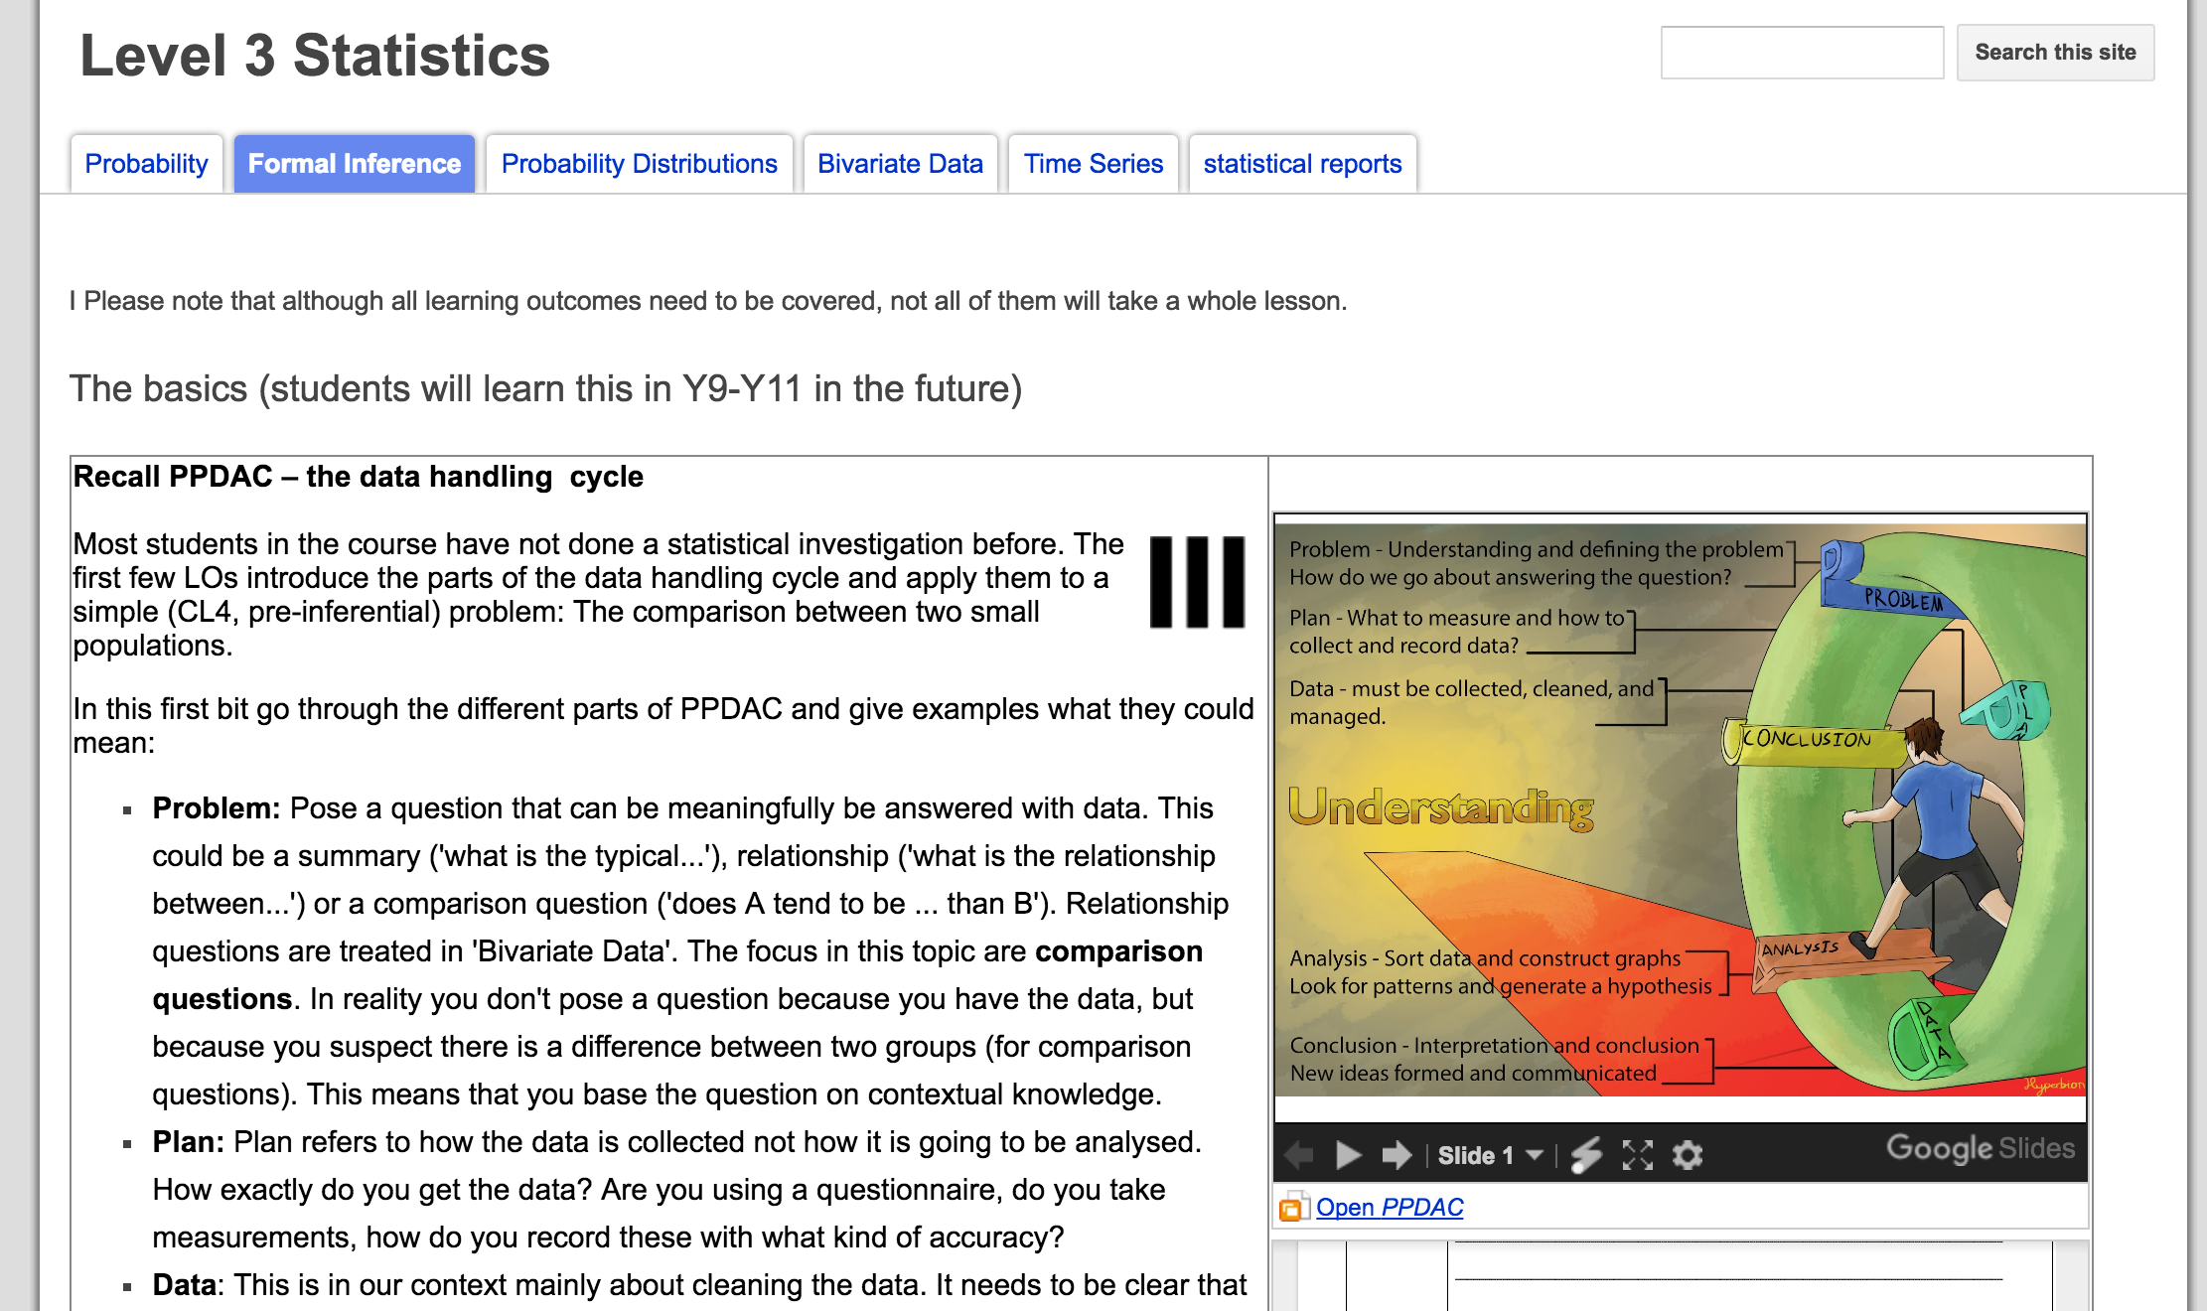
Bringing new statistics teachers up to speed
This is hard and a painful process.
I have asked how teachers in my school experienced the process. They felt:
Not prepared by university degree, teacher training or outside PD
Somewhat prepared by department PD, shared resources, observing other teachers, but mainly by teaching it.

Slide 22
Topic Progression (inferential statistics)
Show the big picture - PPDAC
Do the basic steps on paper (compare two small populations)
Teach the challenging concepts
Sample and population
Sampling variability and how to ’filter it out’
How does this change some parts of the investigation?
Address and eliminate misconceptions
Write, get feedback, repeat

Slide 23
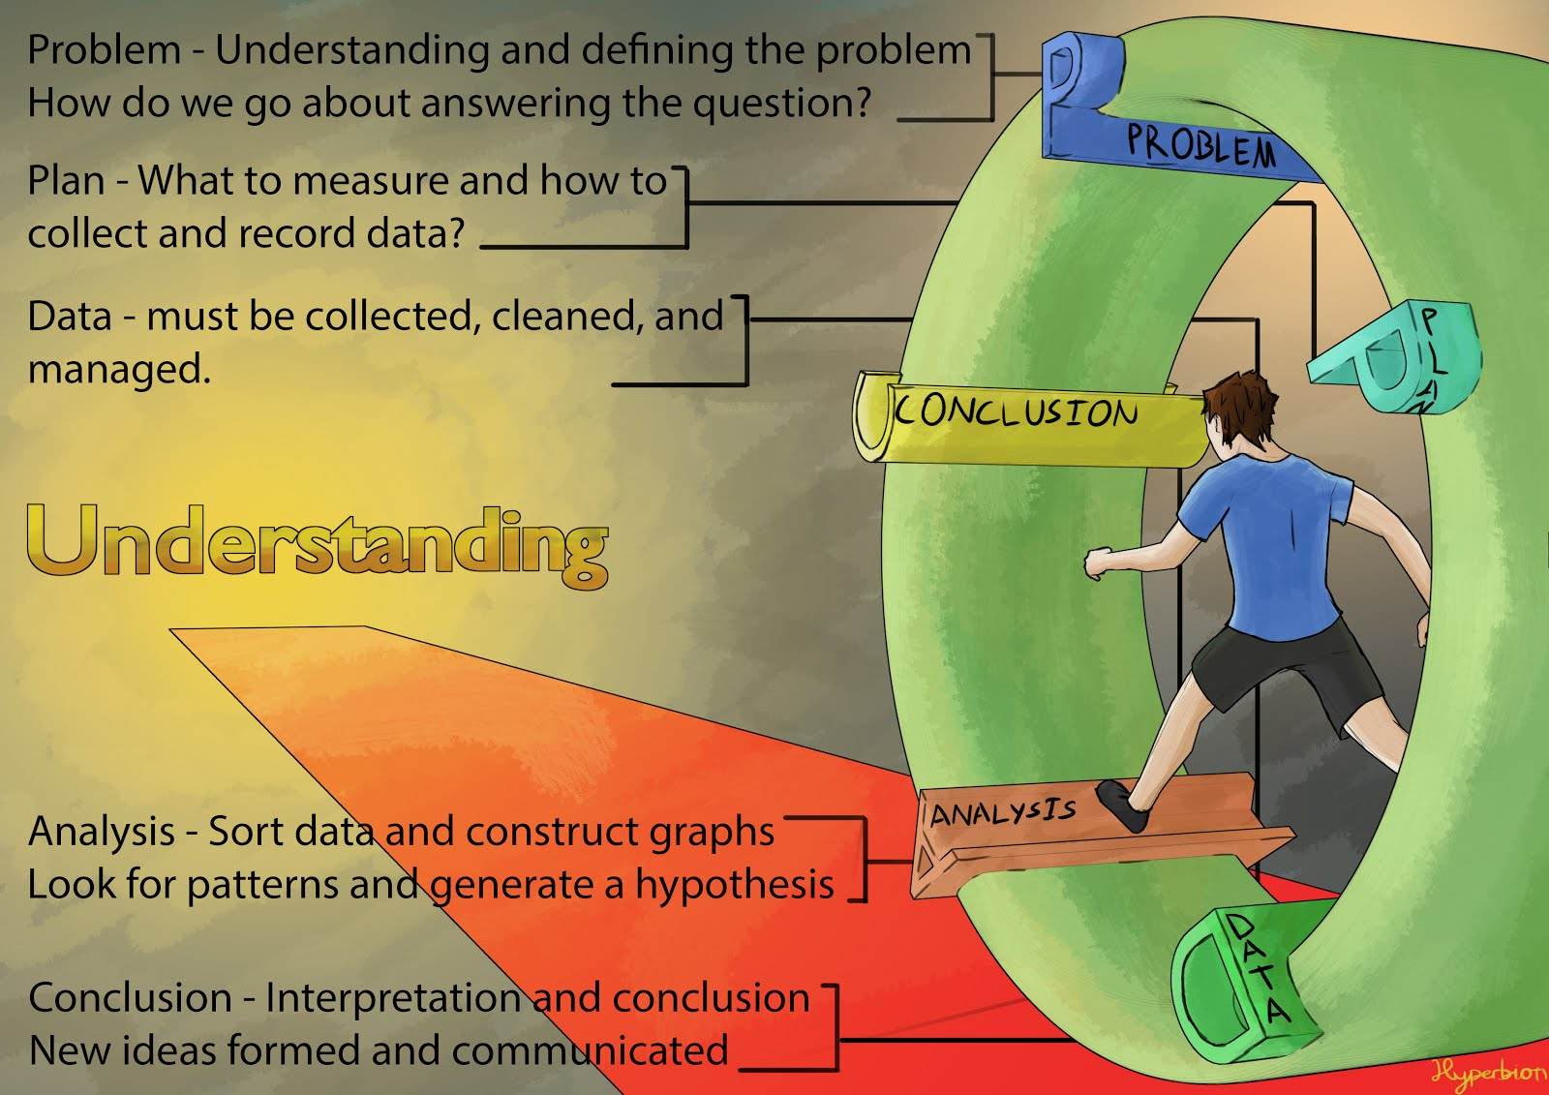
the big picture - PPDAC

Slide 24
Topic Progression (inferential statistics)
Show the big picture - PPDAC
Do the basic steps on paper (compare two small populations)
Teach the challenging concepts
Sample and population
Sampling variability and how to ’filter it out’
How does this change some parts of the investigation?
Address and eliminate misconceptions
Write, get feedback, repeat

Slide 25
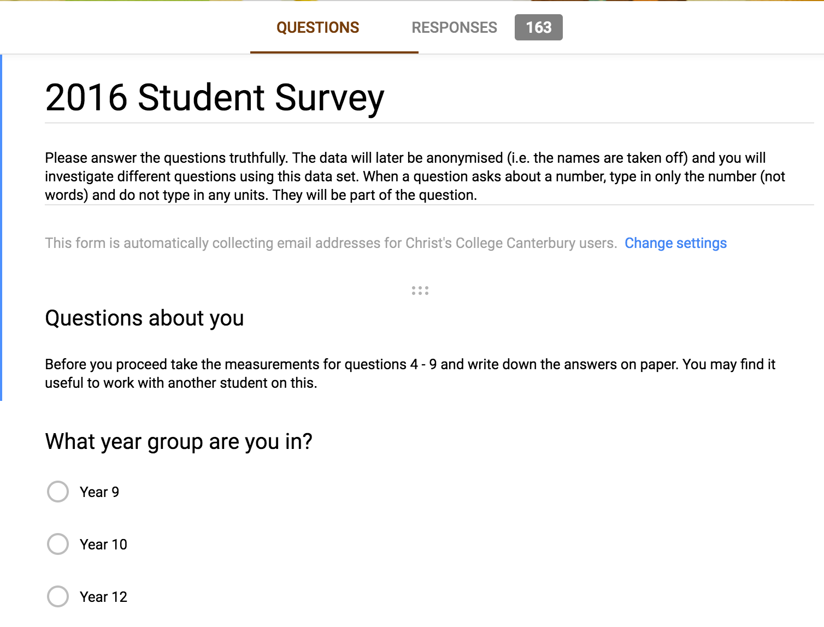
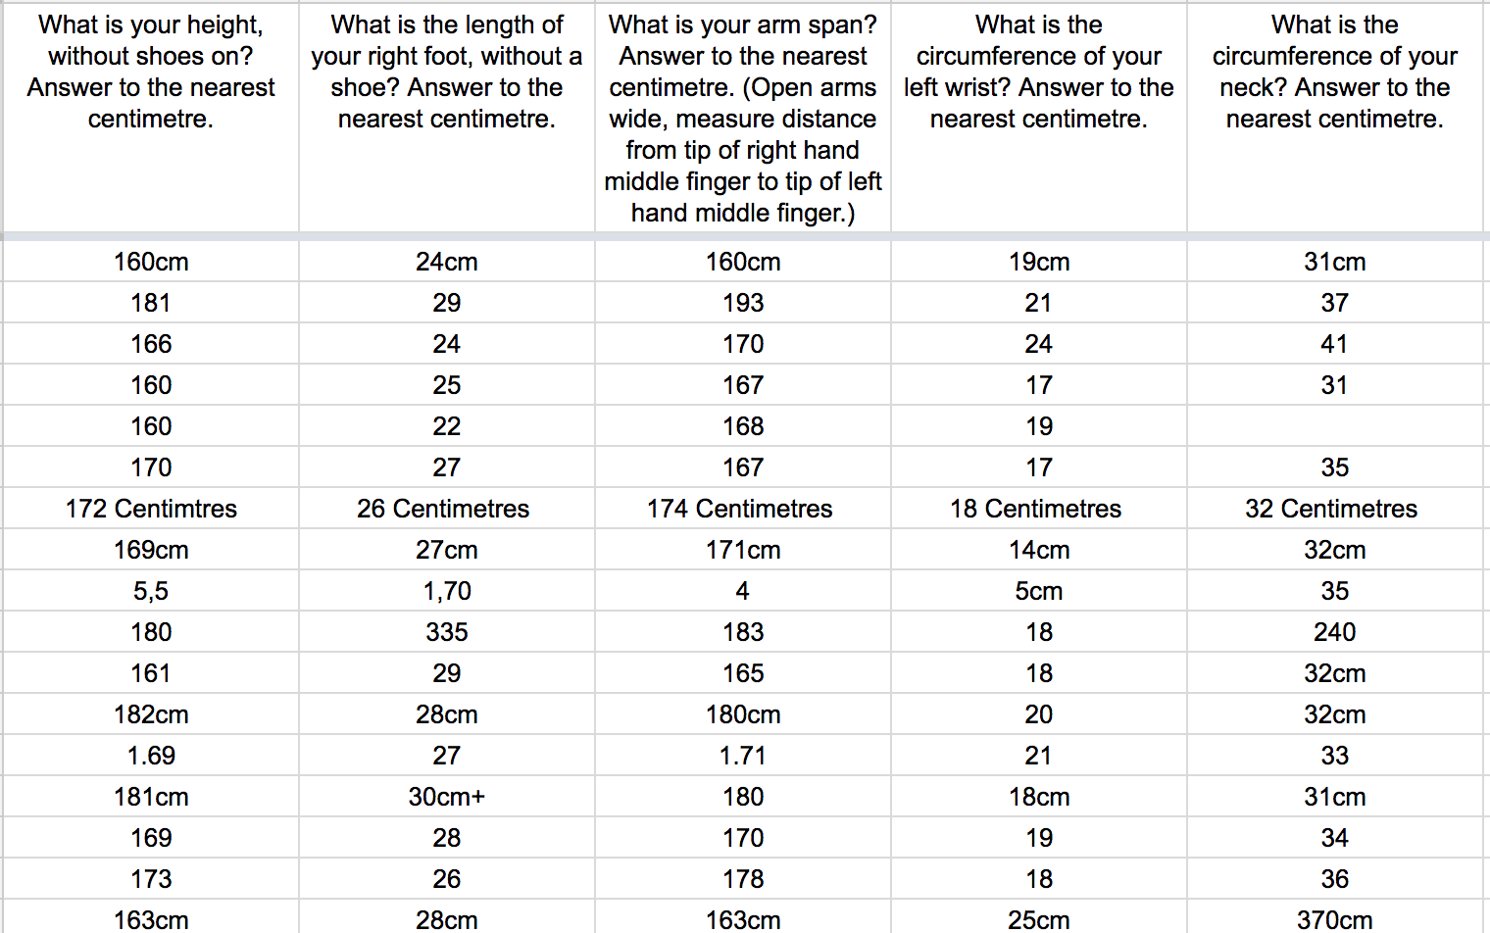
Do the basic steps on paper
Just because it’s not assessed doesn’t mean it’s not relevant.

Slide 26
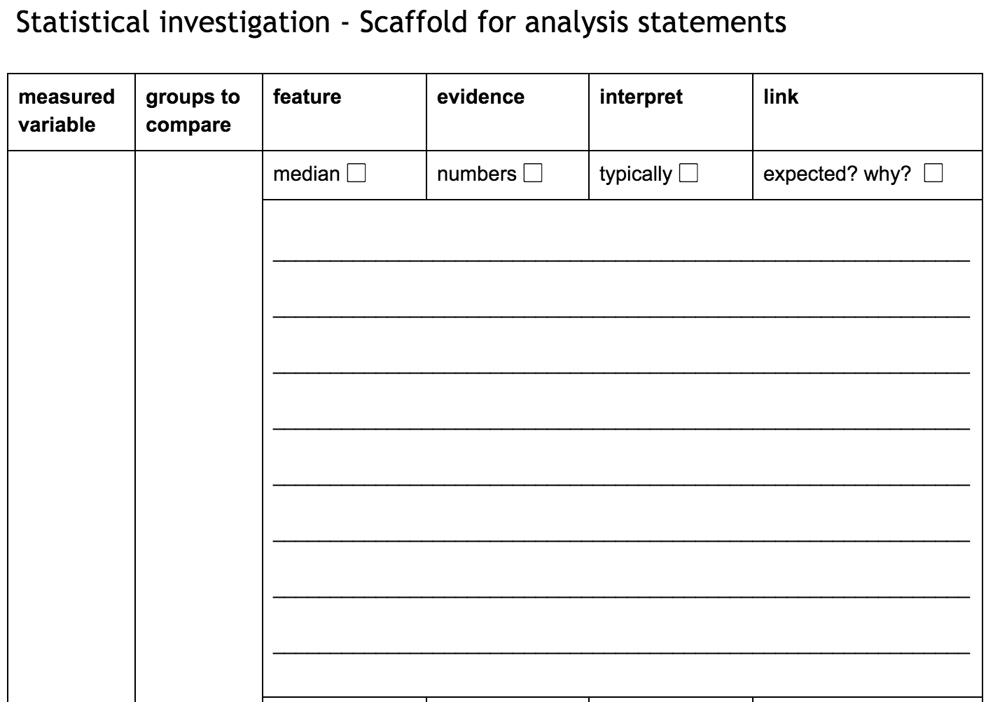
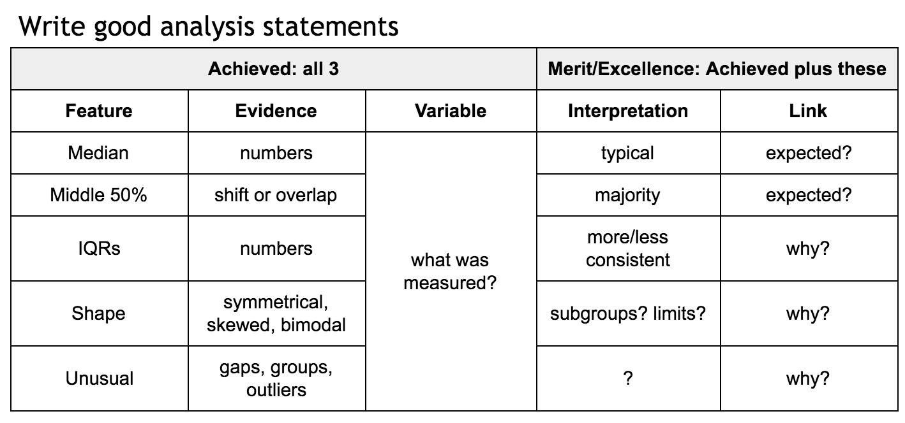
Do the basic steps on paper
Scaffold where necessary.

Slide 27
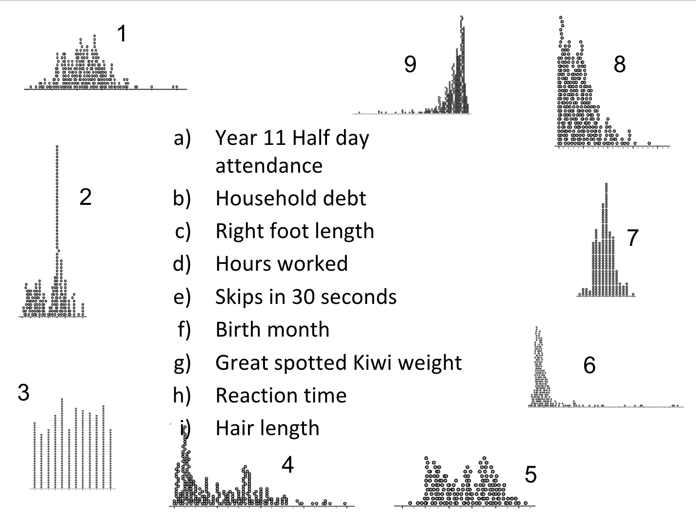
Do the basic steps on paper
Formative assessment

Slide 28
Topic Progression (inferential statistics)
Show the big picture - PPDAC
Do the basic steps on paper (compare two small populations)
Teach the challenging concepts
Sample and population
Sampling variability and how to ’filter it out’
How does this change some parts of the investigation?
Address and eliminate misconceptions
Write, get feedback, repeat

Slide 29
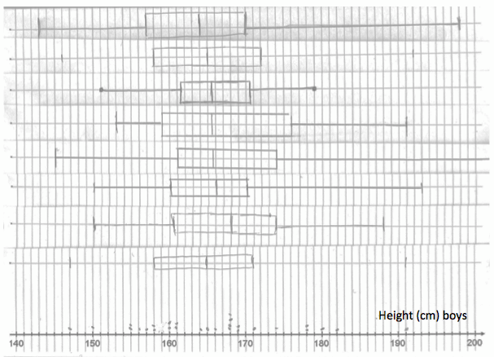
Teach the challenging concepts
Why do people almost never compare population data?
What is a sample?
Explore sampling variability
Problem: How much difference is enough?
Solution (depends on the standard)
Changes in parts of the investigation

Slide 30
Topic Progression (inferential statistics)
Show the big picture - PPDAC
Do the basic steps on paper (compare two small populations)
Teach the challenging concepts
Sample and population
Sampling variability and how to ’filter it out’
How does this change some parts of the investigation?
Address and eliminate misconceptions
Write, get feedback, repeat

Slide 31
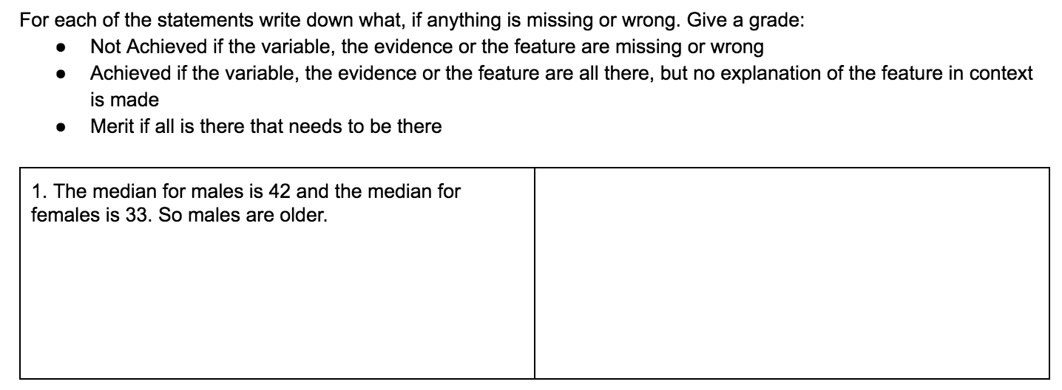
Address and eliminate misconceptions
Write in context
Be clear about sample vs population
Interpret rather than report

Slide 32
Topic Progression (inferential statistics)
Show the big picture - PPDAC
Do the basic steps on paper (compare two small populations)
Teach the challenging concepts
Sample and population
Sampling variability and how to ’filter it out’
How does this change some parts of the investigation?
Address and eliminate misconceptions
Write, get feedback, repeat

Slide 33
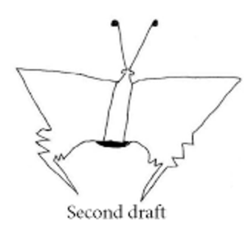
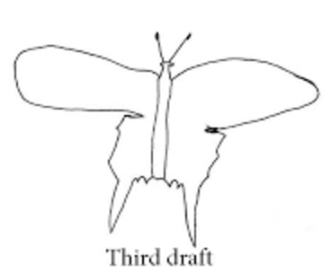
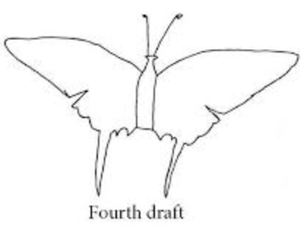
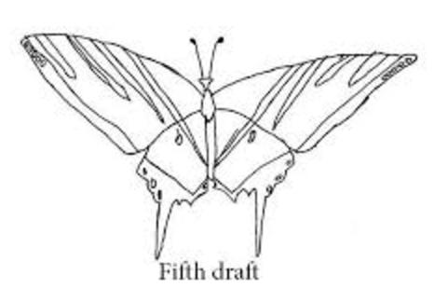
Write, get feedback, repeat
This is the most important activity for me.
Austin’s Butterfly:
Students internalise the requirements of the standard and read critically.
Final feedback from the teacher, after the work has been graded by the students.

Slide 34
Discussion time!

