Slide 1
Auckland University Statistics Teachers Day 2016
Evaluate Statistically Based Reports ( AS 3.12)
Workshop 3C
Dru Rose (Westlake Girls High School)

Slide 2
3 Activities to share exploring the following aspects of 3.12
A: The difference between Observational and Experimental studies
B: Sampling error and the 3 rules of thumb for estimating margin of error in the media reports
C: Non-sampling errors and biases

Slide 3
A: The difference between Observational and Experimental studies
Question: “Does the amount of caffeine you consume affect the amount of sleep you get?”
Task 1: Estimate (a) how much caffeine (mg) you consumed yesterday
(b) how many hours sleep you got last night
(nearest $\frac{1}{4}$ hour).

Slide 4
A: The difference between Observational and Experimental studies
Here are some facts off the internet (http://www.nutritionfoundation.org.nz/nutrition-facts/nutrition-a-z/Caffeine)
1 cup (250ml) flat white or cappuccino or brewed coffee (single shot of coffee): 80mg
1 cup (250ml) of instant coffee (1teaspoon): 60mg
1 cup (250ml) tea : 55mg
1 can of Cola = 38mg
250ml of an energy drink e,g V, Red Bull = 80mg
50g milk chocolate bar (10 squares) = 2 teaspoons of unsweetened cocoa powder: 10mg
50mg dark chocolate (10 squares) : 35mg
(Note: the caffeine content of drinking chocolate and lemonade type soft drinks is minimal)

Slide 5
A: The difference between Observational and Experimental studies
Discussion Questions:
Is this an observational study or an experiment? Why?
Observational: No researcher intervention
2. Is it retrospective or prospective study? Why?
Retrospective: data from yesterday
3. How were the participants selected?
Volunteered (by teacher)
4. What is the explanatory variable?:
Caffeine intake
and the response variable?:
Hours of sleep
5. How should we display the results?:
Scatter plot

Slide 6
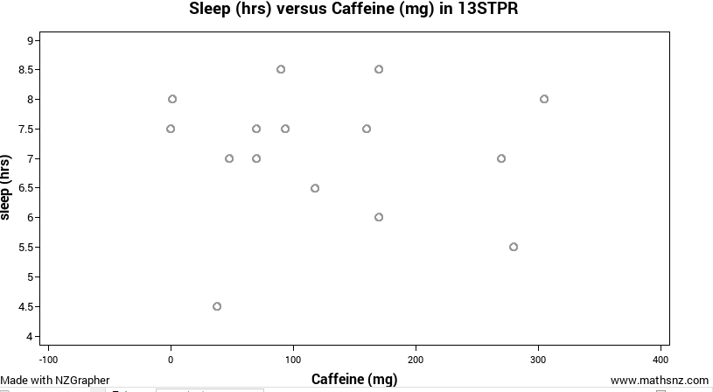
Weak, negative, approximately linear association
A slight tendency for hours of sleep to drop with higher caffeine consumption

Slide 7
This is an observational study.
What is the scope of the conclusion from this type of study?
Non-Causal
We can only suggest an association between caffeine intake and amount of sleep
What are the limitations of this study?
Very small,
very narrow demographic:
year 13 girls.
Yesterday may not have been typical.
What improvements could we make?
Average daily consumption and sleep over a week.

Slide 8
A: The difference between Observational and Experimental studies
Task 2: Design an Experiment
Working in a group of 2 or 3
Briefly describe how you would conduct an experiment to test the effect of caffeine consumption on the amount of sleep a person gets and justify your decisions.
What are the key experimental design elements needed to come to a meaningful conclusion?
(Bullet points of the key elements are OK. This is a hypothetical experiment so you may ignore any ethical concerns you may have regarding the harmful effects of caffeine).

Slide 9
Key elements of an experiment
Random allocation of participants to a treatment (given caffeine) and control (no caffeine) group
Other factors affecting any measured responses (hours of sleep) (e.g. amount of exercise participants do, tolerance to or sensitivity to effects of caffeine) must be evenly distributed through both groups so only the difference is the treatment (caffeine).
Same experimental conditions for both groups
Same routine during the day
same food and drink consumed at the same time
same sleeping environment e.g. temperature and amount of light
The amount (and quality) of sleep should be measured accurately (not self-reported)
e.g. use a fit-bit device or similar

Slide 10
What is the scope of the conclusion that can be drawn from a properly designed experiment?
A: The difference between Observational and Experimental studies
That the amount of caffeine administered CAUSED the measured response (hours and quality of sleep)
Why ?
Random allocation of participants should have enabled the only difference between the treatment and control groups to be the treatment i.e the amount of caffeine administered

Slide 11
A:The difference between Observational and Experimental studies
Task 3: Look at an actual study carried out by a research team.
Report A is an extract from the actual study report, written by the researchers:
published in the peer-reviewed Journal of Clinical Sleep Medicine: Vol. 9, No. 11, 2013
Report B is an extract from an on-line news report about the same study.
http://www.nhs.uk/news/2013/11November/Pages/Even-afternoon-coffee-disrupts-sleep-study-finds.aspx
Students are asked to read Report A and Report B and then answer the questions.

Slide 12
This study has both an experimental and observational component
The questions are similar to those asked in a typical exam question
observational study or an experiment? State evidence from report A
Who were the participants and how were they selected?
“double blind”. What does this mean and why was it important?
Identify the explanatory and response variables
Participants were asked to keep a diary of their usual routines. Why?
No difference across treatment conditions for the baseline measures: Why?
People with certain conditions were excluded. Who? and Why?
When taken 3 hrs before bed, caffeine significantly reduced total sleep time and increased time taken to fall asleep. Use Table 2 in report A to explain the evidence which supports these conclusions.
Limitations: small size, narrow group . Suggest improvements.
Suggest potential confounding variables

Slide 13
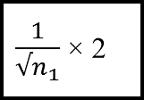
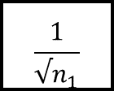
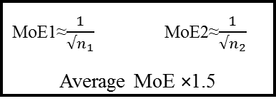
Activity B: Margin of error and the 3 rules of thumb
Type of Claim ?
No Comparison (1 group)
Comparison within 1 group
Comparison between 2 groups
Determine
sample size
$$n_{1}$$
$$n_{1}$$
$$n_{1, }n_{2}$$
$$\frac{1}{√n_{1}}$$
$\frac{1}{√n_{1}}$ × 2
MoE1≈$\frac{1}{{√n}_{1}}$MoE2≈$\frac{1}{{√n}_{2}}$
Average MoE ×1.5
Calculate the
margin of error, as a %
Draw and Calculate CI and interpret it in words
Poll % ± MoE
perc. pt. difference ± margin of error
perc. pt. difference ± margin of error
Does CI
capture claim?
Make a judgement
Both limits positive ?

Slide 14
Activity B: Margin of error and the 3 rules of thumb
Research New Zealand Survey: 27 July 2015
“Should euthanasia be legalised in New Zealand?”
Poll Questions
1. Suppose a person has a painful incurable disease. Do you think that doctors should be allowed by law to end the patient’s life if the patient requests it?
2. Still thinking of that person with a painful incurable disease, do you think that someone else, like a close relative, should be allowed by law to help end the patient’s life, if the patient requests it?

Slide 15
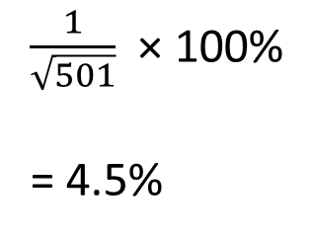
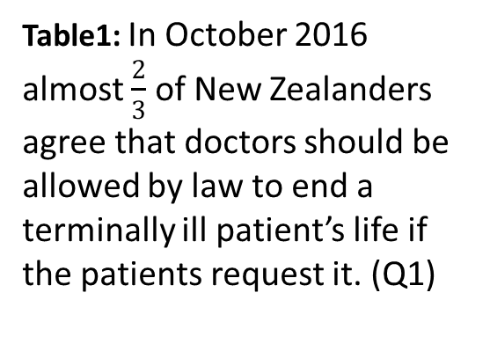
Activity B: Margin of error and the 3 rules of thumb
Claim
Type
Margin of Error
Table1: In October 2016 almost $\frac{2}{3}$ of New Zealanders agree that doctors should be allowed by law to end a terminally ill patient’s life if the patients request it. (Q1)
$\frac{1}{\sqrt{501}}$ × 100%
= 4.5%
No
comparison
Confidence Interval and Judgement
65% ± 4.5%
With 95% confidence we can infer that the % of NZers who agree a doctor can end the life of a terminally patient is somewhere between 60.5% and 69.5%
“almost $\frac{2}{3}"$ is not supported since lower limit is only 60.5%
Better to say “At least 60% of NZers agree…”

Slide 16
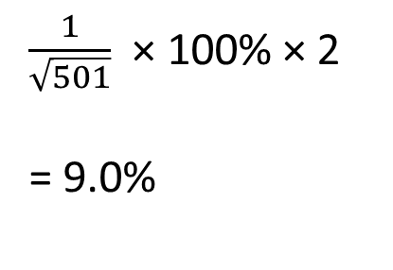
Activity B: Margin of error and the 3 rules of thumb
Claim
Type
Margin of Error
Table 2: A higher % of New Zealanders disagree than agree that other people, such as close relatives, should be allowed to help a terminally ill patient to end their life if they request it. (Q2)
$\frac{1}{\sqrt{501}}$ × 100% × 2
= 9.0%
Comparison
1 group
Confidence Interval and Judgement
Difference:
46 – 43 = 3 p.pts
With 95% confidence we can infer that the difference in % of NZers who disagree compared to agree that a close relative can assist a terminally ill patient to end their life is somewhere between -6 p.pts and 12 p.pts
Claim NOT supported since lower limit is negative indicating a higher % may agree than disagree. % who disagree could be up to 6 p.pts less than those who agree

Slide 17
Activity B: Margin of error and the 3 rules of thumb
Claim
Type
Margin of Error
Table 6: New Zealanders with a bachelor degree or higher are less likely to agree that a doctor be allowed to end a terminally patients life than those with a secondary school qualification. (Q1)
Comparison
2 groups
Average MoE × 1.5
($\frac{1}{\sqrt{167}}$ + $\frac{1}{\sqrt{147}}$) ÷2 $×100\%=\text{8\%}$
8% × 1.5 = 12%
Confidence Interval and Judgement
Difference:
68-55 = 13 p.pts
With 95% confidence we can infer that the difference in the % of NZers with a bachelor degree and % with a secondary qualification who agree that a doctor can end the life of a terminally patient is somewhere between 1p.pts and 25 p.pts.
Claim IS supported since both limits positive. (% with a bachelor degree who agree is likely somewhere between 1 and 25 p.pts higher than the % with a secondary qualification.)

Slide 18
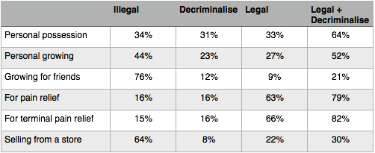
Activity C: Non-sampling errors and biases
Curia research poll commissioned by the NZ Drug Foundation
(A charitable trust working in drug education but known to favour removal of criminal penalties for use, possession and social supply)
Majority backs cannabis law change
.
The Poll was conducted by Curia Market Research from Monday 18 July to Tuesday 2 August 2016. The sample was drawn from a random selection of 15,000 eligible NZ voters contactable on a landline. 1,029 people agreed to participate.

Slide 19
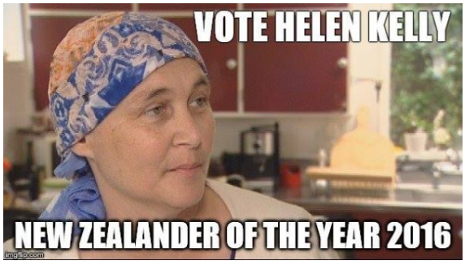
The following article came out on July 25th 2016 , in the middle of the poll being conducted by Curia Research.
Helen Kelly’s courage continues in face of death By Martyn Bradbury “The Daily Blog”
Helen has fought her entire life for the workers of this country, it is sad that this Government and Society would label her a criminal as she faces death just for using cannabis as a pain relief.
Student Activity:
Using the “worry questions” and working with a partner and a shared google doc:
Identify at least 4 non-sampling errors present in the above Curia Research Poll
For each concern you identify, explain your reasoning using evidence from the press releases above.

Slide 20
1. Hidden agenda: The poll was commissioned by an organisation with a vested interest in getting an answer in favour of decriminalisation of cannabis.
2. Selection bias: Only eligible to voters who had a landline could be sampled.
-excludes those with only cell-phones e.g young people and those who move a lot
3. Non-response bias: Of the randomly selected 15,000 eligible voters, only 1029 agreed to participate. They were probably those with strong views on this issue.
4. Interviewer effects: It was a phone poll. Hence the telephone manner, accent etc of the interviewer could have influenced a respondent’s answers.
5. Behavioural concerns: This is a sensitive issue. People may have been reluctant to express their true views, particularly if other family members with different views were in ear shot.
6. Information available to all participants was not the same.
Data collected over a long period ((18th July to August 2nd) and the Helen Kelly article came out in the middle which may have influenced voters sampled at the end but not those near the start.

