Slide 1


Done by: Sally Zaatiti

Slide 2
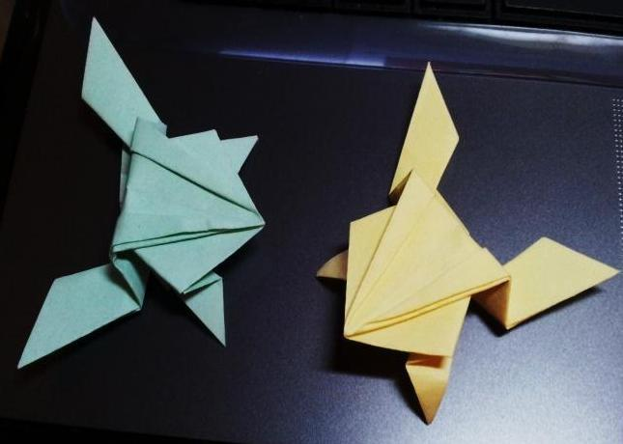
Learning Objectives
In this presentations students will learn:
What is origami
How to make a frog origami

Slide 3
Origami
Origami is the Japanese art of paper folding.
Although Origami is known as a Japanese Art, it actually began in China.
The first known book on how to make an origami object was written in 1797 and is called The Secret of One Thousand Cranes Origami.
The constructions were done using a single sheet of colored paper.

Slide 4
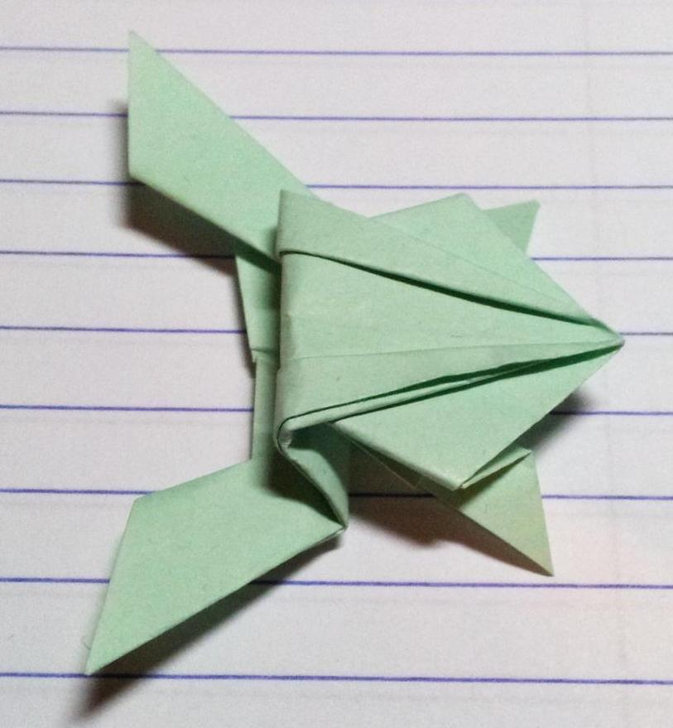
Creating a Frog Origami
In this presentation you are given step by step instructions to make a frog origami and if it is made correctly it acts like it is really jumping.

Slide 5

Step 1
Lay a sheet of square paper on a flat surface in front of you. You can use ordinary white paper, colored paper, or origami paper.

Slide 6
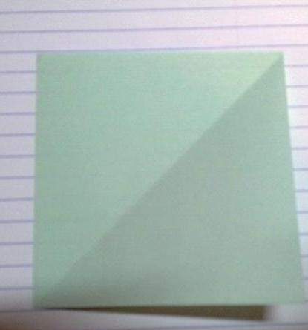
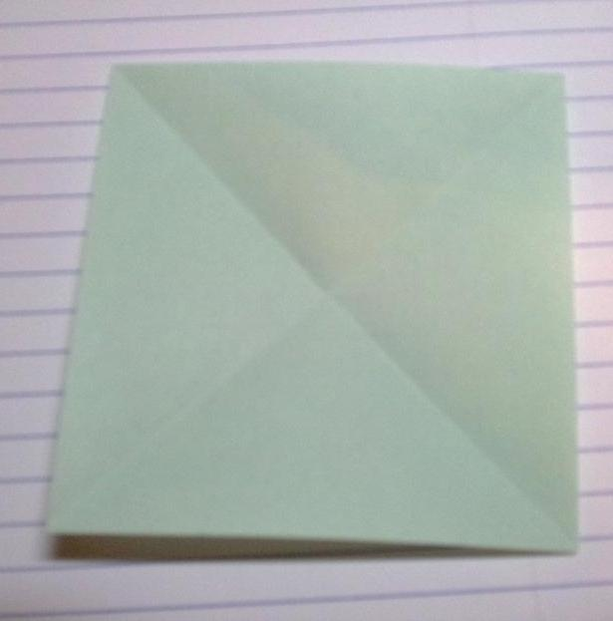
Step 2
Start by folding one of the top corners over diagonally, creating a crease that leads to the opposite corner. Unfold, then repeat with the other top corner.

Slide 7
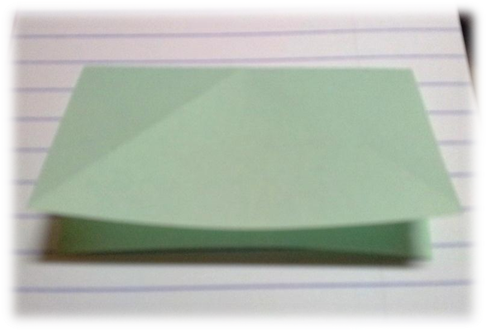

Step 3
Re-fold it across the intersection of the X.
fold in the two opposite sides.

Slide 8
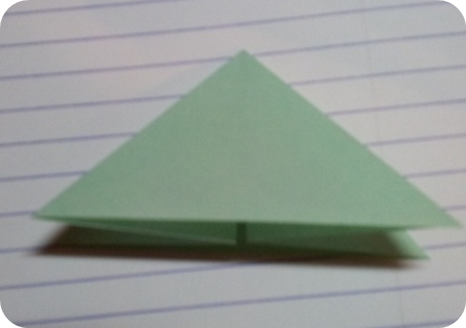
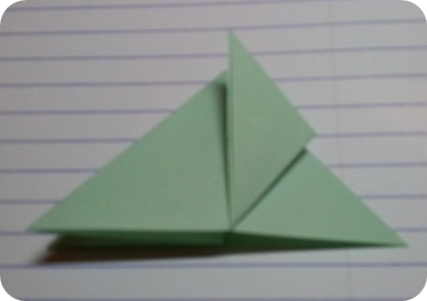
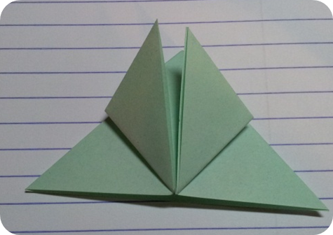
Step 4
Smooth over the creases and fold the base corners of the top layer up to the tip of the triangle.

Slide 9
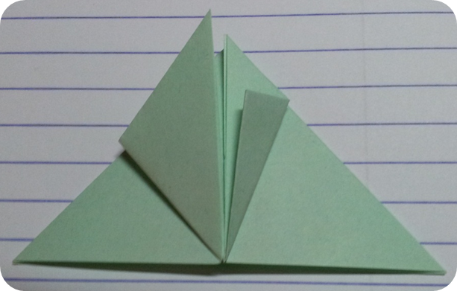
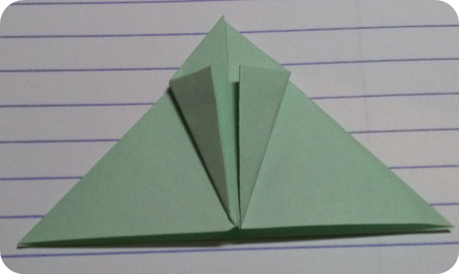
Step 5
Fold the new corners you just made inwards to match up with the center line.

Slide 10
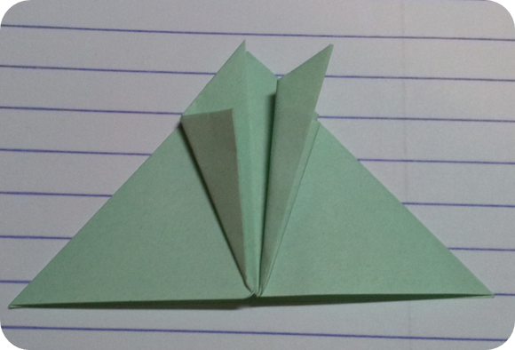
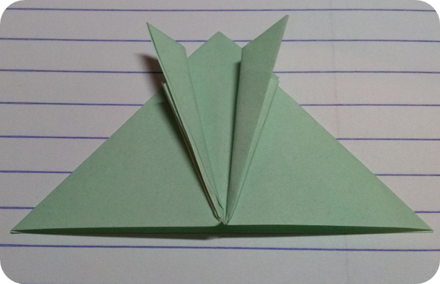
Step 6
Fold the top points you made until the edges are even with the edges you made in the previous steps.

Slide 11
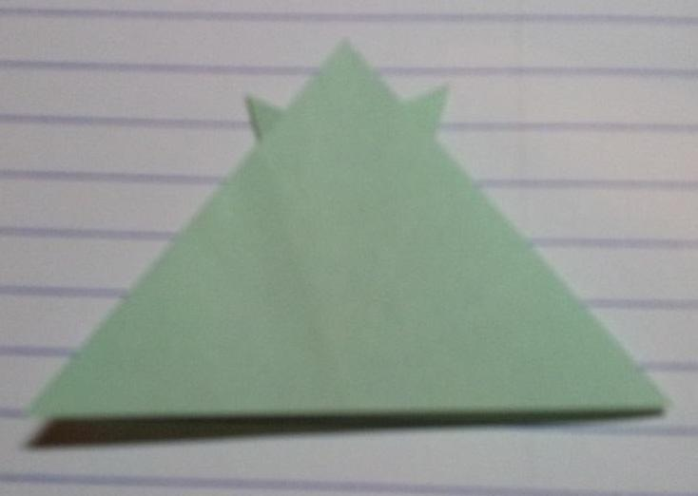
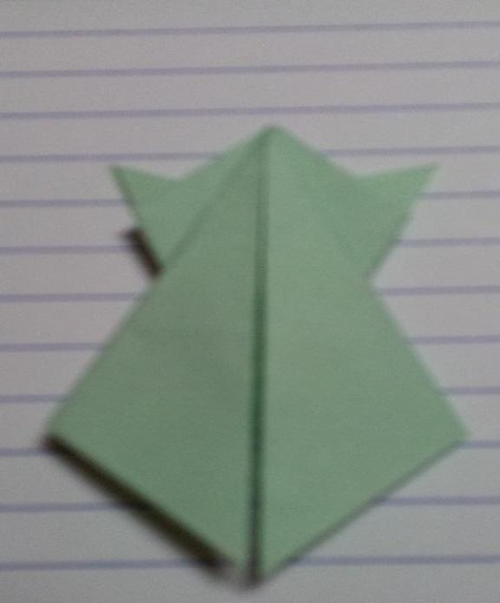
Step 7
Flip the paper over.
Fold both bottommost corners inward toward the center line.

Slide 12
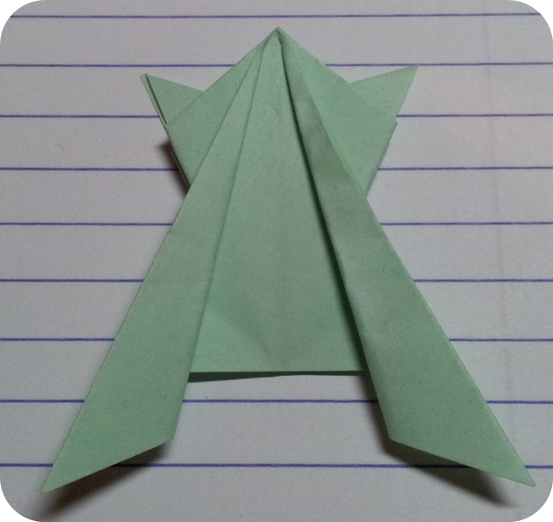
Step 8
Fold the two innermost edges outwards so that they line up with the creases you made in the previous step.

Slide 13
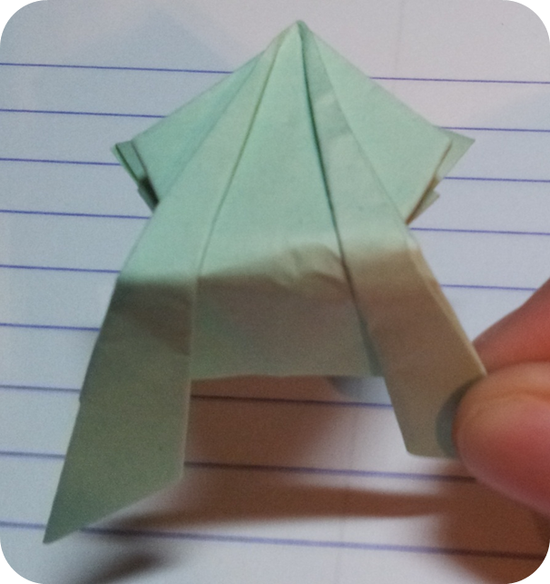
Step 9
Fold the frog over at the waist. Be sure to fold the bottom half (with the legs) underneath the top half.

Slide 14
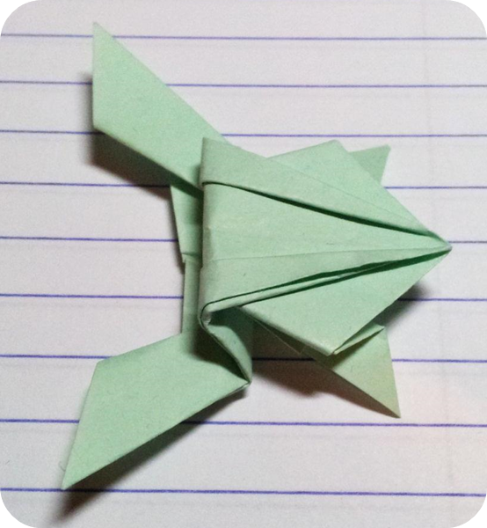
Step 10
Re-fold the frog so that it can jump.
Keeping it folded over at the waist, flip it over vertically so that the legs are facing you. Then, fold the legs upwards, lining the horizontal line of the paper up with the fold at the waist.

Slide 15
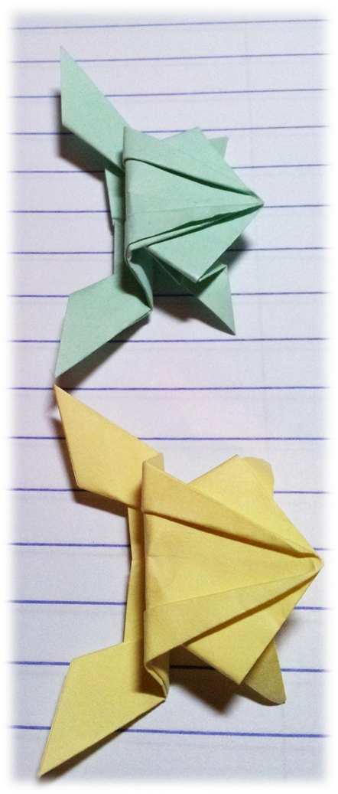
Step 11
Set the frog down on its back legs and press and release the center folds to make it jump.
If you have made it correctly it will act like it is really jumping.
Now you are ready see what your frog can do!

