Slide 1
Discussion and interaction
in statistics and
mathematics classes

Slide 2
What proportion is shaded?
https://solvemymaths.com/2016/11/

Slide 3
Discussion and interaction in statistics and maths classes.
An examination of why discussion helps learning, and techniques for encouraging discussion.
Traditional mathematics teaching did not involve a great deal of discussion, and consequently some teachers find this challenging. In this hands-on workshop we will explore strategies to improve classroom discussion to help learning mathematics and statistics, and look at common pitfalls and how to deal with them.

Slide 4
Dr Nic
Dr Nicola Ward Petty BSc(Hons), DipTchg, PhD
Lecturer in Operations Research at University of Canterbury for 20 years.
Well-known blogger on teaching statistics.
Popular YouTube videos
PhD in operations research/ school effectiveness
Loves to teach and to help teachers.

Slide 5
Statistics Learning Centre
Videos, blog, apps, posters, exams, resources
Started producing resources for NCEA Statistics in 2013
Professional development for teachers
Based in Christchurch

Slide 6
By the end of this you will…
Be able to give reasons why it is important for students to talk in maths and stats classes
Understand the areas where discussions can be improved
Have several strategies for improving discussion in class

Slide 7
Introductions
Why are you here?
What do you want to get out of it?

Slide 8
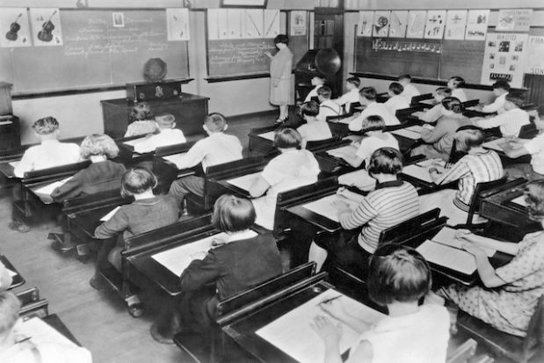
What does your class look like?

Slide 9
Why discuss?
Benefits for students:
Use language, clarify thinking, uncover misconceptions, develop speaking and listening skills, enjoy maths more, justification, think like a mathematician.
The room is smarter than any individual – and possibly smarter than all the individuals.
More fun for all – teacher learns too

Slide 10
Important skills
21st Century skills (NEA)
Critical thinking
Communicating
Collaborating
Creating
Key Competencies
Thinking, relating, language, managing self, participating.

Slide 11
What are some barriers to class discussion?

Slide 12
Good discussion
Teacher response
Class norms
The question or task

Slide 13
Good discussion
Class norms

Slide 14
Class norms
– take time
Safe, respectful, supported
Encourage “wrong” answers
Spread the talking around
Collaborative to get to good answers, not competitive
Risk-taking is encouraged

Slide 15
Good discussion
The question or task

Slide 16
The task
What is there to discuss in maths – surely it is right or wrong?
Not “ping pong”
Discussion ≠ recitation
Good questions require preparation
Open questions, questions about how and why, opinion questions

Slide 17
Good discussion
Teacher response
Class norms

Slide 18
Talk moves – from The Tools of Classroom Talk
Revoicing: the teacher restates what she thinks the student has said.
Repeating: teacher asks students to restate another student’s reasoning.
Asking students to apply their own reasoning to someone else’s reasoning (Do you agree or disagree and why?),
Prompting for further participation (Would someone like to add on?),
Wait time (teachers should allow students to think for at least 10 seconds before calling on someone to answer.

Slide 19
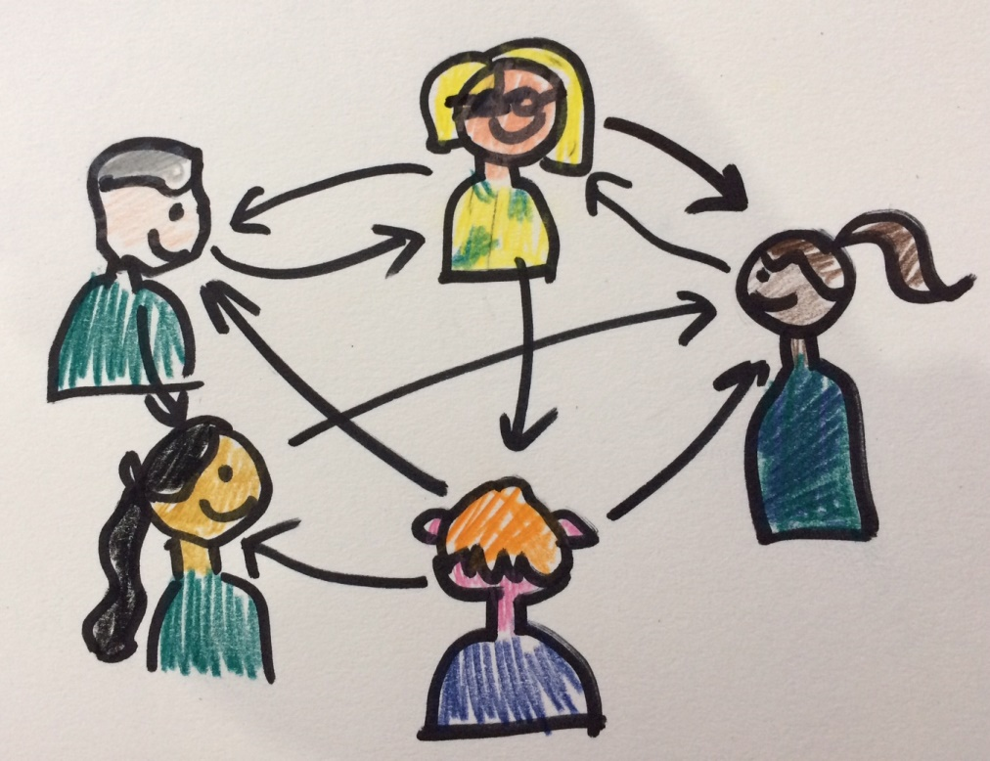
Style of discussion
Soloist or conductor?

Slide 20
True/false questions
Scholarship stats practice

Slide 21
Which one doesn’t belong?

Slide 22
Other examples

Slide 23
Other examples

Slide 24
Other examples

Slide 26
Always, sometimes, never
A rectangle is a square
A confidence interval will contain the population parameter
Y=3x +2
Pie charts are a bad idea
The square of a number is greater than the number
The probability of something happening is 1- the probability of something not happening

Slide 27
What comes next?

Slide 28
By now we hope you …
Feel keen on increasing discussion in maths class
Understand the areas where discussions can be improved
Have some ideas of things you can implement

Slide 29
Making a difference
Turn to your neighbour and tell him or her one thing that you will do differently or new from this workshop.

Slide 30
Useful links for later
Maths discussions – Bobbie Maths
https://nzmaths.co.nz/mathematics-inquiry-communities
100 questions - somewhat excessive, but some good ideas
http://www.casamples.com/downloads/100MathDiscourseQuestions_Printable.pdf

Slide 31
statsLC.com
Sign up for the newsletter
Teaching ideas

