Slide 1

How Far Until it Stops?
AMA Stats Day – November 2016
Sarah Howell (Kaihautū Mātauranga – Pāngarau)
AND
Michelle freeman(Senior Teacher)

Slide 2
The purpose of the unit How far until it stops?
To guide Year 10 students (and teachers) through a PPDAC statistical investigation in the context of stopping distances
Prepare students for AS 1.10

Slide 3
Outcomes for students
Carry out a statistical analysis using the Problem, Plan, Data, Analysis and Conclusion (PPDAC) statistical enquiry cycle…..
…..in a meaningful context.
Create meaning for themselves about stopping distances from raw data.
Develop in all areas of the key competencies, with a particular emphasis on using language, symbols and text and participating and contributing.

Slide 4
Outcomes for students
Wider social outcomes of this unit include their future participation as responsible road-users who will actively contribute to their own safety and the safety of others when driving.

Slide 5
How far until it stops? - the context

Slide 6
How far until it stops? - the context
Total
Stopping
distance
Reaction
distance
Braking
distance
=
+
Linear relationship
Quadratic relationship
ie
2 x speed = 2 x distance
ie
2 x speed = 4 x distance

Slide 7
The Context
Total
Stopping
distance
Reaction
distance
Braking
distance
=
+
This context is rich with a number of further factors that need to be appreciated and considered for their potential influence on stopping distances

Slide 8
The Context
Total
Stopping
distance
Reaction
distance
Braking
distance
=
+
Think: What factors influences stopping distances?
Pair: Discuss with the person next to you
Share: Feedback to the group

Slide 9
Contextual factors of influence
Total
Stopping
distance
Reaction
distance
Braking
distance
=
+
Speed of car
Attention
Motor skills
ie speed of foot to brake
awareness
distraction
noise levels
who else in car
visibility etc…..
Familiarity with the vehicle

Slide 10
Contextual factors of influence
Total
Stopping
distance
Reaction
distance
Braking
distance
=
+
Speed of car
Vehicle features
Road surface
condition of tyres
brakes – new, worn, ABS
new or late model
weight, balance, suspension….etc
chip
asphalt
gravel
grass
downhill, flat, uphill
Weather
eg wet or dry

Slide 11
What students are given
Conditions | Speed | Reaction distance | Braking distance | Total stopping distance
Dry | 40 | 8.6 | 7.2 | 15.8
Dry | 50 | 8.1 | 14.3 | 22.4
Wet | 40 | 7.8 | 14.0 | 21.8
Dry | 50 | 8.2 | 12.3 | 20.5
Conditions = Road conditions (Wet or Dry)
Speed = Initial speed before braking (km/h)
Reaction distance = The distance travelled before the brakes are applied (metres)
Braking distance = The distance travelled from applying the brakes until stopping completely (metres)
Total stopping distance = Reaction distance + Braking distance (metres)

Slide 12
Dataset – disclaimer!
Fictional dataset
But… it was created after research. Averages are consistent with what would be expected for road conditions and speed.
Reaction distances based on ‘typical’ reaction times and a linear relationship with speed.
Braking distances obey the quadratic relationship
Tidy, usable data without ‘distractions’

Slide 13
Problem
Pose two investigative questions about the data collected from a New Zealand study on stopping distances. Your investigative questions must be comparison questions.
A suitable comparison investigative question is one that reflects the POPULATION, has a clear variable to investigate, compares the values of a continuous variable across different categories, and can be answered with the data.
Have someone critique your question.

Slide 14
Problem
Need an example of a question?
At Te Horo High School in 2016, does the number of text messages sent per day by Senior students (Y11-13) tend to be more than the number of text messages sent per day by the Junior students (Y9-10)?

Slide 15
What the students did
Posed a question
  Students found the population challenging to identify
  Population: NZ road and vehicle safety study
“In the NZ road and vehicle safety study, do total stopping distances for wet conditions tend to be further than total stopping distances for dry conditions?”

Slide 16
Group activity
In groups brainstorm the following:
  What are the interesting features of the distributions?
  How can you link this to the context?
  education.nzta.govt.nz/resources/secondary/mathematics#

Slide 17
Writing analysis statements
Fold a piece of A3 paper in half
On one half write a ‘bad’ analysis statement.
E.g. The box for the dots for the wet is longer than the box for the dots for the dry.
On the other half write a ‘good’ analysis statement.
E.g. In the SAMPLE, the middle 50% of total stopping distances for wet conditions is more spread with an IQR of 18.9 m, than the middle 50% of total stopping distances for dry conditions (IQR = 7.34).

Slide 18
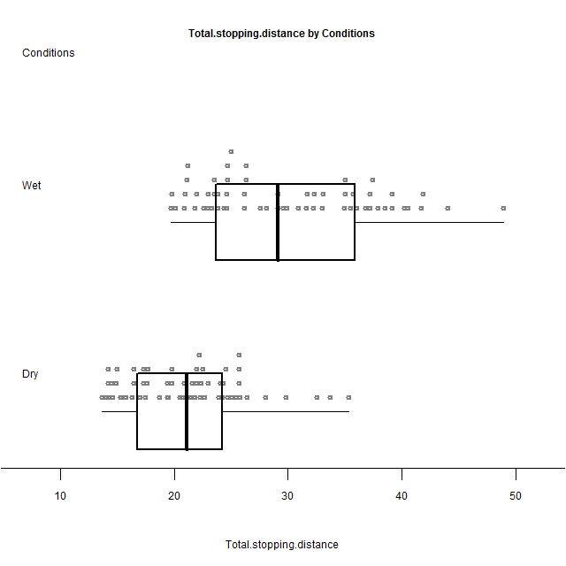
Bimodal
Right-skew
Spread (IQR)
Category | Min | LQ | Median | Mean | UQ | Max
Dry | 13.7 | 16.88 | 21.15 | 20.98 | 24.22 | 35.3
Wet | 19.7 | 23.72 | 29.10 | 29.96 | 35.78 | 48.9

Slide 19
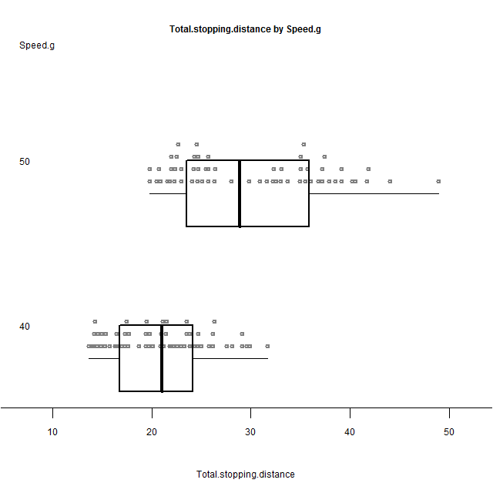
Bimodal
Uniform/rectangular
Category | Min | LQ | Median | Mean | UQ | Max
40 km/h | 13.7 | 16.88 | 21.05 | 20.92 | 24.02 | 31.7
50 km/h | 19.8 | 23.83 | 28.90 | 30.02 | 35.78 | 48.9

Slide 20
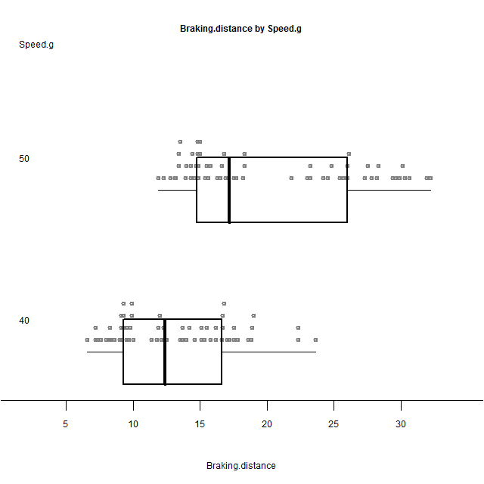
Clusters
Category | Min | LQ | Median | Mean | UQ | Max
40 km/h | 6.6 | 9.30 | 12.4 | 13.08 | 16.62 | 23.6
50 km/h | 11.9 | 14.78 | 17.2 | 20.09 | 26.00 | 32.2

Slide 21
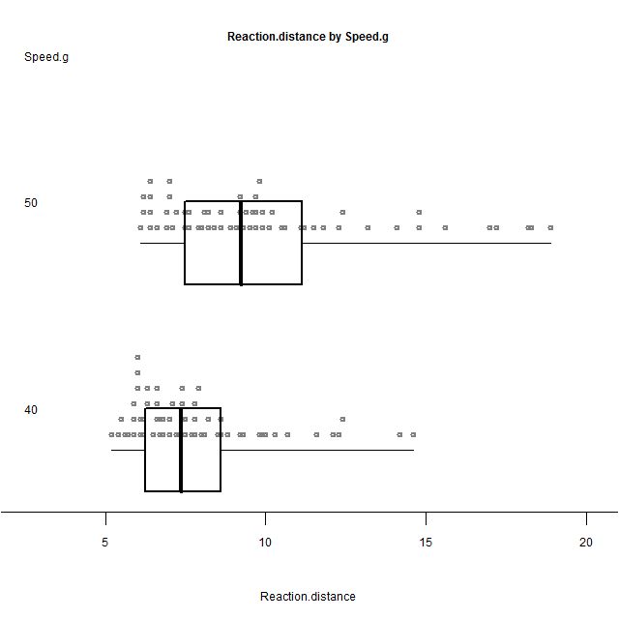
Right-skew
Category | Min | LQ | Median | Mean | UQ | Max
40 km/h | 5.2 | 6.275 | 7.35 | 7.843 | 8.60 | 14.6
50 km/h | 6.1 | 7.500 | 9.25 | 9.928 | 11.12 | 18.9

Slide 22
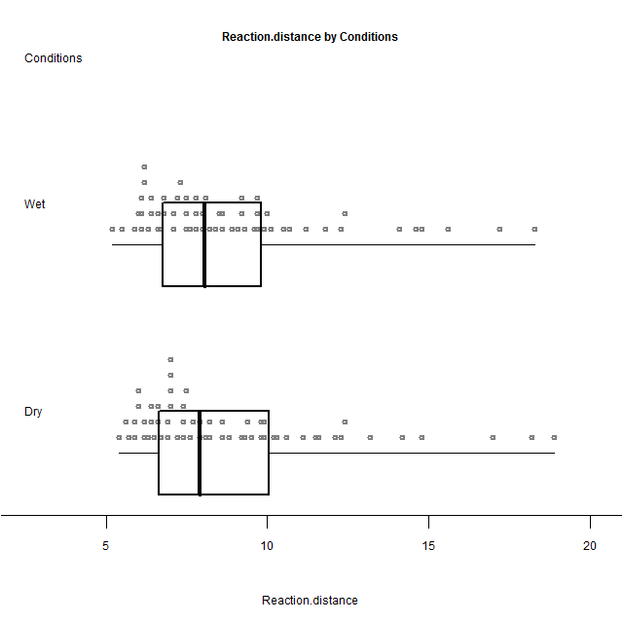
Right-skew
Similar
distributions
Right-skew
Similar medians
Category | Min | LQ | Median | Mean | UQ | Max
Dry | 5.4 | 6.675 | 7.90 | 8.898 | 9.975 | 18.9
Wet | 5.2 | 6.775 | 8.05 | 8.873 | 9.750 | 18.3

Slide 23
Conclusion
Rewrite the question you posed and then answer it.
Use the position of the median of each group relative to the middle 50% of the other group to answer the question.
The conclusion is about the POPULATION.

Slide 24
Two options for a conclusion

Slide 25
What the students did
As part of their conclusion the students discussed the context of their investigation and answered questions such as:
  What pieces of evidence support the conclusion?
  How reasonable do you think your findings are, based on your knowledge of stopping distances?
  What would happen if you repeated this sampling process?

Slide 26
What the students did
As part of their conclusion the students discussed the context of their investigation and answered questions such as:
  Explain why your friends who are learning to drive might be interested in these results.
  Explain why other drivers might be interested in these results.
  Which organisations or other groups of people might be interested in these results, and why?
  What other questions has this investigation generated?

Slide 27
What did the students come up with?
Intended outcomes:
  Students developed their own meaning about vehicle stopping distances at different speeds and for different road conditions
  Students linked their findings to the 2-second and 4-second rules
  Students found out just how much of a difference 10 km/h makes to stopping distances
  Students identify factors affecting stopping distances
  Students pooled their separate analyses to discuss the collective meaning of what they have found

Slide 28
What did the students come up with?
Unintended outcomes
  Students linked their findings to their world in ways that we didn’t anticipate, eg.
    discussing the lowering of the speed limit specific to their home suburb of Miramar
    discussing the effect modified cars with lowered suspension had on braking distances

Slide 29
Resources
education.nzta.govt.nz/resources/secondary-school-curriculum-resources/mathematics#
  Unit overview
  Full lesson plans
  ICT links (helpful websites, Youtube videos)
  Student task – worksheet
  Dataset
  Year 10 assessment schedule
  Student self-review
All resources are adaptable to suit the needs of teachers and their students

Slide 30

education.nzta.govt.nz/resources/secondary

Slide 31
Maths and Stats resources from NZ Transport Agency
How far until it stops? (Year 10 statistics)
Crossing the centre line (Year 10 trigonometry)
Driven to distraction (Year 11 statistics AS1.10)

Slide 32
Acknowledgements
Raewyn Baldwin (NZTA), Martin Vaughan (Wellington College), Mathematics department and Year 10 students (2011, 2012) at Wellington College
For further info contact me at sarah.howell@tekura.school.nz
@Sarah_StatsAko

Slide 33
Why does choice of context matter?
“In a range of meaningful contexts, students will be engaged in thinking mathematically and statistically” (NZC)
Student engagement
Promoting other values from the curriculum: key competencies, citizenship
Can give students who don’t usually participate a voice in the maths classroom

Slide 34
So why choose road safety as a context?
Relevant to students
Accessible context
Engaging context
Citizenship
Participating and contributing
Help them make sense for themselves about their world
Empower them to make decisions using knowledge
Potential for cross-curricular themes
Whanaungatanga – Build relationships by showing students that you care about what happens to them outside of the classroom

Slide 35
AS 1.10 Investigate a given multivariate data set using the statistical enquiry cycle
Use to scaffold the learning during the teaching of AS 1.10
Use as a practice assessment
  Use the intro and dataset and add the standard questions
  Adjust marking schedule from NZ Transport Agency website (this is aimed at a Year 10 level)

Slide 36
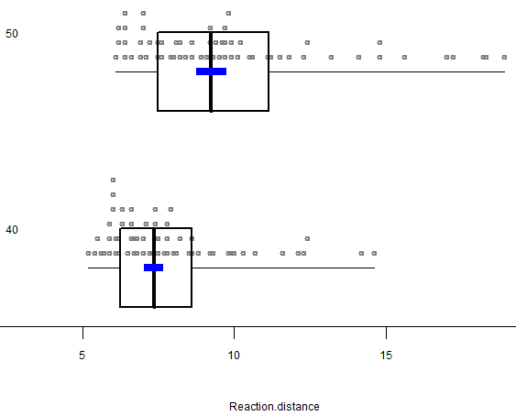
AS 2.9 Use statistical methods to make an inference
Sample size is only 120
Can still be used to practise skills
    Posing a question
    Taking a random sample
    Describing distributions comparatively
    Interpreting informal confidence intervals
    Making conclusions

Slide 37
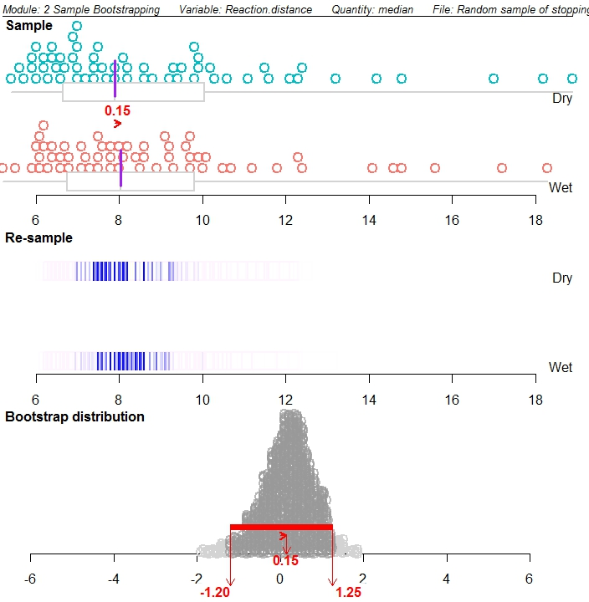
AS 3.10 Use statistical methods to make a formal inference
Data isn’t real but can be used as a practice task with the standard questions
Distributions show many different features which can be discussed and meaningful links to context possible through some basic fact finding.
Interpretation of bootstrap confidence intervals

Slide 38
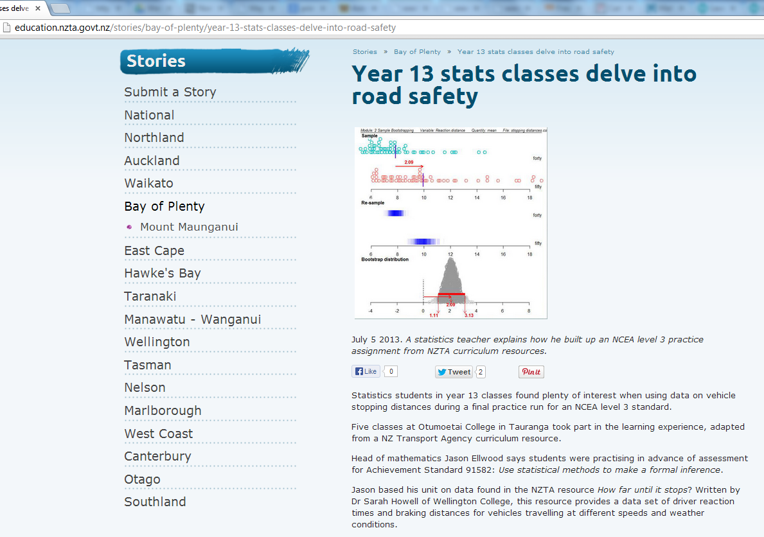

Slide 39
Primary/intermediate
How would you adapt this resource for a Year 7 or 8 Maths class?

Slide 40
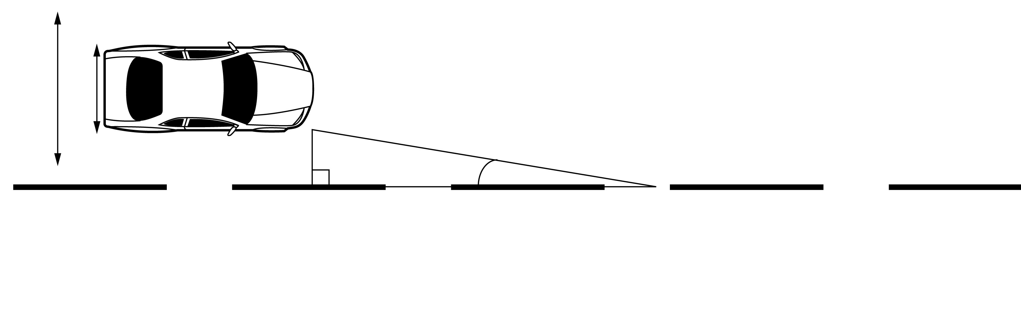
Crossing the centre line
A series of short trigonometry investigations which looks at the effect of lapses in concentration and veering at a slight angle while driving
Aimed at Year 10 but can be used with Year 11

Slide 41

A car is travelling at 50 km/h on a straight road. Positioned in the centre of the lane, the right edge of the car is 1 meter from the centre line. It starts veering to the right at an angle of 5º. Below is a diagram which represents the situation.
(a) How far has it travelled when it starts to cross the centre line?
(b) How long would it take before it starts to cross the centre line?
11.5 m
0.83 s

Slide 42
Driven to distraction
Resources for AS 1.10
Task investigating reaction times, accuracy and speed, comparing groups of students who are tired/not tired and texting/not texting
  Practice assessment and schedule (QAAM)
  Dataset (which can be used for other standards)
  PowerPoints on posing questions, writing analysis statements and making conclusions
  Suggestions for discussion starters, websites and interactive games for introducing the context and establishing prior knowledge

