Slide 1
Probability
91038
and
Junior
Ruth Kaniuk and Maths Department
Lynfield College

Slide 2
posing a question to explore a situation involving elements of chance
planning an experiment to explore the situation (discussing and defining the set of possible outcomes and deciding the sample size)
gathering data by performing the experiment
selecting and using appropriate displays including experimental probability distributions
identifying and communicating patterns in the data
comparing discrete theoretical distributions and experimental distributions as appropriate
communicating findings in a conclusion.

Slide 3
I am going to focus on some ideas that we could use in the classroom
rather than the full PPDAC required in the AS

Slide 4
Idea 1
Tennis

Slide 5
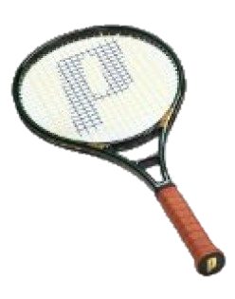
To decide which player is to serve first in a game of tennis, sometimes a racket is spun instead of a coin toss.
The start is decided on which side lands up (label or not).

Slide 6
Bex has noticed that in the last 15 times that she has spun her racket, it has landed with label side up 10 times.
She thinks her racket is not balanced and tells her mother that she needs a new racket.

Slide 7
How should her mother respond?
Discuss how to simulate this situation.
Using a simulation will show the likelihood of 10/15 label side up
Tinkerplots
https://www.srri.umass.edu/tinkerplots/download

Slide 8
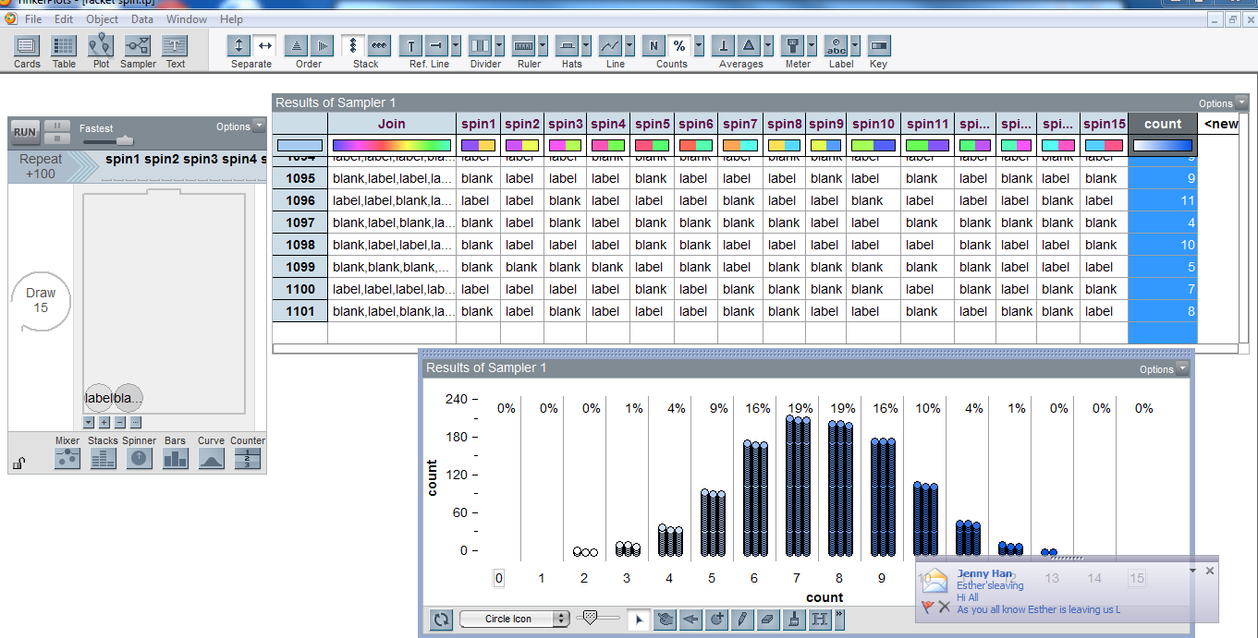

Slide 9
Idea 2
Fatal fires/road deaths/lightening strikes…
(Something that is currently in the media)

Slide 10
fatal house fires spike
This month, Nov 2014, in New Zealand there have been 5 deaths due to people being caught in a house fire.

Slide 11
November 9 - 3-year-old O'rlandau Kingi-Day died in a house fire started from a novelty lighter in Dinsdale, Hamilton.
November 15 - Jake Hayes, Connor Swetman and Toni Maree Johnston, died in a house fire on Collingwood Street, Hamilton
November 20 - One dead in house fire in Linwood, Christchurch.

Slide 12
In NZ, over the past 5 years there has been an average of 19 deaths per year due to house fires.
That is an average of just over 1.5 deaths per month.
Surely, it is unusual that 5 deaths would occur in one month?

Slide 13
Use a coin and a die to decide the month.
Repeat 19 times to represent a trial of 1 year
Is 5 in 1 month unusual?

Slide 14
Idea 3
Horse race
https://www.tes.co.uk/teaching-resource/Horse-racing-6445788/

Slide 15
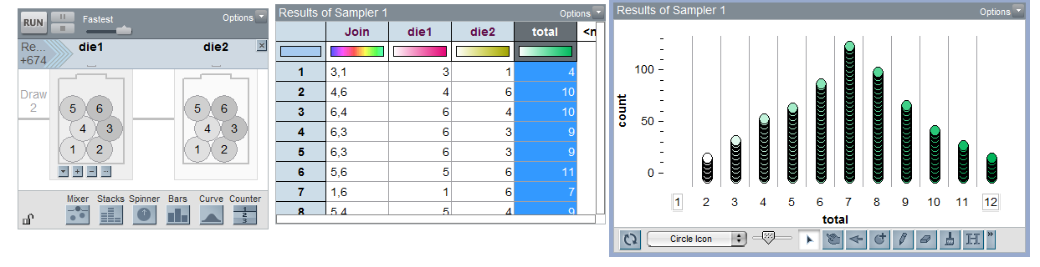

Slide 16
Idea 4
Get out of jail

Slide 17
You have 10 prisoners. You can place them in any of the cells 0 – 5. You can have as many prisoners in a cell as you want.
A prisoner can get out of jail if, when you roll 2 dice and find the difference of the numbers, that difference is their cell number. Only 1 prisoner can be released on each roll of the dice.
Play in pairs. The winner is the person who gets all of their prisoners released first.

Slide 19
Play the game several times, then use a simulation to look at the distribution of cell numbers.

Slide 20
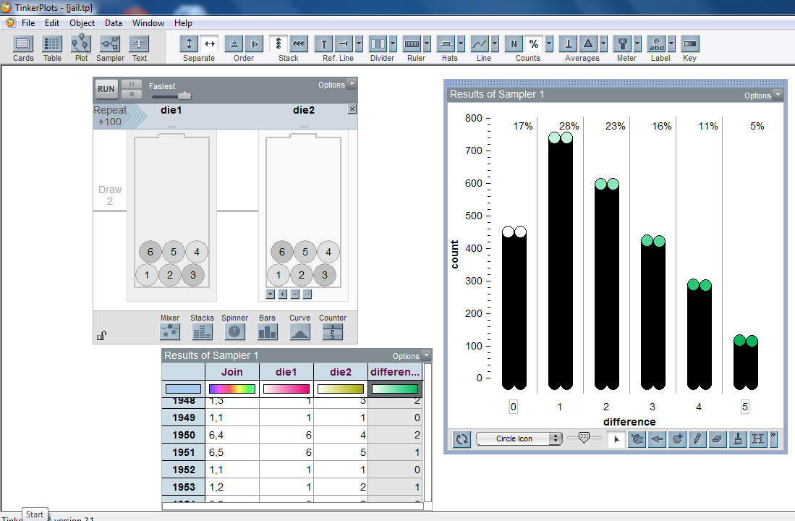

Slide 21
It is good to play the game again – the randomness does not always guarantee the winner is the one with the most strategic placements.

Slide 22
Idea 5
Designer dice

Slide 23
Designer Dice
You are to cut, fold and make a die.
Your dice can have any whole numbers on the faces, but the numbers must sum to 30.
Once you have made your die, you will play a round of 15 games where you and your partner each roll your own die. The winner of that point is the person with the highest number showing.
The winner of the round is the person who has won more points over 15 games.

Slide 24
At the end of the round you may change the numbers on the face of your die, but the sum of the numbers must be 30.
After two rounds, play the game as a knockout competition within the class.

Slide 25
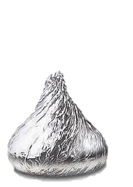
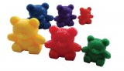
Idea 6
Do expose your students to situations where the outcomes are not equally likely….

