Slide 1
Interpreting confidence intervals
a guide to success.

Slide 2
Crash statistics
NZ drivers involved in vehicle crashes, between the ages of 16-27, and 52-65.
NZQA Exemplar A (AS91582)

Slide 3
Distance of crash from home.
in kilometers.

Slide 4
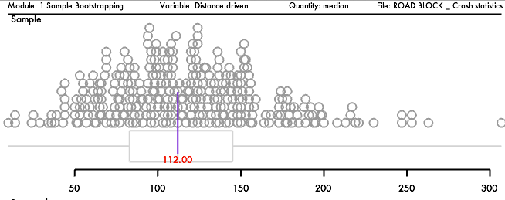
Sample median
..our estimate of the population median is 112km.

Slide 5
Sample median
..our estimate of the median crash distance from home, is 112km.

Slide 6
It is a fairly safe
bet…
…that people crashed at least 106km away from home, but this could up to 121km away from home.

Slide 7
It is a fairly safe
bet…
…that New Zealanders invoked in vehicle crashes, crashed at least 106km away from home, but this could up to 121km away from home.

Slide 8
Crash severity and blood alcohol level
S = severe
M = minor

Slide 9
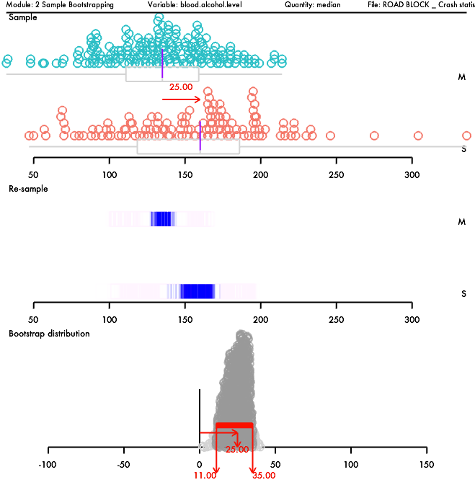

Slide 10
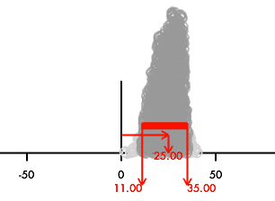
The confidence interval
It is a fairly safe bet that….
..those in severe crashes have a higher blood alcohol level than those in minor crashes….
….by at least 11mg/100ml, and up to 35mg/100ml.
There is a difference, because the confidence interval is above 0, and the blood alcohol level for severe crashes is higher than minor crashes.

Slide 11
Distance of crash from home
..comparing those of learner and full licenses.

Slide 12
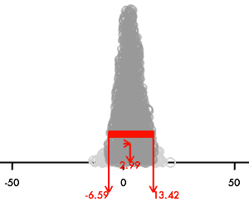
Sample median difference
is 2.99km.

Slide 13
Sample median difference
..learner license drivers crashed 2.99km further away, compared with full licensed drivers.

Slide 14
Is there a difference?
There is no difference between the distance learner and full licensed drivers crash away from home, as the confidence interval contains 0.

Slide 15
Understanding the upper limit
Learner licensed drivers crashed up to 13.42km further, compared with full licensed drivers.

Slide 16
Understanding the lower limit
Learner licensed drivers crashed up to 6.59km closer, compared with full licensed drivers.

Slide 17
alternative interpretation
One
Learner licensed drivers crashed up to 13.42km further away from full licensed drivers; and..
Full licensed drivers crashed up to 6.59km further away than learner licensed drivers.

Slide 18
alternative interpretation Two
It is a fairly safe bet that….
..those with learner licenses crash further away from home than those with full licenses by up to 13.4km;
..those with learner licenses crash closer to home than those with full licenses by up to 6.6km;
There is NO difference, because the confidence interval has 0 in it; on the one hand learners crash further away from home than fully licensed drivers… on the other hand, learners crash closer to home.

Slide 19
Insurance payout
..comparing those of learner and full licenses.

Slide 20
Insurance payouts

Slide 21
Insurance payouts
Insurance payments for learner licensed drivers is higher than full licensed drivers by up to $1,346.
Insurance payments for full licensed drivers is higher than learner licensed drivers by up to $898.
…it is possible that either group could received higher payments than the other; this means there won’t be a difference in the payouts, in the population.

