Slide 1
SI
With 100% Confidence
Notes:
This workshop may not be for you...

Slide 2
Me
For your information.
Notes:
I am a teacher of mathematics & statistics at Ormiston Senior College.. Newly developing area in SE Auckland.
I began my journey of statistics working as a statistical analyst for Statistics New Zealand in their HQ.
I altered course towards teaching, an today find myself TIC of Y13 Statistics at OSC... I am the sole teacher of 2 classes, and Year have been very successful. And we started our Level 3 program only last year!
New to teaching, new school purpose built for MLE, new course, new AS’s…. Oh well why not?

Slide 3
“To build teacher confidence in understanding and therefore delivering the fundamental principals of AS91852...in other words, to provide a starting point.”
– My objective for this day.
Notes:
I am not here to tell you that I’m awesome and your rubbish; I respect your individual journeys especially those who have taught statistics and inspired countless for many years.
I have simply been on the journey …. And that journey was VERY successful! So I must be doing something right…
In particular, externally moderated 8/8
Experience in dealings with various teachers around the country is this:
We are unsure of what exactly to teach.
The Standards themselves are not clear.
…therefore there in un-necessary stress we don’t need!
There is no help out there!!
YET, we want to give these kids to best chance at success…
SO my job is to share my learning’s with you. I have chosen to focus on, what I like to call, the “Fundamental principals” of SI as relating to AS91582.
I want you to leave with a example answer that your have written (of which I am happy to give you feedback on in this workshop)… so that you have a starting point.
Unfortunately your journey about mastering this AS does not end today. It’s only begins…

Slide 4
Quiz
Key Principals
A time to be practical

Slide 5
Inference ≈ a judgment
Notes:
What is an inference?
Purposefully looking at specific characteristics of a known set of sample data, especially all visual features that relate to the difference between 2 sample medians.
Then, comparing the difference between 2 sample medians from the known set of sample data, to other differences between 2 sample medians from other similar samples.
Then, making a judgment using statistical methods, about how different they are.
Not too bad right?
… can be quite confusing for the non-statistically inclined! But it’s logical right?

Slide 6
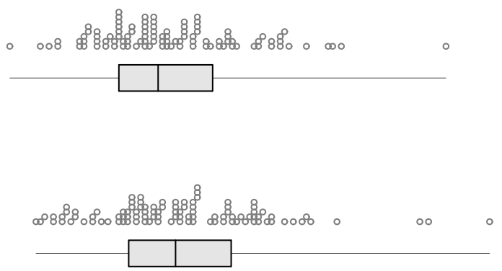
Make an inference
Difference
No Difference
Notes:
What you see here is sample data.
Use all your knowledge to make the correct judgment about the extent of the difference between the population medians.
2 more to practice with on your handout (give a few minutes to complete… allow for prior knowledge to be engaged).
ASK QUESTION: So what parts of the graphs and/or features did people use to make these conclusions?
No set answers here… rather make an argument based on what you see.

Slide 7
Principals of SI
What you have been waiting for…
Notes:
6 principals
Once I have presented a principal, I invite you to ask questions.

Slide 8
Principal 1
Sample
Population.
Sample is a subset of a defined target population.
Not practical to collect data from a population…(other than from census data)
No point in making an inference from census data (why?)
E.G.
“I will investigate the difference between the median BMI for male athletes and median BMI for female athletes from the Australian Institute of Sport.”
Questions ?
Notes:
QUESTIONS??

Slide 9
`
Estimates.
Statistics is about estimating a central value (aka an ‘average’)…
… paying at attention to variation.
Sample estimates are generated as a ‘best guess’ to the corresponding Target population estimates.
Mean.
Median.
Mode.
E.G.
“I will investigate the difference between the median BMI for male athletes and median BMI for female athletes from the Australian Institute of Sport.”
Questions ?
Notes:
Statistics is generally about estimating / approximating some sort of central value (average), whilst paying attention to the variation of these estimates … their likely values; what the ‘could be’ ; Median is the measure we choose to use at secondary school.
QUESTIONS?

Slide 10
Principal 3
Purpose.
A strong evidenced-based reason about why the statistician is conducting the investigation.
“I wonder if…” is our typical starting point.
We now ask why do “wonder if…?”
Use research to collect evidence to become more informed.
E.G.
“Gender differences stemming from weight and height can mean men may have different BMI scores than women.
In particular, livestrong.com suggests that fat mass of male athletes should be about 5% - 13%, and 12% - 22% for female athletes.”
Questions ?
Notes:
QUESTIONS?

Slide 11
Principal 4
Use these….
Visual appreciation of graphs.
[S, N, C] What do you see?
[P] What does it mean ..what could it imply about the target population?
Questions ?
Notes:
In principal, we should not tell the students what to look for. In the formative years it is assumed they have developed their own understanding of the visual features of centre, shape, shift, middle 50%, overlap, outliers, clusters.
Of course, this is an assumption. So how do we guide the students?
That is another presentation all together! .. and not one taken to time to examine. Unfortunately, those students who gain Merit and Excellence, who show statistical insight look beyond the image, look deeper into the image, and are able to section of the key features (pattern noticing).
QUESTIONS?
I want to show you an overview of these features…
NOTE: We are looking for evidence to suggest that the population medians are different enough, beyond the effect of sampling error… because that is what we care about!

Slide 12
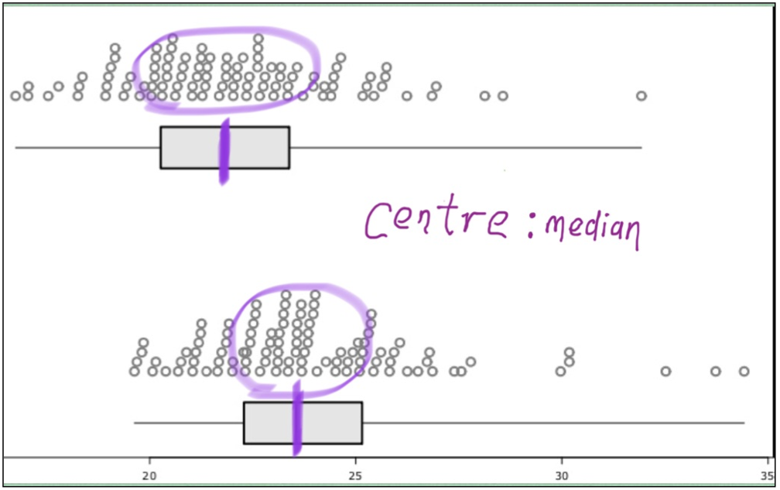
Questions ?
Notes:
Sample median is included in the region where ‘most’ of the sample data is.
Seen here by the purple lines.
A difference in the levels of the sample medians here implies a possible difference between the population medians….
QUESTIONS?

Slide 13
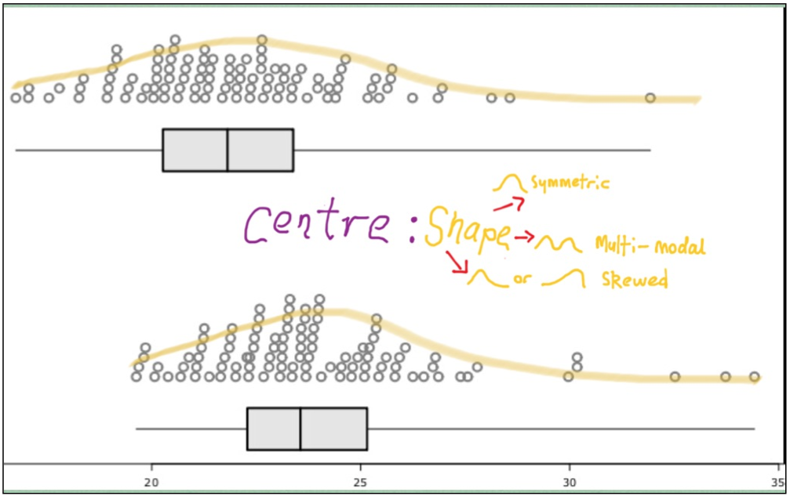
Questions ?
Notes:
Shape will indicate where ‘most’ of the values in a particular group are “likely” to be; this is an indicator for the range of values that are “likely” to include the population median.
If “most of the values” of both groups overlap a similar range, it is an indicator that the population medians may occupy a similar range of values…. OR could be indicator of something else in context. E.g. If sample of males comprised mostly of weightlifters; then we should be a left-skewed distribution.
QUESTIONS?

Slide 14
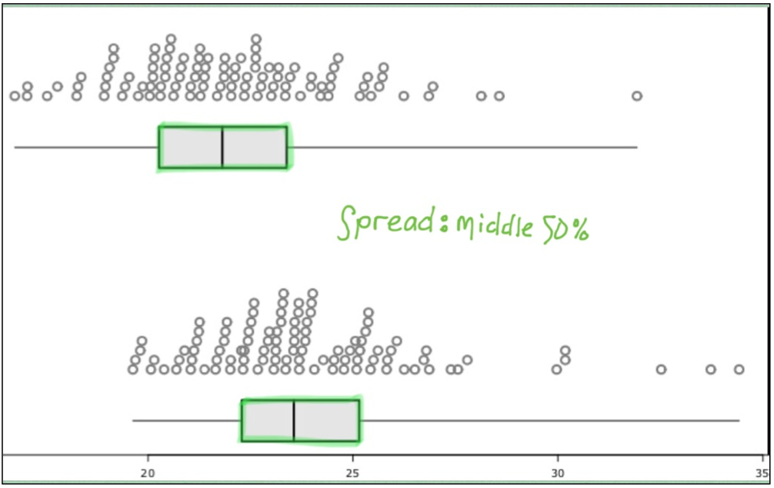
Questions ?
Notes:
Variation is King. Period.
Middle 50% as measured by the Inter-quartile range is a measure of spread, the region of range of values of where the population median is expected to be within. An overlap of the ranges, may indicate it is likely the population median could be the same. Then again… this is the result of just one sample.
QUESTIONS?

Slide 15
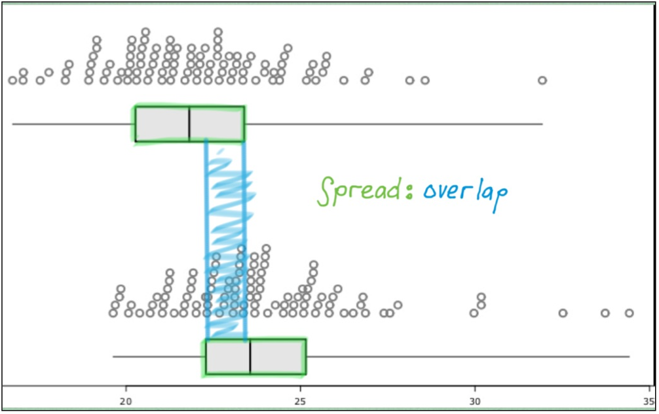
Questions ?
Notes:
Extend of overlap is a determinant of similarity.
QUESTIONS?

Slide 16
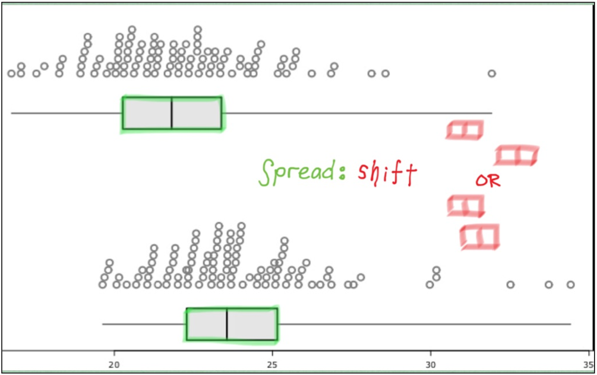
Questions ?
Notes:
Extent of shift of the middle 50%, is a determinant of a possible difference between the 2 sample medians.
QUESTIONS?

Slide 17
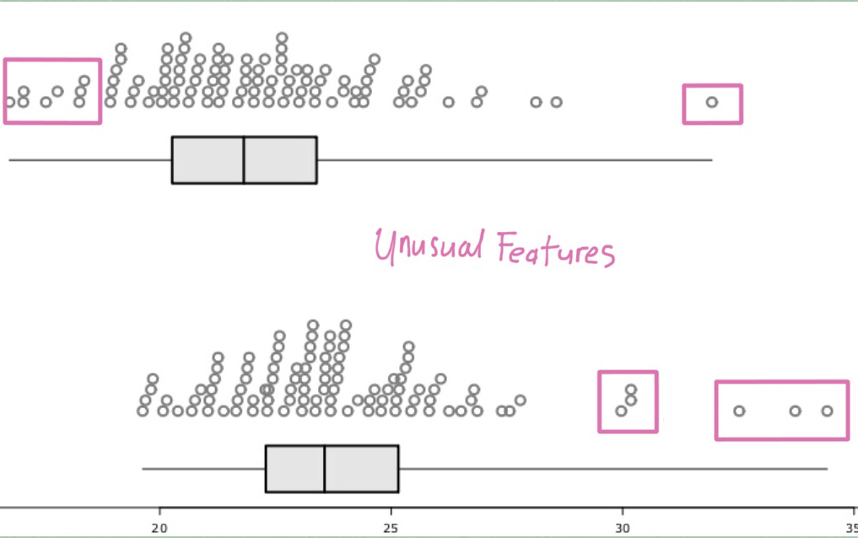
Questions ?
Notes:
QUESTIONS?

Slide 18
Inference ≈ a judgment
Difference
No Difference
Notes:
Based on the features you have just seen…
One sample in insufficient to make a conclusion from…

Slide 19
Principal 5
Variation is King.
E.G.
“Different randomly selected samples taken from the same target population are likely toe produce different sample statistics, therefore a possible change to the ‘statistical inference’
Not practical to sample from the sample population again.
… take a re-sample.
Questions ?
Notes:
What you see here is …
Describe the process: a practical activity.
What should be looking for?

Slide 20
Principal 5
Variation is King.
“Different randomly selected samples taken from the same target population are likely toe produce different sample statistics, therefore a possible change to the ‘statistical inference’
Not practical to sample from the sample population again.
… take a re-sample.
E.G.
“Different samples of the sample size from the athletes from the Australian Institute of Sport, may produce slightly different sample statistics and therefore different results to mine. I will test my result by taking 1000 re-samples of the sample.”
Questions ?
Notes:
What I would expect to see written.

Slide 21
Principal 6
Concluding.
Insufficient to conclude with a descriptive argument.
MUST take a formal statistical inference by interpreting the bootstrapped confidence interval.
… maketh the inference.
E.G.
“The bootstrapped confidence interval suggests that it is a fairly safe bet, that the median female athlete BMI is larger that the median male athlete BMI by somewhere between 0.98 and 2.49 index points.”
Questions ?

Slide 22
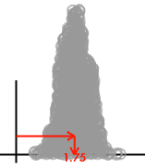

Slide 23
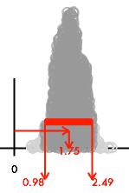

Slide 24
Principal 6
Concluding.
Insufficient to conclude with a descriptive argument.
MUST take a formal statistical inference by interpreting the bootstrapped confidence interval.
… maketh the inference.
E.G.
“Therefore, there is a difference between male and female athlete BMI who a registered with the Australian Institute of Sport, as the bootstrapped confidence interval does not contain zero.
I can be fairly sure that the median female athlete BMI is larger than the male median BMI.”
Questions ?

Slide 25
Your turn.
…the end of the beginning
Notes:
Go to handout work here.

Slide 26
The Report.

Slide 27
Introduction
Setting the scene for investigation.

Slide 28
Technical Notes
Use technical statistics-specific terms and concepts,
in a way that “not everybody understands”.

Slide 29
Executive Summary
Concluding the findings, using terms and
concepts in a way that “most people understand”.

