Slide 1
Probability Modelling
(year 13)
using Tinkerplots
Ruth Kaniuk
Endeavour Teacher Fellow, 2013

Slide 2
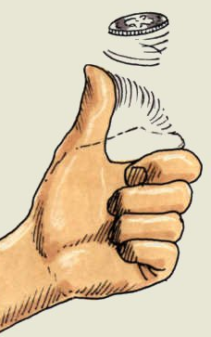
Why use a simulation model?
To take probability beyond the application of a learned rule to a tool that is useful in solving real world problems
To create a model that mimics random behaviour in the real world

Slide 3
Start with a theoretical view of the real world situation
Create a simulation model
Check that the model is adequate
Produce enough data quickly so that the distribution is visible
Consider the assumptions needed for that model

Slide 4
Ask ‘WHAT IF’ questions
Change settings in the model to see the possible effects in the real world

Slide 5
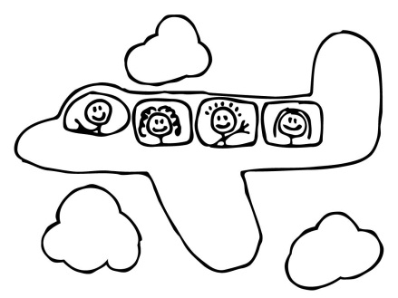
Context 1
How many tickets to sell?
Air Zland has found that on average 2.9% of
passengers who have booked tickets on its main
domestic routes fail to show up for departure.
It responds by overbooking flights. The Airbus A320,
used on these routes, has 171 seats.
How many extra tickets can Air Zland sell
without upsetting passengers who do show up at
the terminal too often?
Notes:
Could look at this question as a??? Distribution (poisson?/Bin?)
Assumptions? Independence?
What do you expect the distribution of #non-arrivals to look like?

Slide 6
How many tickets do you think they should sell?
(2.9% of 171 = 4.959)
What do you think the distribution of the number of passengers that do not show would look like?
Sketch this distribution
What are we counting?
X = number of passengers who do not show

Slide 7
Model?
Uniform? Triangular? Normal? Poisson? Binomial?
What assumptions do we need to make and are they likely to be met by this situation?
Fixed number of trials (number of tickets sold)
Only two outcomes (passengers show or not)
Probability of ‘no show’ is constant (2.9% do not show)
A person arrives or not independent of any other person
Binomial

Slide 8
A Tinkerplots simulation
Notes:
N= how many tickets
Pr(no show) = 0.029

Slide 9
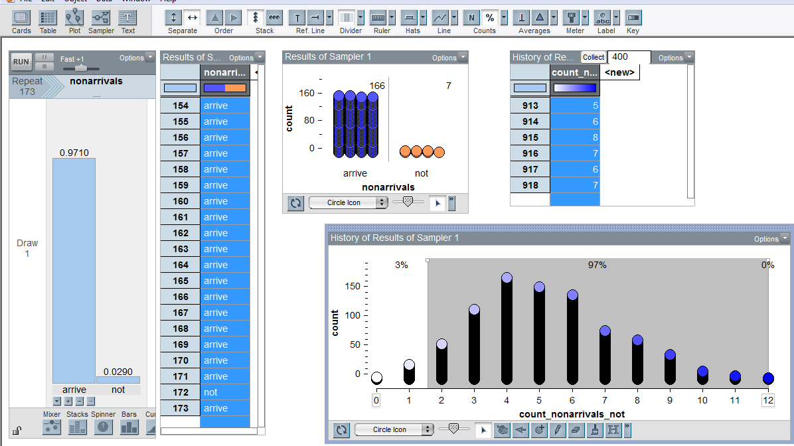
918 simulations of number of passengers not arriving per plane load if 173 tickets were sold

Slide 10
Distribution of the number of people who would not arrive for
their flight if 173 tickets were sold
Notes:
What would you conclude form this?
0.048 4.8% of flights would be expected to have too many people …..about 5 out of every 100 flights
Reaction of the traveller
Reaction of airline
Distribution not symmetric
# of flights with empty seats

Slide 11
Using a theoretical approach
Bin (173, 0.029)
P(X = 0) = 0.006
P(X = 1) = 0.032

Slide 12
Context 2: Diabetes
Normal distribution
Tables of counts
Conditional probability
Source: Pfannkuch, M., Seber, G., & Wild, C.J. (2002)
Probability with less pain. Teaching Statistics, 24(1) 24-30

Slide 13
What do we know about diabetes in NZ?
http://www.youtube.com/watch?v=MGL6km1NBWE

Slide 14
A standard test for diabetes is based on glucose levels in the blood after fasting for a prescribed period.
For ‘healthy’ people, the mean fasting glucose level is 5.31 mmol/L and the standard deviation is 0.58 mmol/L.
For untreated diabetes the mean is 11.74 and the standard deviation is 3.50.
In both groups the levels appear approximately Normal.

Slide 15
Sketch a graph of these two distributions
Healthy
N(5.31,0.58)
x | f(x)
5.31 | 0.69
5 | 0.60
4.5 | 0.26
4 | 0.05
x | f(x)
11.74 | 0.11
8.5 | 0.07
5 | 0.02
3 | 0.005
Diabetic
N(11.74,3.50)
Notes:
For those without calculators: height of graph healthy: x= 5.31

Slide 16
C

Slide 17
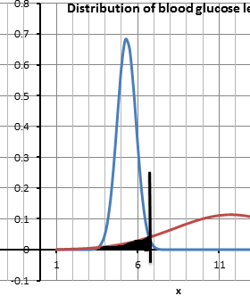
This area represents the proportion of people who have diabetes but test is negative.
This area represents the proportion of people who do not have diabetes but test is positive.
We would like to minimise both!

Slide 18
Task 1
Assume that the cut-off point is 6.5mmol glucose/L blood.
Calculate:
P(test is negative | person does not have diabetes)=
[N(5.31, 0.58), P(X < 6.5) = 0.98]
P(test is positive | person has diabetes)=
[N(11.74, 3.50), P(X > 6.5) = 0.933]
0.98
0.933

Slide 19
Notes:
So 2% of healthy people would be diagnosed as having diabetes
6.7% of undiagnosed diabetics would be diagnosed as not having diabetes
With C = 6.5

Slide 20
In 2012, 225 686 people in New Zealand had been diagnosed with diabetes out of an estimated total population of 4 433 000.
Calculate the base rate (proportion of the population with diabetes)
Base rate =
5%
Notes:
1 click animation!

Slide 21
Suppose there was a screening programme introduced where the entire population of New Zealand was tested for diabetes using this test and the cut-off point was taken as 6.5mmol/L.
Set up a Tinkerplots simulation for this base rate and find how many people would be misdiagnosed.
Notes:
Exit to Tinkerplots

Slide 22
Use the simulation to explore the conditional probabilities
P(test is negative | person does not have diabetes)
P(test is positive | person has diabetes)
as opposed to
P(has diabetes | test is negative)
P(does not have diabetes | test is positive)
as well as working out an optimum cut-off value, C

Slide 23
Task 2:
Use the model to see the effect of changes in the base rate.
What do you think will happen if the base rate is higher?
Notes:
If the base rate is higher, what do you think will happen?
Higher base rate gives greater proportion of people with incorrect diagnosis compared to lower base rate. (1.1%; 0.4%).
Higher base rate gives greater proportion of false negative results than lower base rate (1.9%, 1%)
Higher base rate gives smaller proportion of false positive results than lower base rate (1.9%, 6.8%)

Slide 24
Task 3:
How could we calculate the base rate?

Slide 25
So… why use simulation
To get an idea of what ‘long run’ means
In the long run 2.9% of passengers do not show- what does this mean in practice?
Understand that there is uncertainty around that expected value
The expected value has a distribution around it
If 173 bookings were taken, there might be no people that do not show but there also might be 12 people …
An exactly full plane load would not be expected to occur all that often…

Slide 26
So… why use simulation…
To use probability models to mimic the real world
Setting up the model is problem solving..
To use the model to ask ‘what if?’ – what are the likely impacts of a change
How many people are likely to be misdiagnosed if the cut-off value is../base rate is different
To introduce students to how applied probabilists think and work

Slide 27
Distribution
Distribution
Notes:
You could also use this resource without the simulation software

Slide 28
This work is supported by:
The New Zealand Science, Mathematics and Technology Teacher Fellowship Scheme which is funded by the New Zealand Government and administered by the Royal Society of New Zealand
and
Department of Statistics
The University of Auckland

