Slide 1
Collecting a sample with students using social media for AS3.10
by Jared Hockly and Katrina Johnson
Western Springs College

Slide 2
in this session you’ll:
Hear from us about:
Why we went down this path
How we made it work
How the students managed
Gain detailed knowledge of an assessment you can use
Along the way, some new learning on:
- information on facebook
- use of google spreadsheets
- iNZight to manipulate your data

Slide 3
Why Sample, it’s not in the standard
AS3.10 is about sample to population inferences, it doesn’t require sampling.
We didn’t find any interesting sampled datasets in assessment banks or through searching the net
But sampling is part of NZC
Doing the sampling allows student to understand the data and gain insight into what the population is and what bias might be evident (similar to research)
Sampling from a database is pointless these days (we’ve done this for AS 2.9)

Slide 4
We shouldn’t be struggling to find data
Data is everywhere
We’ve been “deluged” with it, particularly from the net
Just needed a quick way of randomly finding data that had a mix of categorical and numerical data.
Notes:
about 10 mins to here

Slide 5
Facebook - need to knows
Some info required on sign up is publicly available for all users (gender, profile photo, cover photo, locale (language chosen))
Privacy settings control whether other info is made public or only available to friends or friends of friends or only you (e.g. status updates, photos, videos, friend lists)

Slide 6
How we sampled Facebook users
http://www.facebookrandomusers.com
No knowledge about how site chooses user.. is it random? are all users included?
2 classes of 21-26 students, each meant to collect data on 2 random users (94 total)
Each class collected a different gender so we had similar amounts of each

Slide 7
How we sampled Facebook users
Variables
Categorical (publicly available)
Gender
Locale (based on language chosen by user)
Profile photo type (face, full body, other)
Numerical (may or may not be publicly visible)
Number of friends
Number of photos
Days since last activity
calculator http://www.timeanddate.com/date/duration.html#

Slide 8
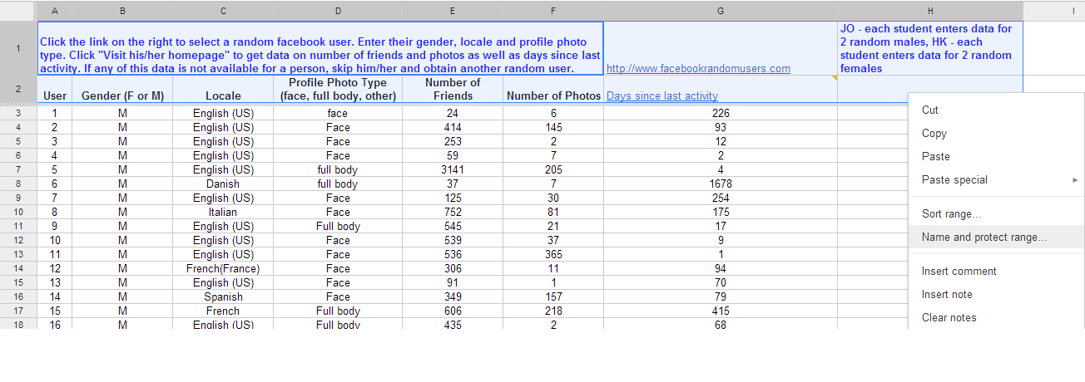
Data collection in Google spreadsheet
Instructions, links and headings created and protected so students could not edit

Slide 9
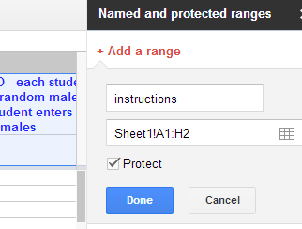
Data collection in Google spreadsheet
Name the range of cells
Tick box to protect (prevent editing by others)

Slide 10
Issues with data collection
Students must have a facebook account (almost all did)
Could take several tries to find a user with all necessary details made public (students may have given up or made up details?)
Some students did not collect data and thus were less aware of the sampling process/population
We had to collect some samples ourselves to get a suitably large data set

Slide 11
Our assessment
(handouts: Task, schedule/evidence statements)
Prior to assessment: Students were given an intro into how to collect their two data points for the sample AND further information on the context. The data set was cleaned and CSV’d by us.
Assessment: Students worked for 2 lessons plus working into intervals/lunch/after school/holidays
Students worked on netbooks using a Google doc (shared with us), were not allowed to work on it outside supervised times
Students were allowed to do further research during assessment, but were not allowed to be on sites that helped them with their statistical analysis or report writing (e.g. NZQA exemplars)
Resubmissions were done by letting a student know which aspect they had not achieved well in and allowing them to correct/improve this (done by hand)

Slide 12
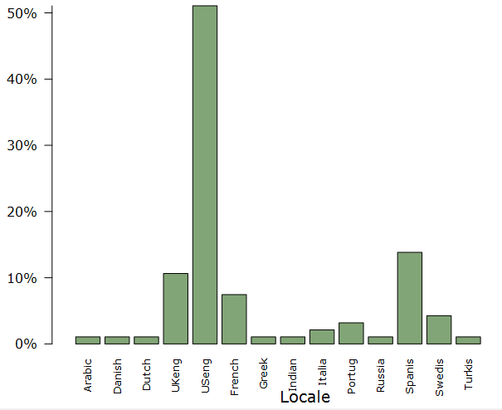
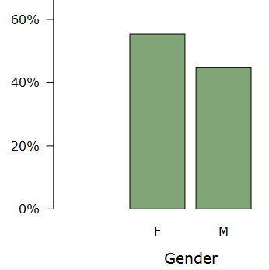
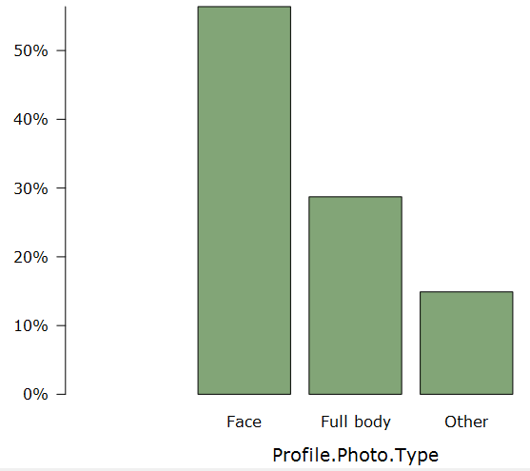
Demographics of this dataset

Slide 13
What students did
Our students’ comparisons
An excellence piece of work (handout)
 | # of photos | # of friends | # days of inactivity
gender | 31 | 3 | 2
photo type |  | 1
locale |  |  | 1

Slide 14
(aside) How to collapse variables
iNZight does not (currently) allow bootstrap difference in means/medians between more than 2 groups
Can be done in Excel using formulae or more manually
e.g. I want to compare English speaking users with non-English (other)

Slide 15
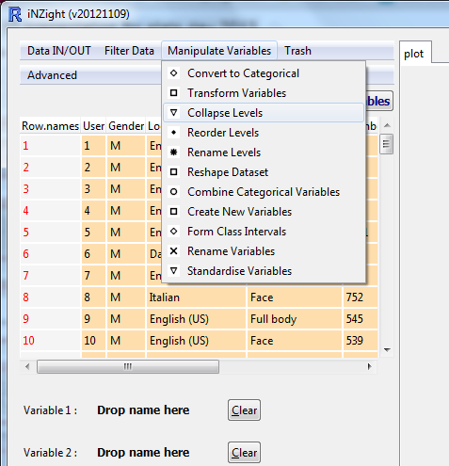
(aside) How to collapse variables
use normal version of iNZight (not a VIT module), load up your data set
manipulate variables menu
collapse levels

Slide 16
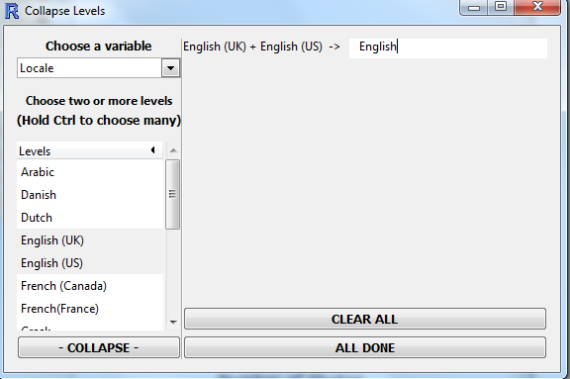
(aside) How to collapse variables
choose the variable you want to collapse
choose the categories(levels) you want to combine
press collapse
rename it if you want
(You can repeat this for other combinations)
press all done
To save:
data in/out menu
export data
browse to choose folder and name

Slide 17
What else is possible to “easily” sample?
With the people around you, think of some other data sets that could be collected in a similar way:
- Students surveys
- samples from Census at school from diff countries
- Sport (SPARC) datasets
- Websites traffic (perhaps school site)
- School data use per username
- Twitter tweets
- Random blogs on different blog sites

