Slide 1
Using School Data to Engage Students in NCEA Level 2 and 3 Statistics
Jason Ellwood
HoF Mathematics & Statistics
Otumoetai College

Slide 2
WHY dig around in your SMS??
Authentic Data
  To engage students in data exploration
  To help students relate to data
  To help students access and make sense of data without contextual boundaries
Notes:
This powerpoint is a combination of slides I’ve used with my classes and slides prepared for you
There are not a lot of concrete resources to take away, the plan being that you take the ideas and methods to apply in YOUR schools using YOUR data. There are some excel spreadsheets you can have that make sorting data and generating resources a bit easier though.
I don’t intend to talk through methods etc, but rather to focus on school data/contexts that I’ve used in class.

Slide 3

KAMAR – the data gathering process

Slide 4
AS91264
Use statistical methods to make an inference

Slide 5
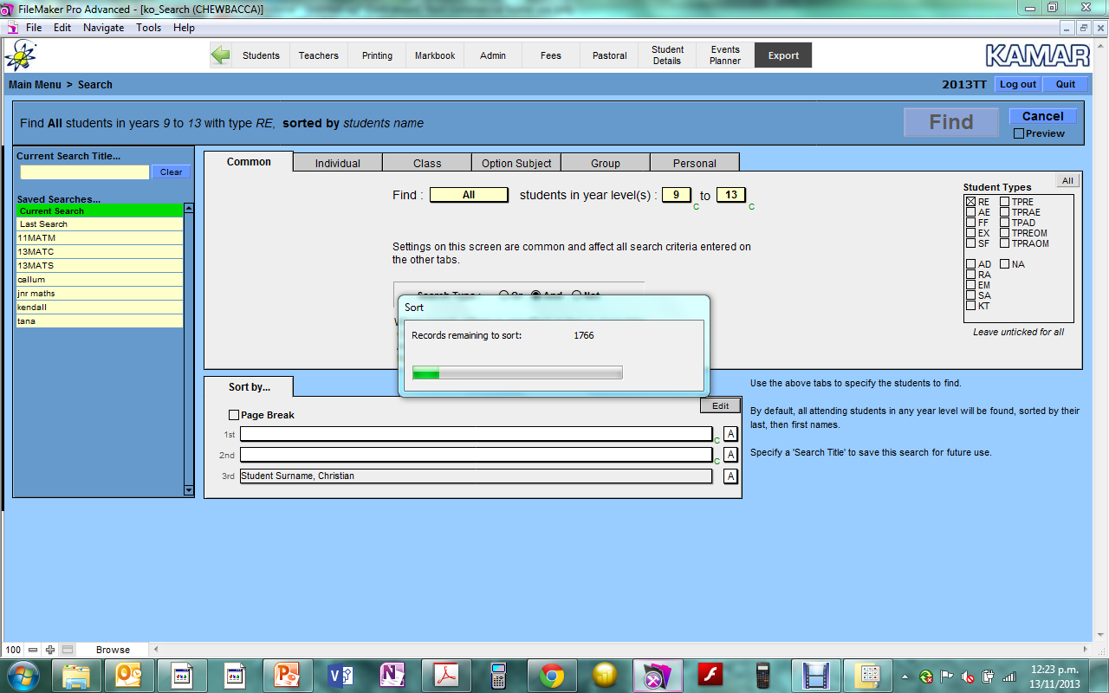
KAMAR: Students
Add graphic here

Slide 6
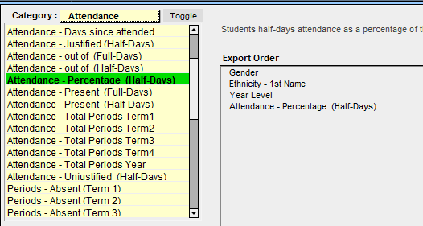
KAMAR: Fields
Add graphic here

Slide 7
OTC Attendance Data 2012
In the population of 2012 Otumoetai College students you have been given, each square represents an individual student.
What do you think each of the variables are?
????
Gender
????
????
Year
Attend-
ance
??/??
Ethnicity
Notes:
Do it!!!

Slide 8
I Wonder….
What questions might we ask about the attendance data?
I wonder …
Notes:
Limited scope for questions here – deliberately
Set up to investigate ethnicity and year level strata later on

Slide 9
I Wonder Whether Male Students at OTC TEND TO have higher attendance than Female Students at OTC?
How might we answer this question?
Off you go…
Notes:
Trying to get idea that we gather male and female weight and compare. Hopefully get as far as plotting box plots.
Don’t cue students on sampling idea at this stage. If they want to use the population weights, let them start – the odds are on they will realise their error soon enough and learn for themselves a good reason to sample. <Thanks to Pip Arnold here>

Slide 10
Why Sample???
Too hard/expensive to use/measure the entire population
Try it with your students…
  Mix them up and pick out 25 Males and 25 Females
  What do your samples “look” like
  Describe your samples
Notes:
Beauty of large data set here is that students can individually grab 25 and not significantly alter population

Slide 11
What Effect does Sample Size have???
We often take samples of size 30
How much variation do we expect to see in samples of this size?
Take 5 samples of 30 students from the OTC population. Plot each sample LQ, Median and UQ as shown on the next slide

Slide 12
Data Collation
Median in red, quartiles in blue
64 | 66 | 68 | 70 | 72 | 74 | 76 | 78 | 80 | 82 | 84 | 86 | 88 | 90 | 92 | 94 | 96 | 98
Notes:
Collate all student sample stats on the one axis. Aim for as many samples as possible here in order to give the idea of variation in central 95% of the medians making up 1 third of the overall observed spread

Slide 13
1000 Samples of 30
Notes:
Fathom Demo
Unfortunately data set is too big for iNZight VIT sample variation module.

Slide 14
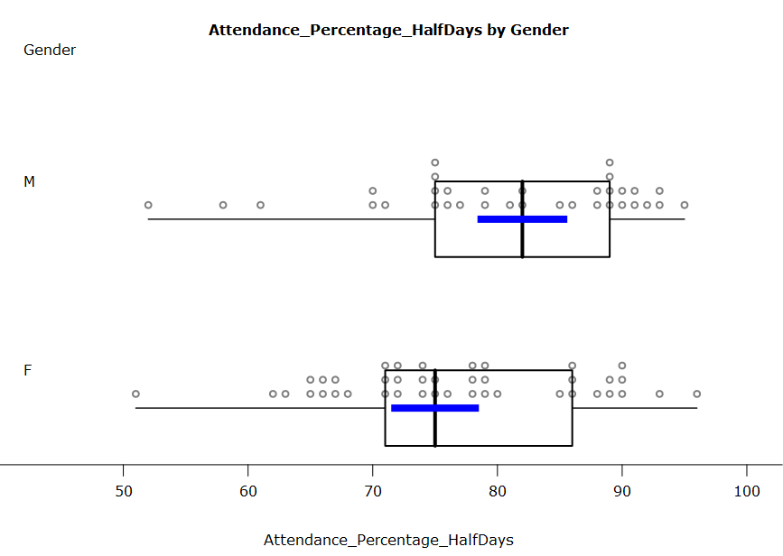
30(ish) Male and Female Students
Notes:
Hopefully enough variation in the data to get a range of comparisons…

Slide 15
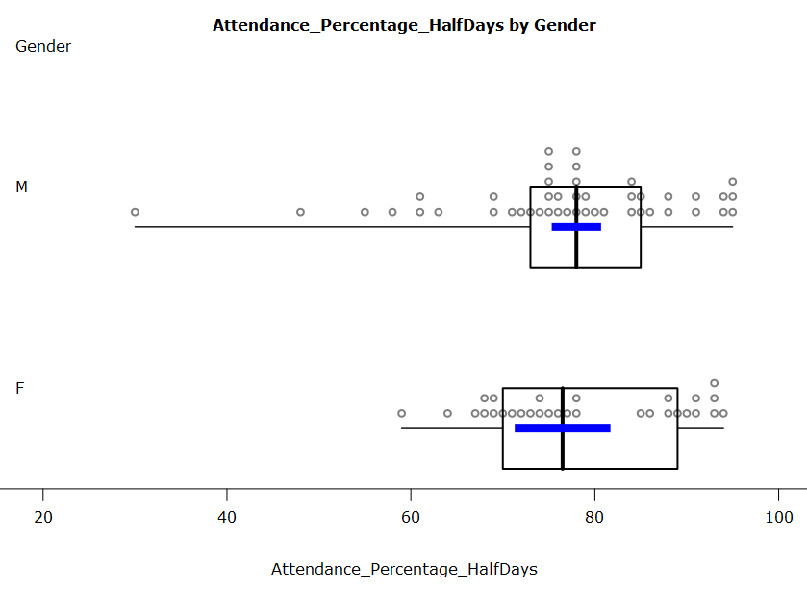
Another 30(ish) Male and Female Students

Slide 16
AS91581
Select and analyse continuous bivariate data

Slide 17
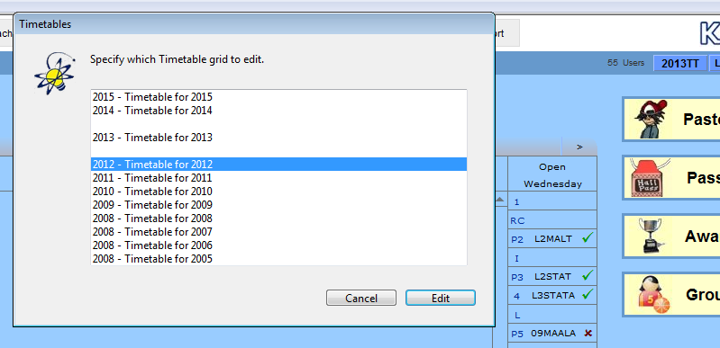
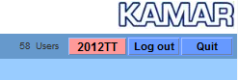
KAMAR: Previous Years’ Data
Add graphic here

Slide 18
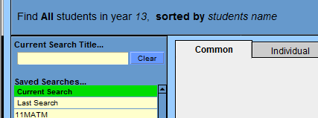
KAMAR: Students
Add graphic here

Slide 19
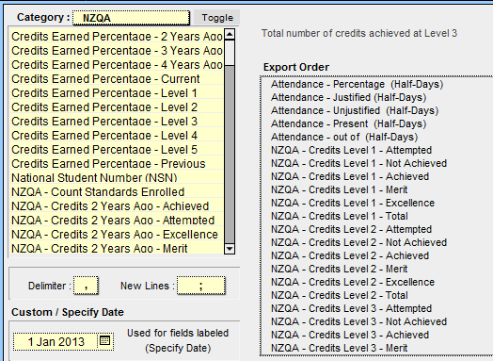
KAMAR Fields
Add graphic here

Slide 20
Calculating GPA in Excel
KAMAR does do GPA’s at a course by course level, but I can’t make it do it globally…
So at each level of NCEA…
  Multiply Excellence credit count by 4, Merit count by 3 and Achieved count by 2. Divide by Attempted Credit count multiplied by 4.
  Essentially a percentage score for the year

Slide 21
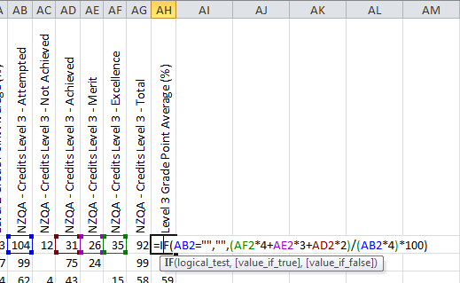
Calculating GPA in Excel

Slide 22

OTC
Notes:
A practice assessment task looking at relationships between various attendance and achievement based variables

Slide 23
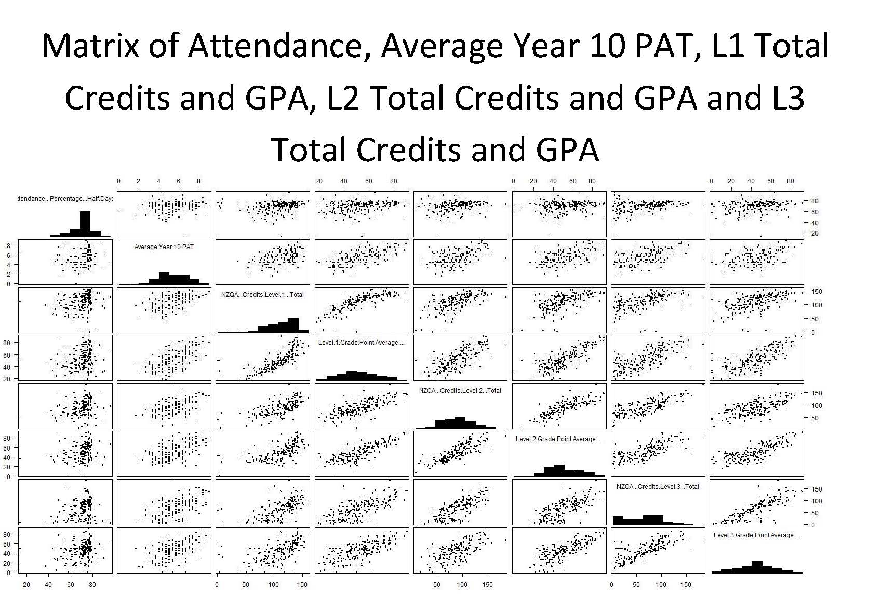
Notes:
PAT’s in KAMAR are set up by schools. In my case they’re in the global markbook which you may need to be given access to… this one sits with your DBA

Slide 24
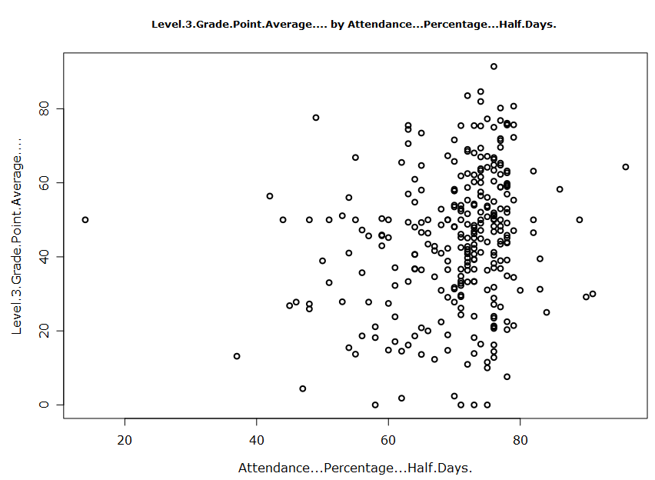
Notes:
NCEA Level 3 GPA by attendance % - disappointing!!!!!
Made for a really good conversation though – I, the teacher was really wanting to see a positive correlation between attendance and achievement, but I didn’t get what I wanted from the data
Went on to use students own previous achievement to predict how they would do this year – great fun and seriously motivating for the students!!

Slide 25
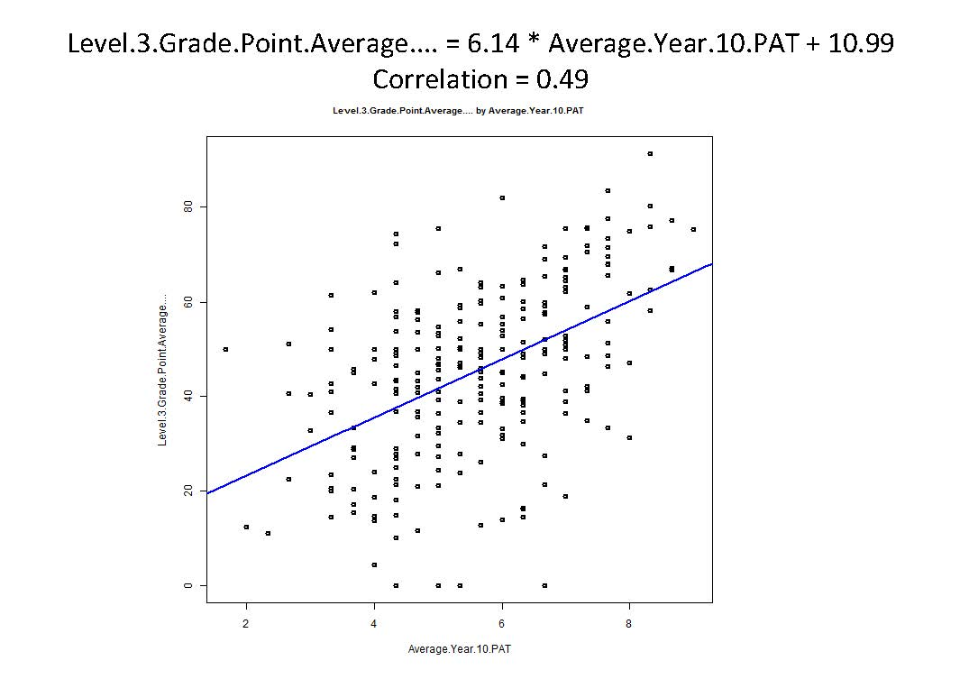
Notes:
Just to give you an idea of the scope we looked at with students…
Starting with trying to model L3 GPA with year 10 PAT scores

Slide 26
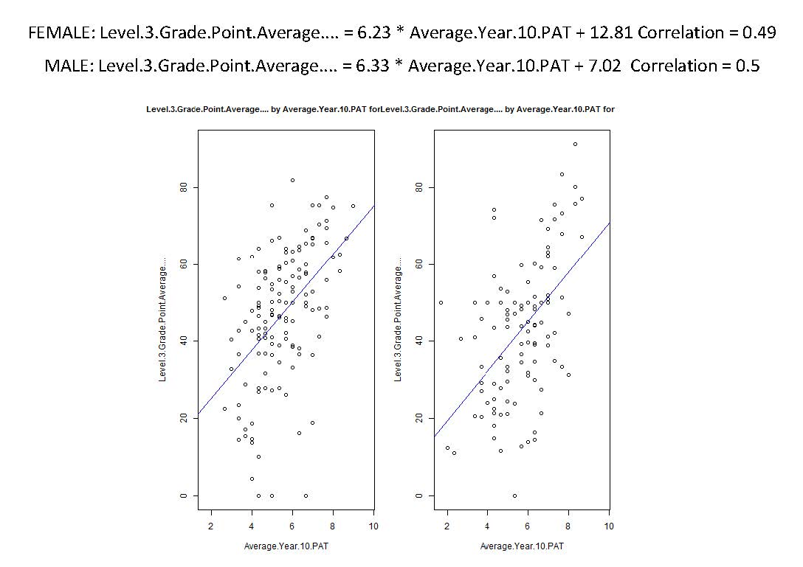
Notes:
Splitting by gender

Slide 27
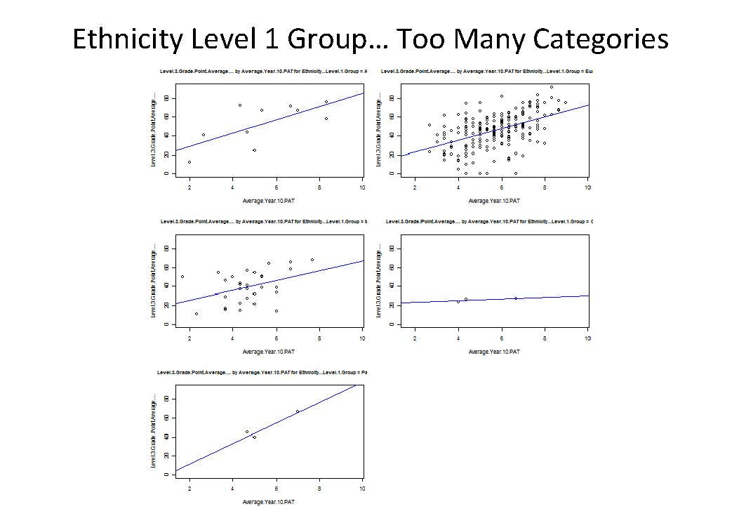
Notes:
Splitting by ethnicity grouping
MELAA = Middle Eastern, Latin American and African

Slide 28
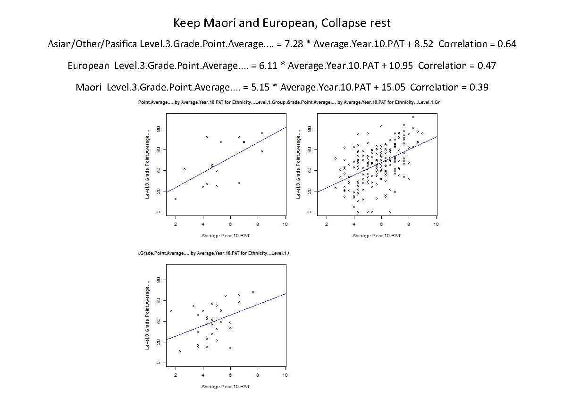
Notes:
Collapsing ethnicity groups

Slide 29
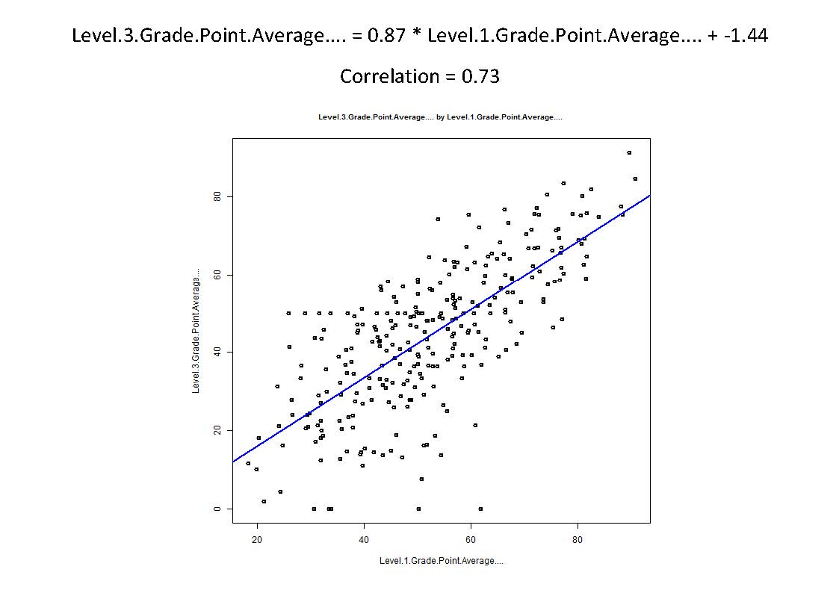
Notes:
Same process using L1 GPA as explanatory variable…

Slide 30
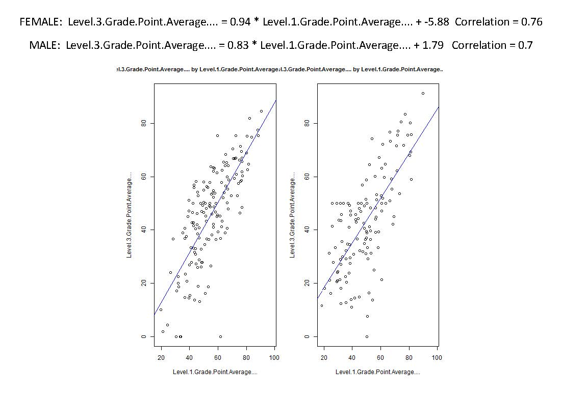

Slide 31
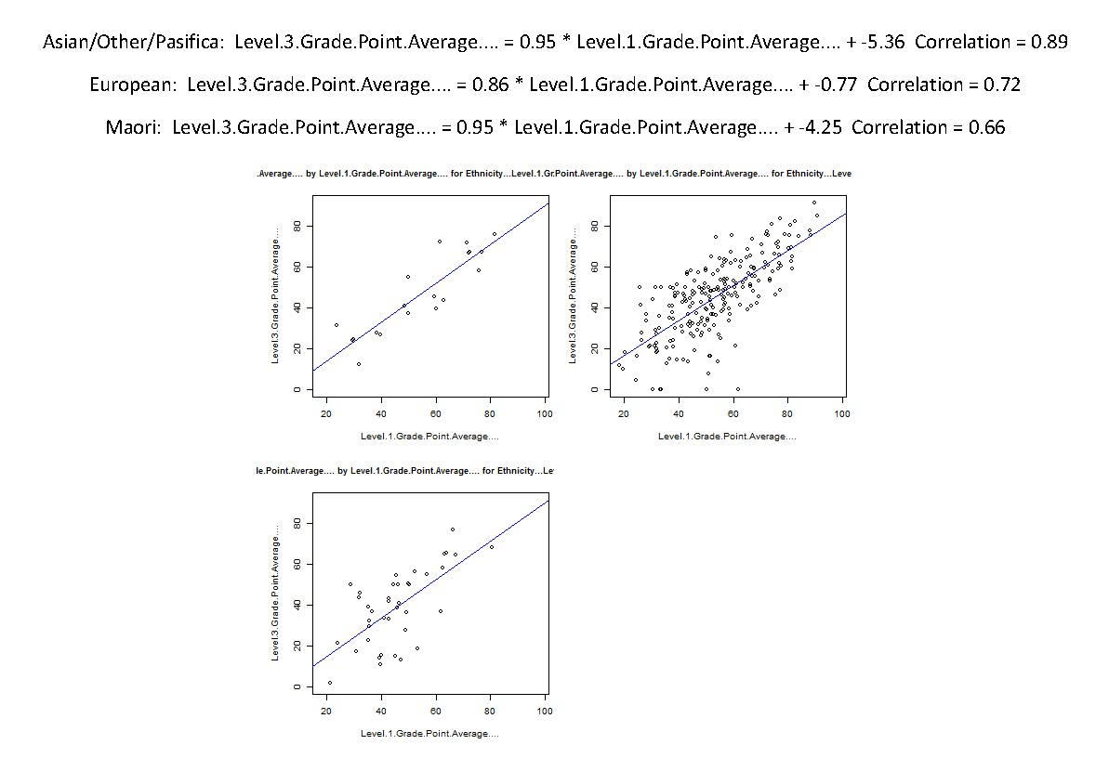

Slide 32
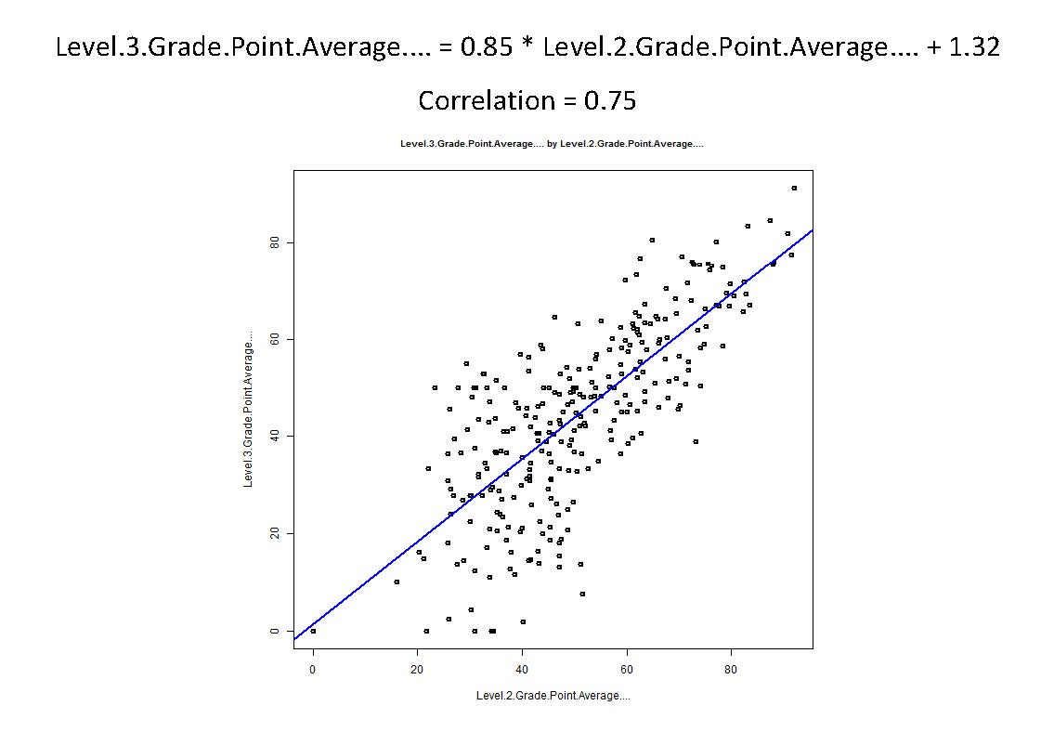

Slide 33
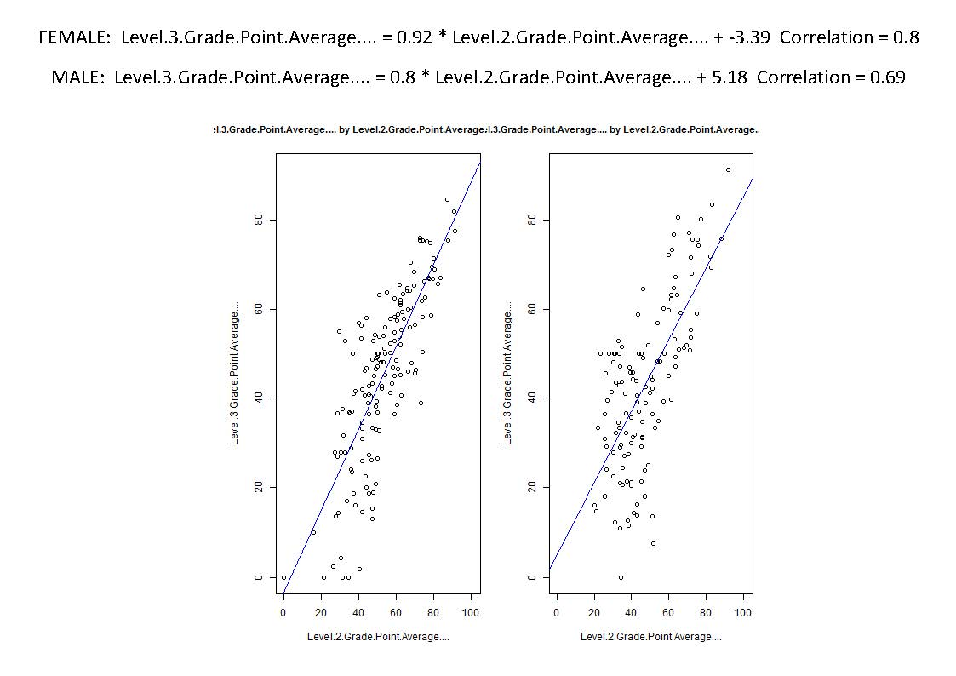
Notes:
Ultimately, students could decide how best to predict their own L3 scores given their particular demographics

Slide 34
AS 91582
Use statistical methods to make a formal inference

Slide 35
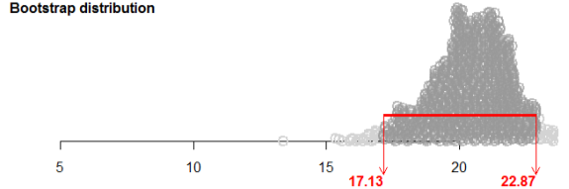
Credit Counts
95% of these resampled means lie between 17.13 and 22.87credits
It’s a fairly safe bet that the mean number of credits scored in NCEA Level 3 Statistics by students in your school is between 17.13 and 22.87.

Slide 36
So What?...
Bootstrap resampling does mimic repeated sampling from a population.
It is a fairly safe bet that the mean number of credits gained by NCEA Level 3 Statistics students at our school is somewhere between ___________ & ___________
Is the population mean number of credits definitely between ___________ & ___________?
  We don’t know, but it’s a fairly safe bet that it is.
Another school claims that Level 3 Statistics students at our school only achieve 14 credits on average. Is this a credible claim?
Notes:
Useful??.

Slide 37
AS 91585
Apply probability concepts in solving problems

Slide 38

KAMAR: Students
In the course Markbook…
  Create & Export a summary with internal AS GPA
In KAMAR Printing…
  Export the same group of students’ attendance
Match these up in Excel
  Vlookup
  Sort all lookup fields ascending!!!
Notes:
Demo excel if needed

Slide 39
OtC L3 Statistics GPA’s 2013- first three internals
 |  | Attendance (85%)
 |  | Regular | Not Regular | Total
GPA (50%) | On Track | 69 | 16 | 85
 | In Trouble | 25 | 11 | 36
 | Total | 94 | 27 | 121
What is the risk of being ‘In Trouble’ for students with ‘Regular’ attendance? ‘Not Regular’ attendance?
Find and interpret the risk of being ‘In Trouble’ for students with ‘Not Regular’ attendance, relative to those with ‘Regular’ attendance?
Find and interpret the risk of being ‘In Trouble’ for students with ‘Regular’ attendance, relative to those with ‘Not Regular’ attendance?
Which base line makes the most sense here?
Notes:
Attendance here represents time in class. Calculated from raw attendance half days accounting for unjustified and justified absence
Category cut offs indicated by percentages

Slide 40


OtC L3 Statistics GPA’s 2013
 |  | Attendance (85%)
 |  | Regular | Not Regular | Total
GPA (50%) | On Track | 69 | 16 | 85
 | In Trouble | 25 | 11 | 36
 | Total | 94 | 27 | 121
What is the risk of being ‘In Trouble’ for students with ‘Regular’ attendance? ‘Not Regular’ attendance?
$$P\left(In Trouble | Regular\right)=\frac{25}{94}≈0.2660 (4sf)$$
$$P\left(In Trouble | Not Regular\right)=\frac{11}{27}≈0.4074 (4sf)$$
Notes:
Attendance here represents time in class. Calculated from raw attendance half days accounting for unjustified and justified absence
Category cut offs indicated by percentages

Slide 41
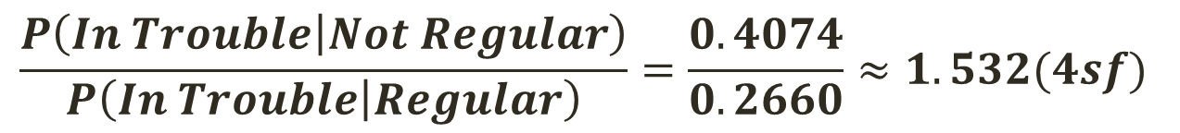
OtC L3 Statistics GPA’s 2013
 |  | Attendance (85%)
 |  | Regular | Not Regular | Total
GPA (50%) | On Track | 69 | 16 | 85
 | In Trouble | 25 | 11 | 36
 | Total | 94 | 27 | 121
Find and interpret the risk of being ‘In Trouble’ for students with ‘Not Regular’ attendance, relative to those with ‘Regular’ attendance?
For students who do not attend class regularly the risk of being in trouble with their achievement after the first three internal assessments is approximately 1.5 times the risk for students who do attend class regularly.
$$\frac{P\left(In Trouble | Not Regular\right)}{P\left(In Trouble | Regular\right)}=\frac{0.4074}{0.2660}≈1.532(4sf)$$
Notes:
Attendance here represents time in class. Calculated from raw attendance half days accounting for unjustified and justified absence
Category cut offs indicated by percentages

Slide 42

OtC L3 Statistics GPA’s 2013
 |  | Attendance (85%)
 |  | Regular | Not Regular | Total
GPA (50%) | On Track | 69 | 16 | 85
 | In Trouble | 25 | 11 | 36
 | Total | 94 | 27 | 121
Find and interpret the risk of being ‘In Trouble’ for students with ‘Regular’ attendance, relative to those with ‘Not Regular’ attendance?
For students who attend class regularly the risk of being in trouble with their achievement after the first three internal assessments is approximately 0.65 times the risk for students who do not attend class regularly.
$$\frac{P\left(In Trouble | Regular\right)}{P\left(In Trouble | Not Regular\right)}=\frac{0.2660}{0.4074}≈0.6529(4sf)$$
Notes:
Attendance here represents time in class. Calculated from raw attendance half days accounting for unjustified and justified absence
Category cut offs indicated by percentages

Slide 43
OtC L3 Statistics GPA’s 2013- first three internals
 |  | Attendance (85%)
 |  | Regular | Not Regular | Total
GPA (50%) | On Track | 69 | 16 | 85
 | In Trouble | 25 | 11 | 36
 | Total | 94 | 27 | 121
Which base line makes the most sense here?
  It makes most sense to quote the risk for students who do not attend regularly relative to those who do.
  These statistics are more likely to be used to encourage students who do not attend regularly to improve their attendance.
Notes:
Attendance here represents time in class. Calculated from raw attendance half days accounting for unjustified and justified absence
Category cut offs indicated by percentages

Slide 44
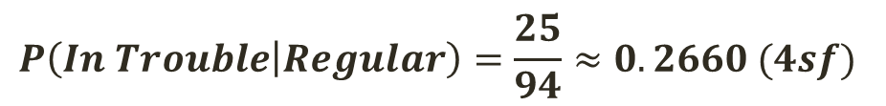
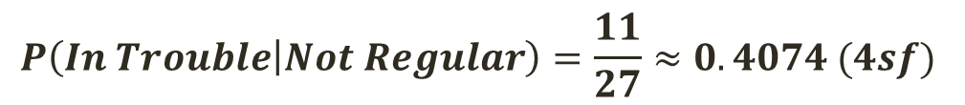
OtC L3 Statistics GPA’s 2013
What is the percentage change in risk of being in trouble for a student who mends their ways and changes their attendance from ‘not regular’ to ‘regular’?
The risk of being ‘in trouble’ decreases by approximately 35% if attendance changes from ‘not regular’ to ‘regular’.
$$P\left(In Trouble | Not Regular\right)=\frac{11}{27}≈0.4074 (4sf)$$
$$P\left(In Trouble | Regular\right)=\frac{25}{94}≈0.2660 (4sf)$$
$$Proportional Change=\frac{0.2660−0.4074}{0.4074}≈−0.3471 (4sf)$$

Slide 45
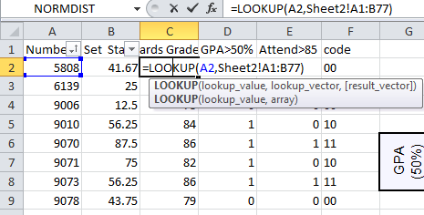
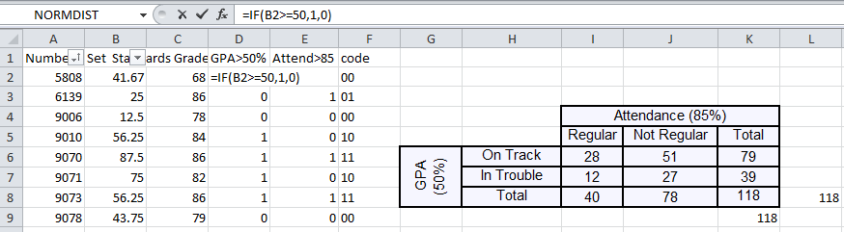
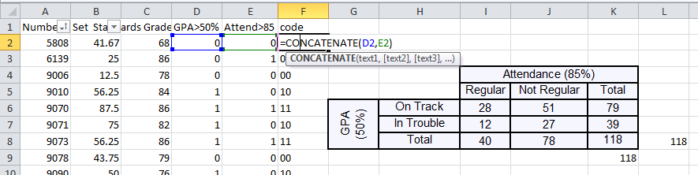
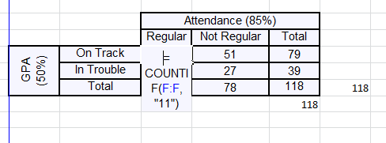
Excel…

Slide 46
Q&A
Thanks for listening!!

