Slide 1
Sampling Error
Dru Rose

Slide 2
I wonder what percentage of all 600 Kare Kare College students travel to school by car ?
Population 600
students
Sample
n = 25
Dru Rose

Slide 3
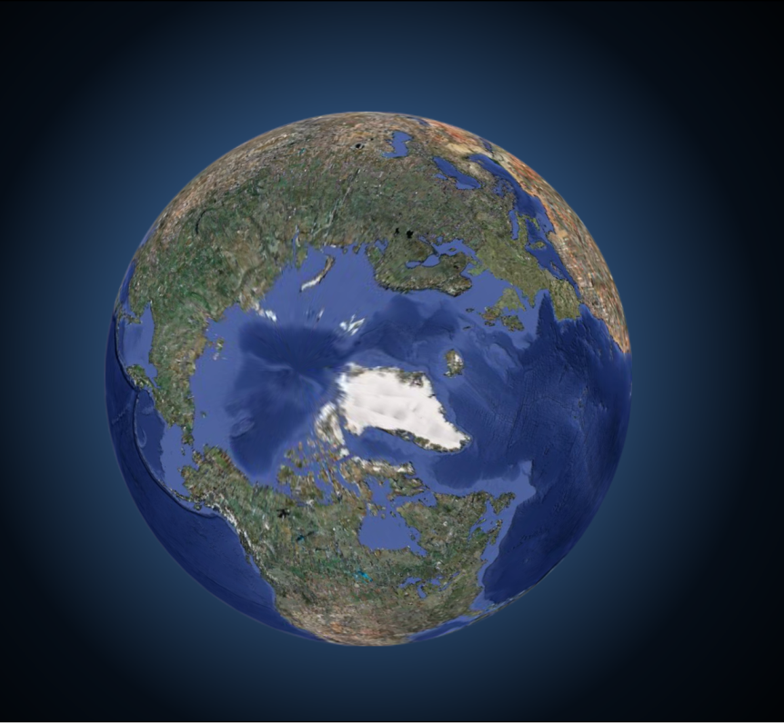
Looking at the world using data is
Like looking through a window with ripples in the glass
“What I see …
is not quite the way it really is”
Notes:
Remember that when we are looking at the world using data, it is like looking through a window with ripples in the glass: what we see, may not quite be the way it really is. So . . .

Slide 4
Although imperfect, each sample should give a reasonable picture of the population as a whole.
In the real world, we usually only have one sample. We want to use this sample to estimate the population parameter. (make an inference)
e.g. estimate the percentage of students at Kare Kare College
who travel to school by car.
Since the sample is representative of the population, we will re-sample from the sample (with replacement) to estimate the sample-to-sample variability ie sampling error or margin of error.
Re-sampling from the sample is called Bootstrapping
Dru Rose

Slide 5
For categorical data e.g. Poll %s, we need large sample sizes to keep the margin of error small.
For a sample of size n =500 and a poll % close to 50% and a 95% confidence level the margin of error is about 4.5%
For poll %s of about 50% (between 30% and 70%) ,
margin of error ≈ $\frac{1}{\sqrt{n}}$at a 95% confidence level
For poll %s <30% or >70%, the margin of error is smaller
95% of the time, the 95% confidence interval captures the true percentage in the population e.g. NZ children (in the censusatschool database) who travel to school by car.
We can say, with 95% confidence, that the % of NZ children who travel to school by car is somewhere between 39% and 48 %.
Dru Rose

Slide 6
“Opinion Divided on NZ-US exercises”
= $\frac{1}{\sqrt{750}}$ = 3.7%
Margin of error
% who support resumption
95% CI:
Meaning:
Judgement:
= 47.6%
47.6%
43.9%
51.3%
With 95% confidence, we can infer that the % of Nzers who support the resumption of exercises is somewhere between 43.9% and 51.3%
Claim of 50% support for resumption of excercises NOT supported since support could be as low as 43.9%.

Slide 7
Sampling Errors (random)
errors caused by the act of taking a sample (there is always sample to sample variability)
have the potential to be bigger in smaller samples than in larger ones
it is possible to determine how large they can be (margin of error)
unavoidable (price of sampling)

Slide 8
Difference in Poll %s
Dru Rose
Consider this scenario:
MoE = 4% sample
% who agree could be somewhere between
46% and 54%
A likely new sample
Difference in new sample poll %s = 8perct. pts
= 2 × MoE
A difference of more than 2 × MoE would be needed to disprove a claim of 50% agree
50%
50%
46%
54%

Slide 9
Broadcasting Standards Poll (1)
Can it be claimed that more young people agree than disagree?
Sample Size
n = 600
Poll MoE
$\frac{1}{√600}$ = 4.1%
2 x 4.1
= 8.2 perc. pts
Difference
51-44
= 7 perc. pts
MoE difference
7
-1.2
15.2
95% CI difference
[ -1.2 perc pts. , 15.2 perc. pts.]
Meaning
With 95% confidence, I can infer that more young people may disagree than agree by up to 1.2 perc.pts and more young people may agree than disagree by up to 15.2 perc. pts
Judgement
Claim Not Supported
Dru Rose

Slide 10
Broadcasting Standards Poll (1)
Can :it be claimed that more young people agree than disagree?
7
-1.2
15.2
95% CI difference
[ -1.2 perc pts. , 15.2 perc. pts.]
Alternative way of interpreting this CI:
It is a fairly safe bet that the percentage of young people who agree is somewhere between 1.2 perc.pts lower and 15.2 perc. pts higher than the percentage of young people who disagree.
Meaning
Judgement
Claim Not Supported
Dru Rose

Slide 11
Comparing Poll %s in independent samples
E.g. Are female students more likely to travel to school by car than males?
sample from census at school data base n=500
235 males, % motor = 39.6% (MoE = $\frac{1}{\sqrt{235}}$=6.5%)
265 females,% motor = 47.2% (MoE =$\frac{1}{\sqrt{265}}=$6.1%)
95% confidence interval for the difference
(%female-%male): [ -1.2 perc. pts ,16.2 perct. pts]
With 95% confidence, we can infer that %females who travel by car could be up to 1.2 pc. pts less than the % of males and up to 16.2 pc. pts more.
7.6
-1.2
16.2
Dru Rose

Slide 12
Comparing Poll %s in independent samples
E.g. Are female students more likely to travel to school by car than males?
95% confidence interval for the difference
(%female-%male): [ -1.2 perc. pts ,16.2 perct. pts]
Alternative way of interpreting this CI:
It’s a fairly safe bet that the %females who travel by car is somewhere between1.2 pc. pts less than the % of males who travel by car and up to 16.2 pc. pts more.
7.6
-1.2
16.2
Dru Rose

Slide 13
MoE for difference = 8.5% (half CI)
MoE Males
= $\frac{1}{\sqrt{235}}$=6.5%
MoE Females
=$\frac{1}{\sqrt{265}}=$6.1%
Average MoE = ($\frac{6.5+6.1 }{2}$) = 6.3%
Rule of thumb for MoE difference
= 1.5 x Av MoE = 1.5 x 6.3 =9%
We can show that this works about 95% of the time
Dru Rose

Slide 14
Broadcasting Standards Poll (2)
Can it be claimed that young women were more
likely to agree than young men ?
= $\frac{1}{\sqrt{293}}$=5.8%
MoE women
= $\frac{1}{\sqrt{307}}$=5.7%
MoE men
= ($\frac{5.7+5.8 }{2}$) = 5.75%
MoE difference
Av MoE
1.5 x 5.75 = 8.6%
12
Difference
=57-45 = 12 perc. pts
3.4
20.6
95% CI difference
[3.4 perc pts. , 20.6 perc. pts.]
It’s a fairly safe bet that the % of young women who agreed was somewhere between 3.4 and 20.6 perc. pts more than the % of young men
meaning
Judgement
Claim is supported
Dru Rose

