Slide 1
The Emotional Statistician
Michael Shadbolt, Otumoetai College mshadbolt@otc.school.nz
Notes:
Michael Shadbolt, Otumoetai College
Presented at AMA Stats Day, 28 November 2017, Auckland Uni campus
Based on work presented in 15-min slot on AMA Stats Day 2016 Panel: Inspirational, innovative, engaging statistics!
Picture source: http://lanceschonberg.com/wp-content/uploads/2015/07/26-Emotion.jpg

Slide 2
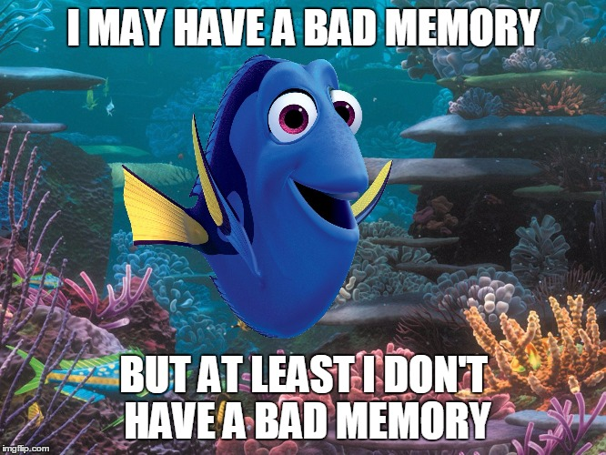
Notes:
Picture source:https://i.imgflip.com/10wf77.jpg

Slide 3
Using emotions to make learning memorable
“Although forgetting is the common fate of most of our experiences, much evidence indicates that emotional arousal enhances the storage of memories, thus serving to create, selectively, lasting memories of our more important experiences.”
"Making lasting memories: Remembering the significant", James L. McGaugh
Notes:
https://www.ncbi.nlm.nih.gov/pmc/articles/PMC3690616/
See also:
McGaugh JL. Memory and Emotion: The Making of Lasting Memories. New York: Columbia Univ Press; 2003.
Reisberg D, Hertel P. Memory and Emotion. New York: Oxford Univ Press; 2003.
Nielson KA, Powless M. Positive and negative sources of emotional arousal enhance long-term word-list retention when induced as long as 30 min after learning. Neurobiol Learn Mem. 2007;88(1):40–47.

Slide 4
“It is said that, before writing was available to keep records of important events, such as a wedding or granting of land, a child was selected to observe an event and then thrown into a river so that the child would subsequently have a lifelong memory of the event.”
"Making lasting memories: Remembering the significant", James L. McGaugh
Notes:
https://www.ncbi.nlm.nih.gov/pmc/articles/PMC3690616/

Slide 5
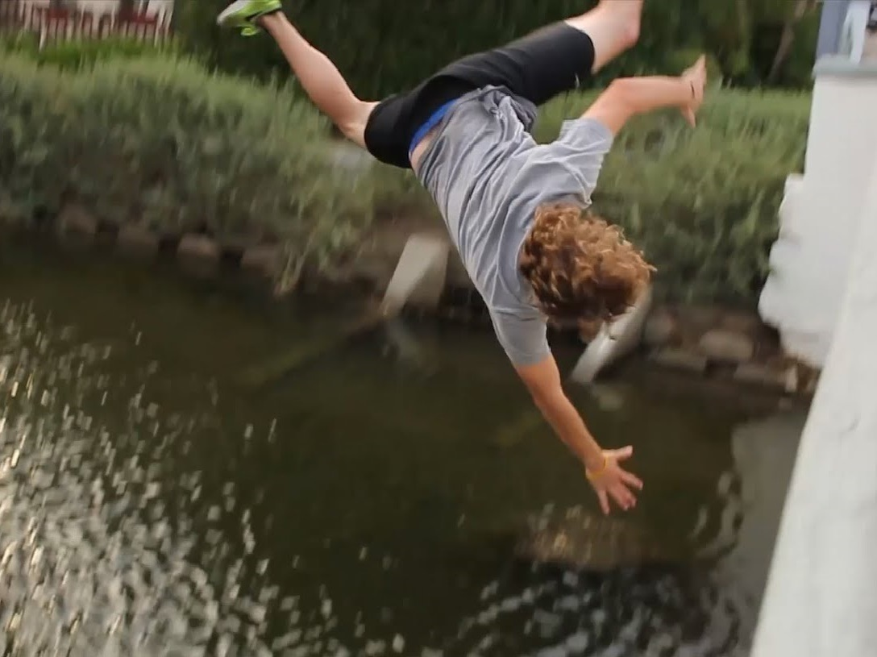
Notes:
https://i.ytimg.com/vi/dGUGw8r1Z6Q/maxresdefault.jpg

Slide 6
Modern Learning Environment?
Notes:
https://i.ytimg.com/vi/dGUGw8r1Z6Q/maxresdefault.jpg

Slide 7
Students want emotional engagement
“Too often, secondary school teachers feel that they have to be serious and maintain a professional and detached demeanour in order to be an effective teacher.
…however, the teachers students remember most fondly decades after they’ve left school, are the ones who:
shared something of themselves,
who weren’t afraid to act a little wacky once in a while to make a point in a lesson,
or who even were transparent enough to let students know that they too are human beings with lives of their own.”
Thomas Armstrong
Notes:
http://www.institute4learning.com/2017/02/03/6-ways-to-use-emotion-to-increase-engagement-in-the-middle-or-high-school-classroom/

Slide 8
Emotional engagement correlates to academic performance
In a study of Finnish students, emotional engagement was a strong predictor of academic performance.
“The trajectories of student emotional engagement and school burnout with academic and psychological development: Findings from Finnish adolescents”
Ming-Te Wang, et al
Notes:
“The trajectories of student emotional engagement and school burnout with academic and psychological development: Findings from Finnish adolescents”
Ming-Te Wang, Angela Chow, Tara Hofkens, Katariina Salmela-Aroc
Learning and Instruction Volume 36, April 2015, Pages 57-65

Slide 9
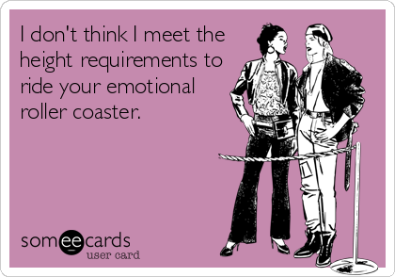
Notes:
Picture source: https://cdn.someecards.com/someecards/usercards/i-dont-think-i-meet-the-height-requirements-to-ride-your-emotional-roller-coaster-7a9c3.png

Slide 10
Joy (in sugar form)

Slide 11
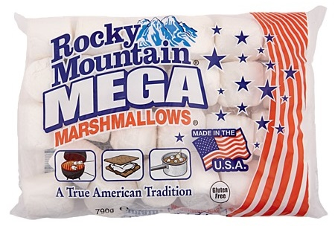
Notes:
Use GIANT marshmallows: Rocky Mountain MEGA Marshmallows. $14 for a bag of around 24, but $7-8 when reduced to clear.
http://www.thewarehouse.co.nz/red/catalog/product/Rocky-Mountain-MEGA-White-Marshmallows-790g?SKU=1600522
OR Campfire Giant Roasters Marshmallows 340g for $5.00
http://www.kmart.co.nz/product/campfire-giant-roasters-marshmallows-340g---------------------------------------------------------------------------------------/1725340

Slide 12
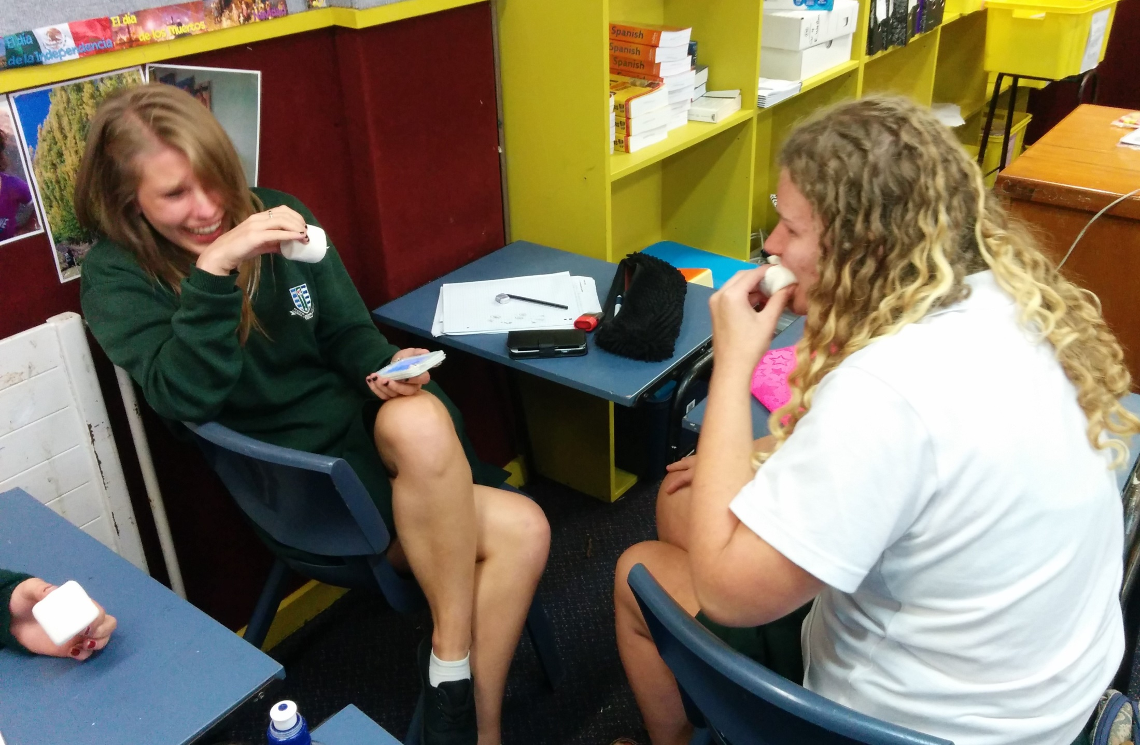
L1 Inference - Marshmallows
Notes:
L1 introduction to statistical inference
Hilarity ensues. Source: M Shadbolt, Otumoetai College

Slide 13
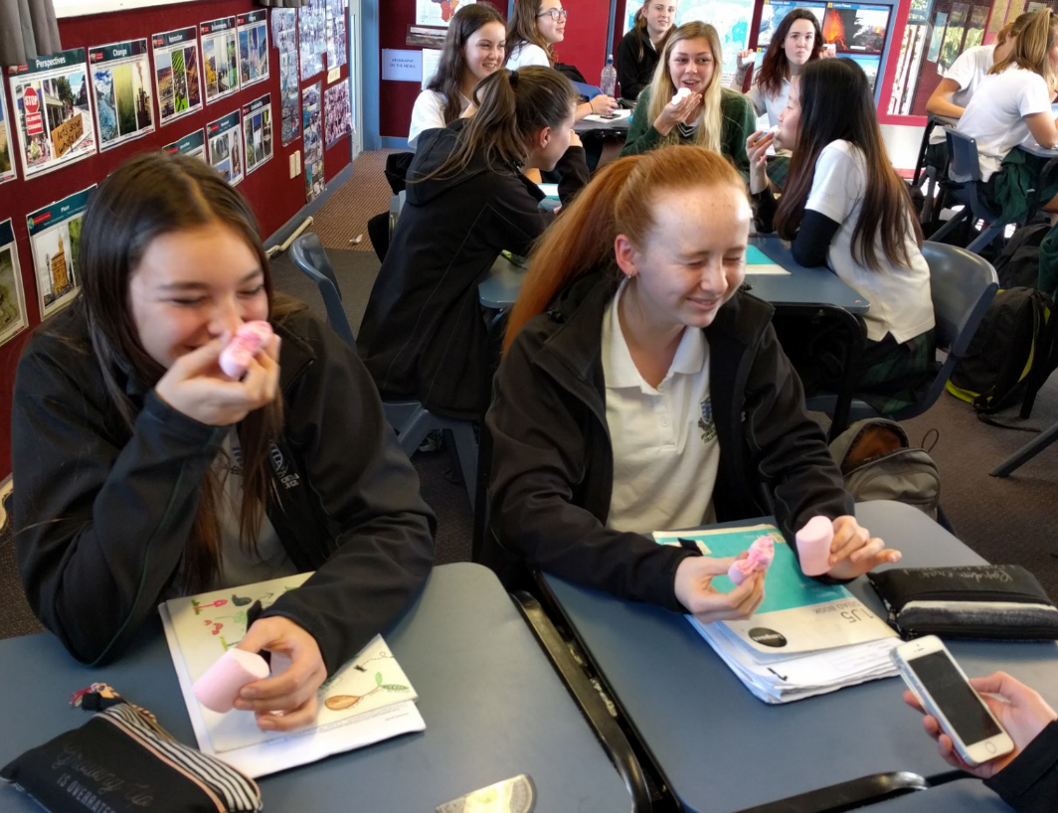
L1 Inference - Marshmallows
Notes:
L1 introduction to statistical inference Source: M Shadbolt, Otumoetai College

Slide 14
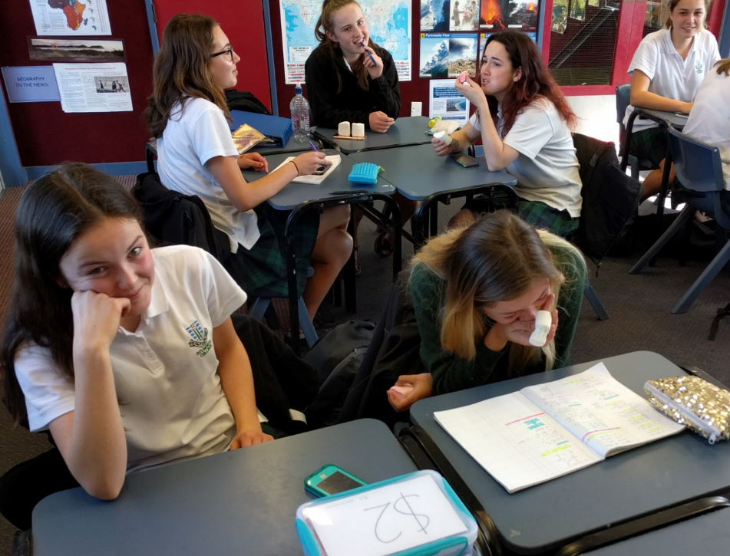
L1 Inference - Marshmallows
Notes:
L1 introduction to statistical inference Source: M Shadbolt, Otumoetai College

Slide 15
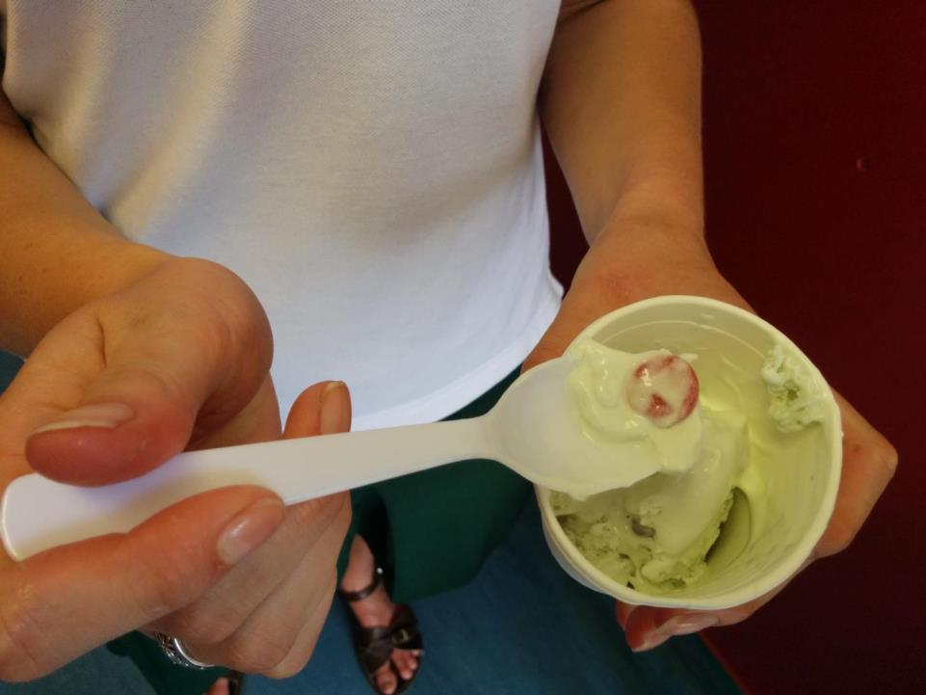
L3 Prob Distributions - Poisson
Notes:
Source: M Shadbolt, Otumoetai College L3 Poisson distribution

Slide 16
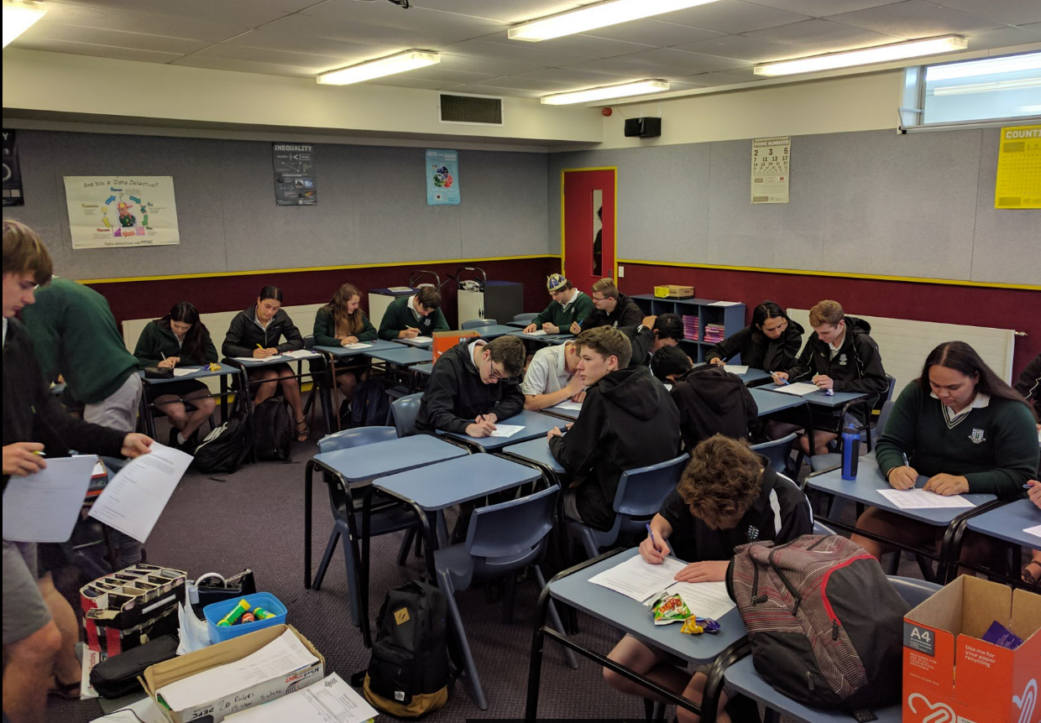
L2 Questionnaires Pilot Survey Day!
Notes:
Source: M Shadbolt, Otumoetai College Pilot Survey Day

Slide 17
Humour

Slide 18
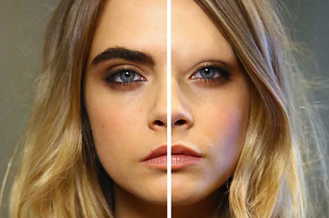
L1/L3 Bivariate – “Over-plucking”
Notes:
…. and no eyebrows/data. (Cara Delevingne)
Picture source: http://s3-static-ak.buzzfed.com/static/2015-04/1/11/campaign_images/webdr07/12-celebrities-with-and-without-their-eyebrows-2-16429-1427900420-11_big.jpg

Slide 19
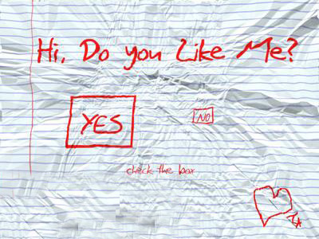
Your first ever survey?
L2 Questionnaires
Notes:
Some wonderful bias in this questionnaire! I use this right at the beginning of the L2 Questionnaire topic as a discussion point.
I like they didn’t include a “Maybe”. Too much of a cop-out!

Slide 20
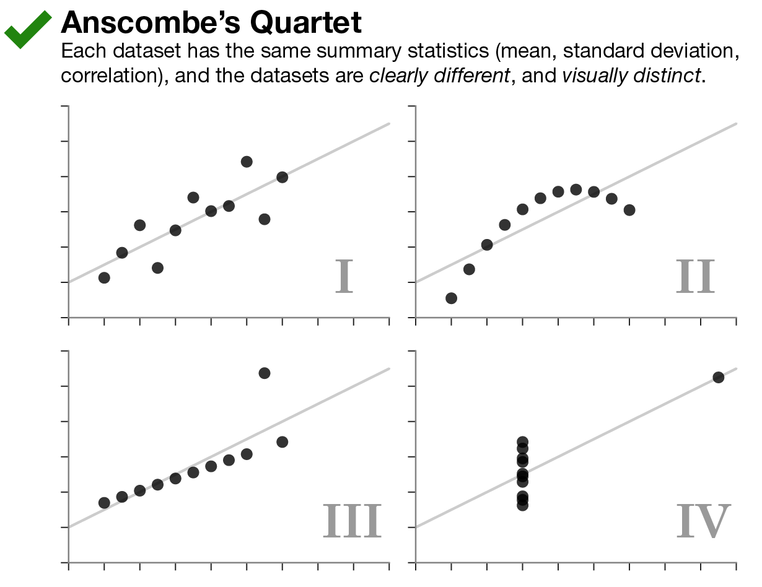
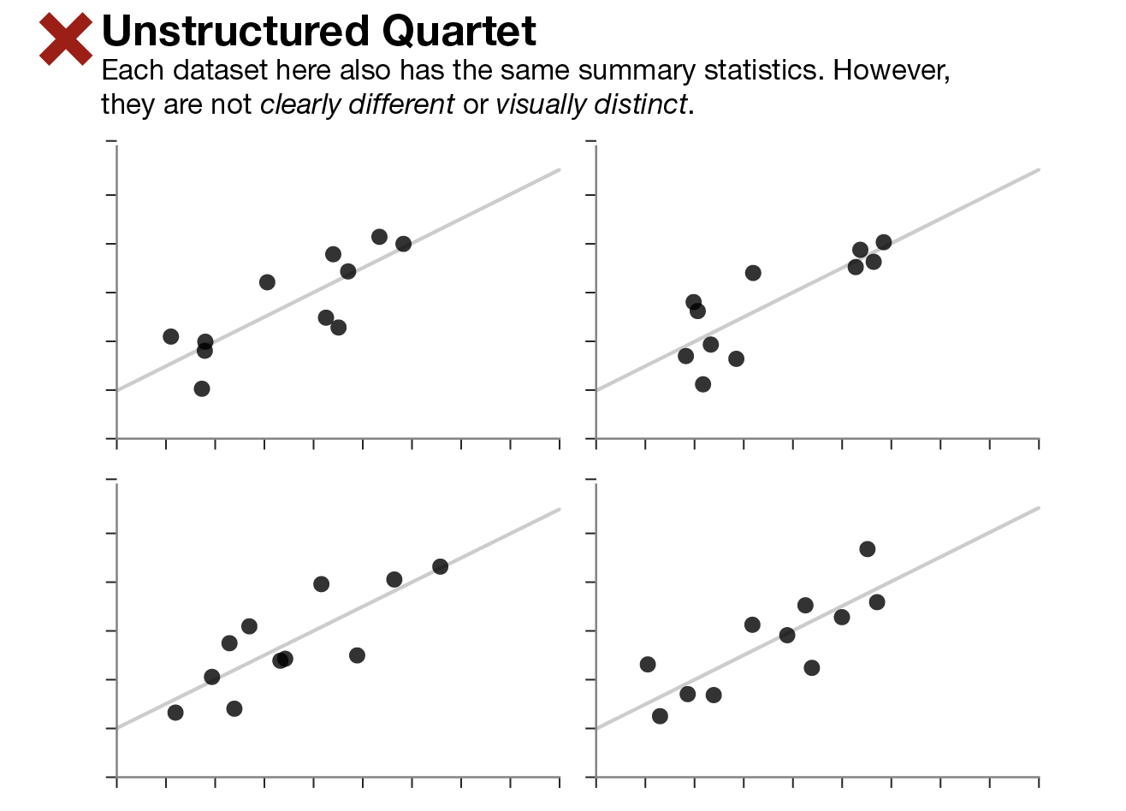
L3 Bivariate Anscombes Quartet
Notes:
https://www.autodeskresearch.com/publications/samestats

Slide 21
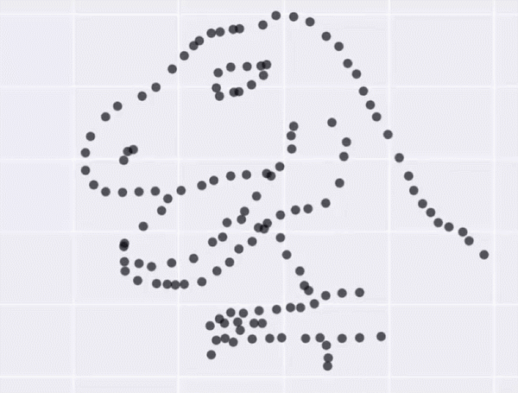
L3 Bivariate – Anscombe’s Quartet
Notes:
https://www.autodeskresearch.com/publications/samestats

Slide 22
“Inappropriate” Humour

Slide 23
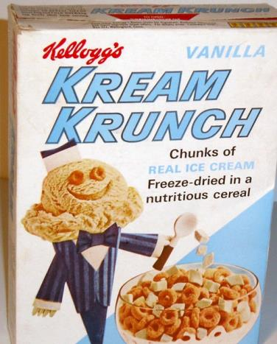
L3 Prob Distributions Continuity Correction
750g
Notes:
If you are going to use cereal as a context, don’t use cornflakes! Cornflakes are boring! Find the most interesting cereal the planet has ever known! http://en.wikipedia.org/wiki/Kream_Krunch http://www.mrbreakfast.com/cereal_detail.asp?id=403 Launched 1964 and discontinued in 1965. The cereal consisted of freeze-dried strawberry, vanilla or orange ice cream pieces, as well as O-shaped oat pieces.

Slide 24
Amazement

Slide 25
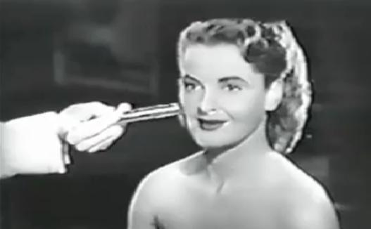
Dorothy Gray Cold Cream Clip 1950s
L2/3 Experiments
Notes:
Dorothy Gray Cold Cream 1950s.mp4. Discuss the way the experiment was carried out: 3 products, blinded.
Search Youtube for “dorothy gray cold cream”

Slide 26
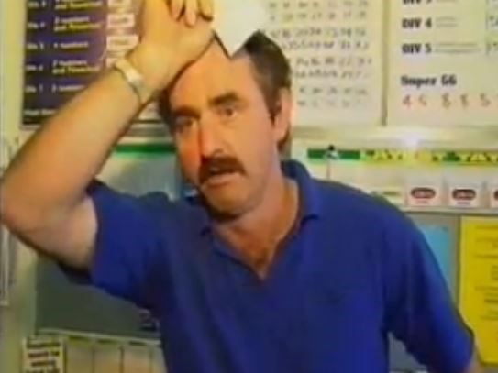
Probability
Notes:
1:30 Video of the TV news segment on Bill Morgan: https://www.youtube.com/watch?v=6R5MqxcKdV8
Note: The sound isn’t great!

Slide 27
Discomfort

Slide 28
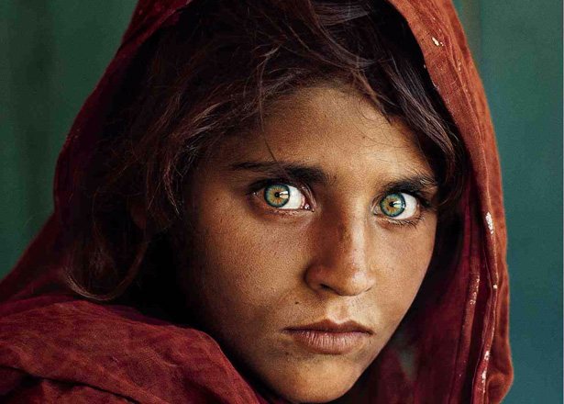
L2 Experiments
Notes:
This photo of a young Afghan girl Sharbat Gula has become an iconic image over the years since it featured on the cover of National Geographic magazine in 1985. The photograph was taken at the Nasir Bagh refugee camp in 1984 by photographer Steve McCurry. The girl was one of the students in an informal school within the refugee camp; McCurry, rarely given the opportunity to photograph Afghan women, seized the opportunity and captured her image. She was approximately 12 years old at the time.

Slide 29
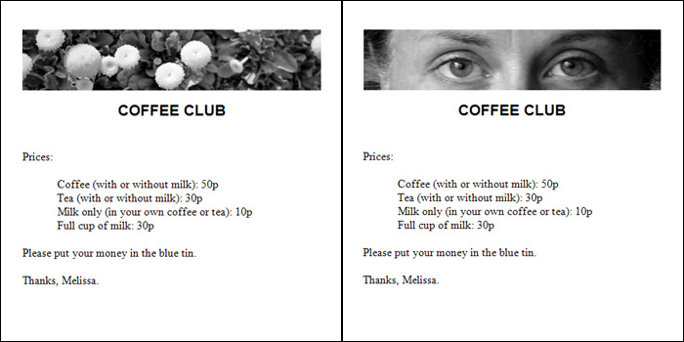
Honesty Box Experiment
An experiment was carried out in a staff common room at Newcastle University in England. There was an ‘honesty box’ system in place to pay for tea/coffee use. Each week, an A5 poster was put above the box. One week it has a picture of flowers, the other it has a picture of a pair of eyes.
Notes:
https://www.newscientist.com/article/dn9424-big-brother-eyes-make-us-act-more-honestly/

Slide 30
Preparing your class for serious discussions
Ensure that you have an existing relationship where the students trust the teacher and each-other.
Acknowledge that we are going to be talking about some difficult subjects.
Acknowledge that for some people these things might be ‘closer to home’ than for others.
Offer the opportunity to duck outside for a minute if it ever gets too uncomfortable.

Slide 31
Concern and Empathy

Slide 32
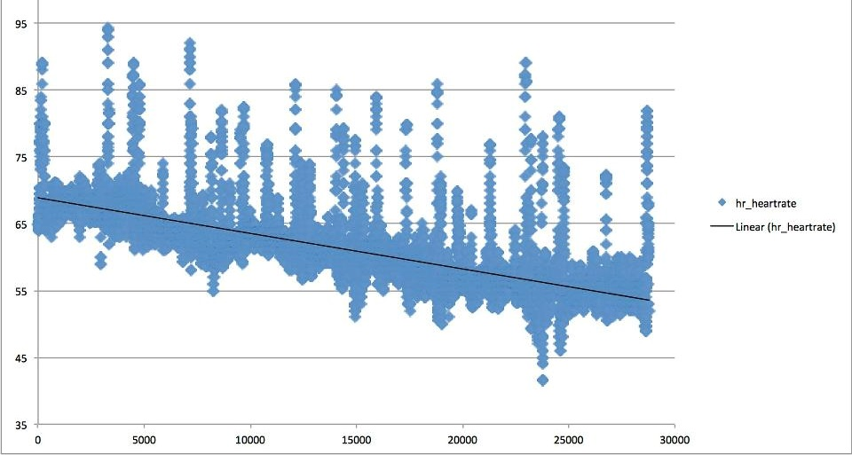
L3 Time Series or L1 Chance & Data
Results from wearing a heart-rate monitor overnight. X-axis is time (seconds) after going to bed. Y-axis is heart rate in beats per minute.
Describe the overall trend.
What would happen to Tim (the person monitored) if he kept sleeping? Make an approximate forecast for Tim’s heart-rate after 24hrs asleep.
Notes:
Level 3 Time Series
Source: My friend Tim Noble. Real data from a heart-rate monitor he wore one night. (Drops 15bpm over 25000 sec, gradient of -0.0006 bpm/sec or -2.16 per hour) (Starting at ~70bpm, after 24hrs, drops ~52bpm, so 18bpm. 0 bpm after approx. 32hours) What assumptions are we making?

Slide 33
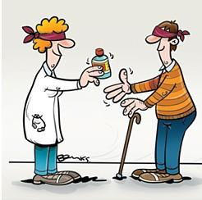
Double – blinding L2/3 Experiments
Notes:
L2/3 Experiments – Double-blinding

Slide 34
Relative Risk of Developing Breast Cancer (Utts, Seeing Through Statistics, p224)
First Child at or after age 25 | Breast Cancer | No Breast Cancer | Total
Yes | 31 | 1597 | 1628
No | 65 | 4475 | 4540
Total | 96 | 6072 | 6168
Notes:
L2/L3 Risk

Slide 35
Disgust

Slide 36
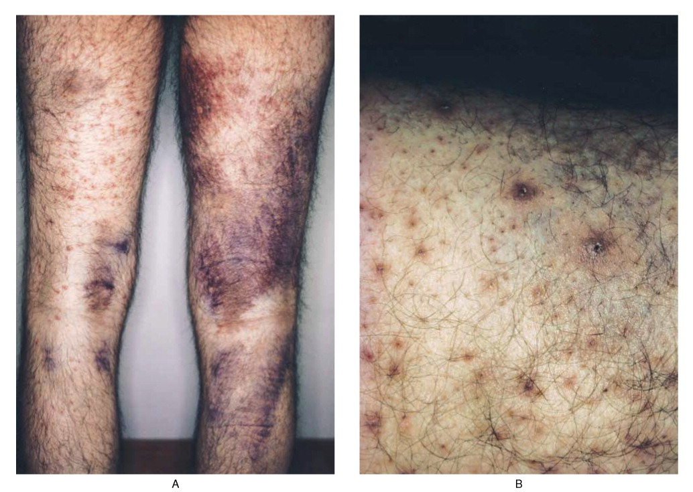
L2/3 Experiments
Notes:
The effect of scurvy on skin. New England Journal of Medicine. http://www.nejm.org/doi/full/10.1056/NEJM199506153322405

Slide 37
Puppy Lives? You Decide!
It’s not always obvious which variable is the response and which is the explanatory. Sometimes we need to think about which one makes more sense as an explanatory.
Eg: Heart weights of puppies vs body weights of puppies.
Do we want to be able to predict a puppy’s body weight by cutting out its heart and weighing it?
Or do we want to be able to predict a puppy’s heart weight by weighing the whole puppy?
In this case, perhaps it would be better if heart weight was response and body weight was explanatory…
I ruff you!
Notes:
Level 3 (or even Level 1) Bivariate. Really sell the contrast here! Mime out cracking open the rib-cage, pulling out the still-beating heart and slopping it down onto the scales in order to predict the body weight. Real shock factor will sear this example into student memories for years to come. http://www.wesitpets.com/media/images/other/MPj04312540000[1].jpg

Slide 38
Injustice and Outrage

Slide 39
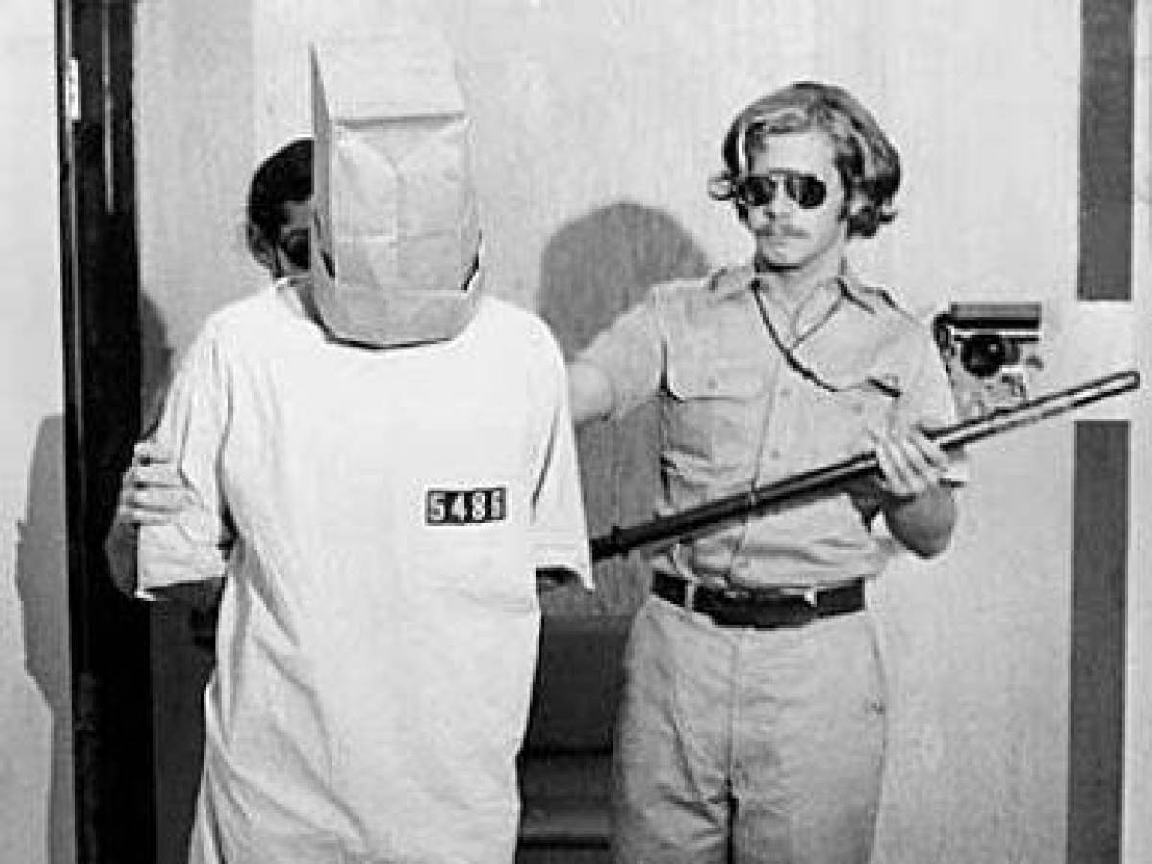
L2/3 Experiments Stanford Prison Experiment
Notes:
Official website: http://www.prisonexp.org/
Movie trailer: https://www.youtube.com/watch?time_continue=2&v=7LviGTHud5w
Picture source: http://s2.dmcdn.net/imyLr.jpg

Slide 40
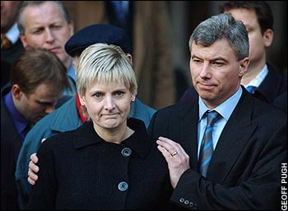
L3 Probability The Sally Clark Trial
Notes:
Ted Talk by Peter Donnelly touches on this, and the flawed statistical thinking which led to her wrongful conviction for double murder.
https://www.ted.com/talks/peter_donnelly_shows_how_stats_fool_juries

Slide 41
Student voice
Instead of asking: “What did you enjoy most this year?”
Ask:
“What was the most memorable thing from Math this year?”

