Slide 1
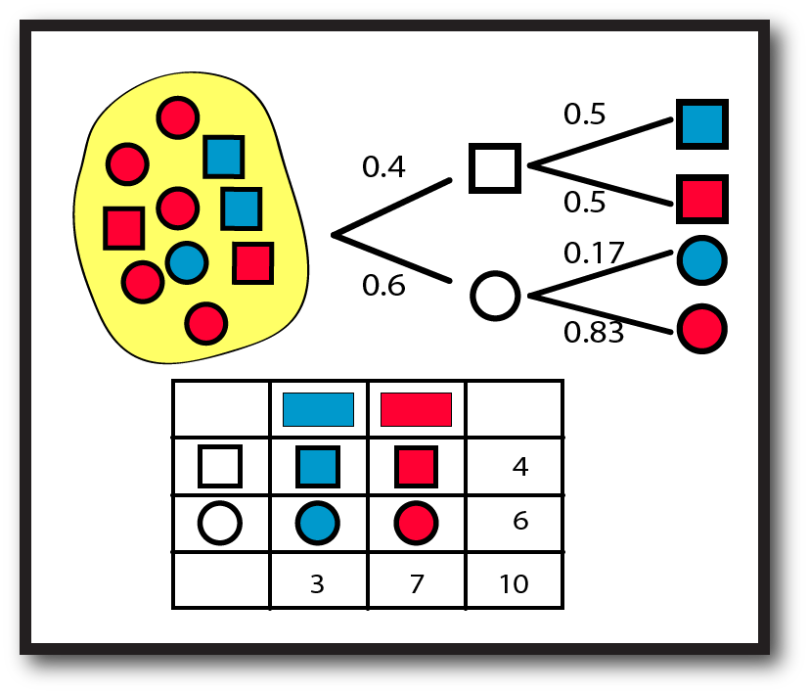
Having fun with probability concepts and solving problems
Dr Nicola Ward Petty
Statistics Learning Centre
Statisticslearningcentre.com

Slide 2
Statistics Learning Centre
Based in Christchurch
Started producing materials for NCEA Statistics in 2013
NZ Stats 3 and NZ Stats 2 – online resources to students
Professional development for teachers
Videos, blog, apps
Consulting in Operations Research
Inventors of Rogo

Slide 3
Introducing Dr Nic
Dr Nicola Ward Petty BSc(Hons), DipTchg, PhD
Lecturer in Operations Research at University of Canterbury for 20 years.
Won UC teaching award, researched in education and statistics.
Well-known blogger on teaching statistics.
Popular YouTube videos
Winner of Greenfield award for disseminating statistics
PhD in operations research/ school effectiveness
Loves to teach and to help teachers.

Slide 4
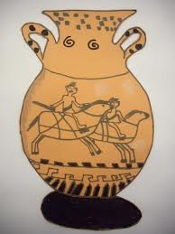
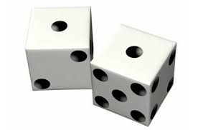
Move away from dice, coins, balls and urns!
Not only are they boring but when we use equiprobable equipment all the time, it can entrench incorrect ideas.

Slide 5
The problem with dice, coins, balls and urns
Not relevant !
Imply “true probability” – harder to get the idea of a model across when it seems true.
Entrench equi-probability
Ok to use a little, but be wary
Cards have cultural issues – do not assume familiarity

Slide 6
Overview
Water problem: True probability, model estimate, experimental estimate
Curriculum progression
Models - Scenario cards
Ethics and probability
Problems that matter
On-line resources

Slide 7
Abstract (overly ambitious)
We will attempt to cover the following questions and concepts:
True probability?
How are model estimates and experimental estimates related?
What does the curriculum mean by good model, poor model and no model?
How do you teach about deterministic and probabilistic models?
What exactly is a model and why is it hard for students to get their heads around the concept?
Finding and exploring problems that matter.
Ethical aspects to the teaching of probability?
On-line resources for teaching probability?

Slide 8
Probability is:
Important
Relevant
Fun
Applied
Interesting
Well contained
Difficult – with literacy challenges

Slide 9
Water problem
There has been an outbreak of a disease and authorities don’t know the source.
It comes from the local drinking water.
Can only test some people (why?)
If I pick a person at random from this class, how likely is it that he or she has had a drink of tap water in the last 12 hours?

Slide 10
How likely is it that a randomly chosen person will have had a drink of water?
Everyone write down your answer in words.
Now write your answer using a number.
Now all stand up and get in order.
What do we (students/teachers) learn from this exercise?
different terminology between people
a way of assessing student understanding of the meaning of the numbers.

Slide 11
Quick Discussion
How did you decide on your number?
What kind of model is this?
What information did you use?
Do you think the people who did drink water would say a higher probability than those who didn’t?
(Should they have?)

Slide 12
The distribution
What other outcomes are possible?
Didn’t drink water
This is the full distribution – could have another discussion about timing, amount etc.

Slide 13
Discussion
What type of probability model is this?
Subjective/ Objective
Are there any circumstances in which it could be called a good model?
Why do we call it a model?

Slide 14
Improving our probability estimate
How can we get a better idea of the probability of a water drinker?
Take a sample:
Ten people – what have you got?
Would you change your model?
 | Drank | Didn’t drink
Number
Probability

Slide 15
Discussion
What kind of model is that?
Probability based on model or experiment?
No model/ poor model/ good model?
Purpose
How can we make it better?
Bigger sample.

Slide 16
From the curriculum (Senior secondary guide)
Probability distributions can be investigated by making assumptions about the situation and applying probability rules and/or by doing repeated trials of the situation and collecting frequencies.
Interprets results of probability investigations, demonstrating understanding of the relationship between true probability (unknown and unique to the situation), model estimates (theoretical probability), and experimental estimates.

Slide 17
True probability
If we ask the whole group and get the correct proportions, will that give us the true probability?
No. We never know the true probability. It is always only a model. But this is a VERY good model.
Teaching hint – also use an example for which the true probability is difficult to model – eg Lego brick. (Senior Secondary Guide has a lesson extending to random variables)

Slide 18
Testing it
Who has a surname starting with P?
Did you have a drink of water?
What does that tell us about our estimate?
Unless our probability for drinking water was 0 or 1, a single result doesn’t tell us anything!

Slide 19
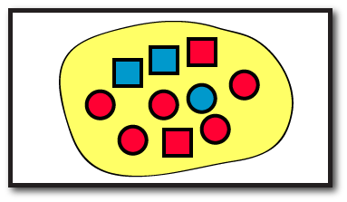
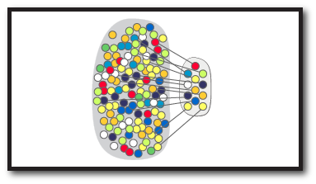
Relationships between models
Model estimate of probability
True probability
Unknown
Estimate
Estimate
Experimental estimate of probability
informs
Includes theoretical distributions, often based on experimental data.
Affected by sample size

Slide 20
Why does this matter? Dr Nic’s take on it
Probabilistic thinking is difficult but important.
Misconceptions abound.
Traditional approaches over-emphasise the predictive ability.
Two ways of approaching (frequentist, “exact”) can be kept too separate in students’ minds.
By emphasising the concept of the “model” we can teach the idea of probability as a useful construct, rather than “the truth”.

Slide 21
Curriculum progression – Primary levels
From Key Ideas on NZMaths site
Level 1 – chance situations, always, sometimes, never
Level 2 – comparative – more or less likely
Level 3 – quantifying – theoretical and experimental – distributions, models
Level 4 – Two stage probabilities, comparing experimental results, idea of independence

Slide 22
Curriculum progression – Secondary
Level 5 – (Years 9 and 10) Two and three stage probabilities, comparing experimental results, theoretical models.
“Students need to recognise that theoretical model probabilities and experimental estimates of probabilities are approximations of the true probabilities which are never known.”
Level 6 – NCEA Level 1- as above, plus discrete random variables, role of sample size
Level 7 – NCEA Level 2 - Continuous random variables, normal distribution, tree diagrams, tables, simulations, technology.
Continue to emphasise good, no and poor model.
Level 8 - NCEA Level 3 – Distributions, randomness, types of model, simulation

Slide 23
Extending the water example
Only three tests available – probability all same result.
Probability of getting disease is 0.95 if drank, 0.1 if didn’t drink. Make up table from this.
Good problem because:
Interesting
Detective-like – has a real application
Not personal

Slide 24
Question
How long will it take me to get from here to Hamilton?
What do we take into account?
Deterministic
Probabilistic
What will the answer look like?
This is a model!

Slide 25
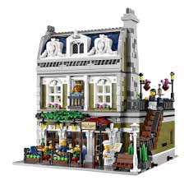
Models
Mathematical modelling used in Operations Research, engineering, medicine, biology…
Also a way of thinking, communicating
Always an approximation of the real-life situation or problem
Has a purpose
Profit = Revenue - Costs

Slide 26
Scenario exercise – probabilistic and deterministic thinking
You have some cards with scenarios printed on them.
Work with the other people with the same coloured cards as you.
Put the cards in order – the criteria are up to you. (Or sort into different categories)

Slide 27
Scenarios
The All Blacks won the Rugby World Cup.
We jumped in the swimming pool and got wet.
Eri did better on a test after getting tuition.
Holly was diagnosed with cancer, had a religious experience and the cancer was gone.
A pet was given a homeopathic remedy and got better.
Bill won $20 million in Lotto.
You got five out of five right in a true/false quiz.
Your friend cheated in class and got caught.

Slide 28
Discuss
As students
What criteria?
Likely, important, predictable, cause and effect
For each scenario give a deterministic and a probabilistic explanation
As teachers
What can this exercise teach?
Ethical aspects?
Would it work?
How might it help towards understanding uncertainty and probability?

Slide 29
Ethics and probability
People’s understanding of probability and chance events has an impact on how they see the world as well as the decisions they make.
Challenge thinking, but be gentle, not arrogant.
Sensitive to personal experiences, cancer, road accidents, religion, earthquakes.
Think about your stance on gambling.
http://learnandteachstatistics.wordpress.com/2013/05/27/probability-and-deity/

Slide 30
Problems that matter
Use real data (e.g. crime reporting and resolution, emergency calls, pocket money, environmental issues, safety…)
Things that matter to students:
Fairness in chance events – ballot for tickets, privileges, partner in assignment, talent shows
Gameshows, especially Deal or No Deal (See blog)
Crime investigations, forensics and proof
Computer and board games
MP3 shuffle
Sport
Lego Minifigures or New World toys

Slide 31
Cool ideas
Random dance, music, art work

Slide 32
On-line resources
Manipulatives
Nrich
Videos, background
Understanding uncertainty
NOT Khan academy – too mechanistic, flawed
Teaching suggestions
Senior Secondary Guides (Lego example)
Census @ School

Slide 33
The universal problem – suggestions?
Turning the words into mathematics
Knowing how to start
Conjecture – they have only an instrumental understanding of the problem.
They can do the mechanics, but don’t really get what is happening.
Tree or table?

Slide 34
References
Pfannkuch, M., & Ziedins, I. (in press). A modeling perspective on probability. In E. Chernoff & B. Sriraman (Eds.), Probabilistic thinking: Presenting plural perspectives. Springer.

Slide 35
statsLC.com

