Slide 1
Probability – Risk-Free
Lars Thomsen, Avondale College

Slide 2
What has changed?
Re-conceptualising probability

Slide 3
Changes in the Probability Standard
Old 2.6
Simulate probability situations
Apply the normal distribution
New 2.13
Simulation
Tree diagrams
(old Level 1 probability)
New 2.12
Probability
Experimental distributions
(progression from new 1.13)
Risk and relative risk (new)

Slide 4
2.12 Probability
evaluate statistically based reports
  interpreting risk and relative risk
investigate situations that involve elements of chance
  comparing theoretical continuous distributions, such as the normal distribution, with experimental distributions
  calculating probabilities, using tools such as two-way tables, tree diagrams

Slide 5
2.12 Probability
Methods include a selection from those related to:
  risk and relative risk
  the normal distribution
  experimental distributions
  relative frequencies
  two-way tables
  probability trees.

Slide 6
From the T&L guides:
Indicators
A. Comparing theoretical continuous distributions, such as the normal distribution, with experimental distributions:
Describes and compares distributions and recognises when distributions have similar and different characteristics.
Carries out experimental investigations of probability situations …
Is beginning to use mean and standard deviation as sample statistics or as population parameters.
Chooses an appropriate model to solve a problem.

Slide 7
From the T&L guides:
Indicators
B. Calculating probabilities, using such tools as two-way tables, tree diagrams, simulations, and technology:
Uses two-way frequency tables to solve simple probability problems ...
Constructs and interprets probability trees ...
Students learn that situations involving real data from statistical investigations can be investigated from a probabilistic perspective .

Slide 8
From the T&L guides:
Indicators
B. Calculating probabilities, using such tools as two-way tables, tree diagrams, simulations, and technology:
Uses two-way frequency tables to solve simple probability problems ...
Constructs and interprets probability trees ...
Students learn that situations involving real data from statistical investigations can be investigated from a probabilistic perspective .

Slide 9
Re-conceptualising probability
from
Theoretical probability vs. Experimental probability
to
Probability as a way of making sense of data
Similarities to statistical methods
But: variation through chance, not sampling

Slide 10
Re-conceptualising probability
Statistics
Probability
Sample
Population
Variability from sampling
Median / IQR (or others)
Inference
Continuous variable
Experimental distribution
Infinite / not defined?
Variability from chance
Mean / sd
Model
Continuous (histogram) or discrete / categorical ( two way table) variable

Slide 11
Experimental distribution or not?
Test reaction time of all students in class
Take a sample of 50 reaction times from C@S
Compare two samples of 50 reaction times from C@S
Plant 30 sunflowers and measure the height after 2 weeks
Measure the length of the right foot of each student in class (in winter)
DISCUSS!

Slide 12
Introducing probability distributions
What we have learnt from AS91038

Slide 13
Investigations into CHANCE
Dice bingo
LO: Carry out an investigation involving chance

Slide 14
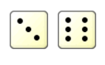
DICE BINGO!
Fill out a 3x3 grid with numbers from 0-5. You may use numbers more than once. E.g.
To play dice bingo two dice are rolled and the difference between them is the number called out. E.g. = 3
The winner is the first to get the whole grid.
3 | 0 | 2
5 | 4 | 1
4 | 3 | 0
LO: Carry out an investigation involving chance

Slide 15
PROBLEM
Write down an appropriate problem statement for this investigation
Write down what you think the answer will be
Write down how you think we could investigate this problem
LO: Carry out an investigation involving chance

Slide 16
PLAN
I roll 2 dice and work out the difference between the numbers, I will do this 30 times
I will draw up a table from 1 – 30 and write down the difference of the two dice each time
I will also draw up a tally chart to keep a track of how many times I get 0, 1, 2, 3, 4, or 5 as the difference of the two dice
LO: Carry out an investigation involving chance

Slide 17
DATA
Trial | Difference of the two dice
1
2
3
→ 30
LO: Carry out an investigation involving chance
Difference of the two dice | Tally | Frequency
0
1
2
3
4
5

Slide 18
ANALYSIS
Draw a graph of the difference between the two dice against the trial number
LO: Carry out an investigation involving chance
e.g.
Trial | Difference of the two dice
1 | 2
2 | 3
3 | 0
4 | 5
Difference of the two dice
vs trial number
5 -
4 -
3 -
2 -
1 -
0
Difference of the two dice
1 2 3 4 5 6 7 8 9 10 11 12 13 14 15 → 30
Trial number

Slide 19
ANALYSIS
Describe what you see in your graph:
  Draw a horizontal line where you think the outcomes jump around and link this the typical outcome
  Identify any “runs” of outcomes and link this with whether each trial outcome appears to be independent
  Identify the range of the outcomes and link this with the possibilities for the outcomes
LO: Carry out an investigation involving chance

Slide 20
ANALYSIS
Draw a dot plot for frequency of the difference of the two dice
LO: Carry out an investigation involving chance
Difference of the two dice | Tally | Frequency
0 | | | 1
1 | ||| | 3
e.g.
Dot plot of difference of the two dice
Frequency
0 1 2 3 4 5
Difference of the two dice

Slide 21
ANALYSIS
Describe what you see in your dot plot:
  Identify the “tallest” outcome and link this with the mode “most common”
  Circle the “towers” that represent at least 50% of the outcomes and link these with
  “most likely”
  Outline the shape of the dot plot and link this with the shape of the distribution (skewed, symmetric, bi-modal)
LO: Carry out an investigation involving chance

Slide 22
ANALYSIS
Create a distoplot by drawing rectangles around your dots
LO: Carry out an investigation involving chance
Distoplot of number of heads
Frequency
0 1 2 3 4 5 6
Number of heads

Slide 23
ANALYSIS
Work out the probability of getting each of the outcomes and write at the top of the box
LO: Carry out an investigation involving chance
Distoplot of number of heads
33%
23%
3/30 = 0.1
0.1 = 10%
20%
Frequency
10%
10%
3%
0 1 2 3 4 5 6
Number of heads

Slide 24
CONCLUSION
Write an answer to your problem and provide supporting evidence from your investigation:
  Clearly give an answer “Based on my experiment, I would estimate that….”
  What are you pretty sure about what do you think (would be the same with another experiment and why)?
  What are you not so sure about (what do you think would change with another experiment and why)?
LO: Carry out an investigation involving chance

Slide 25
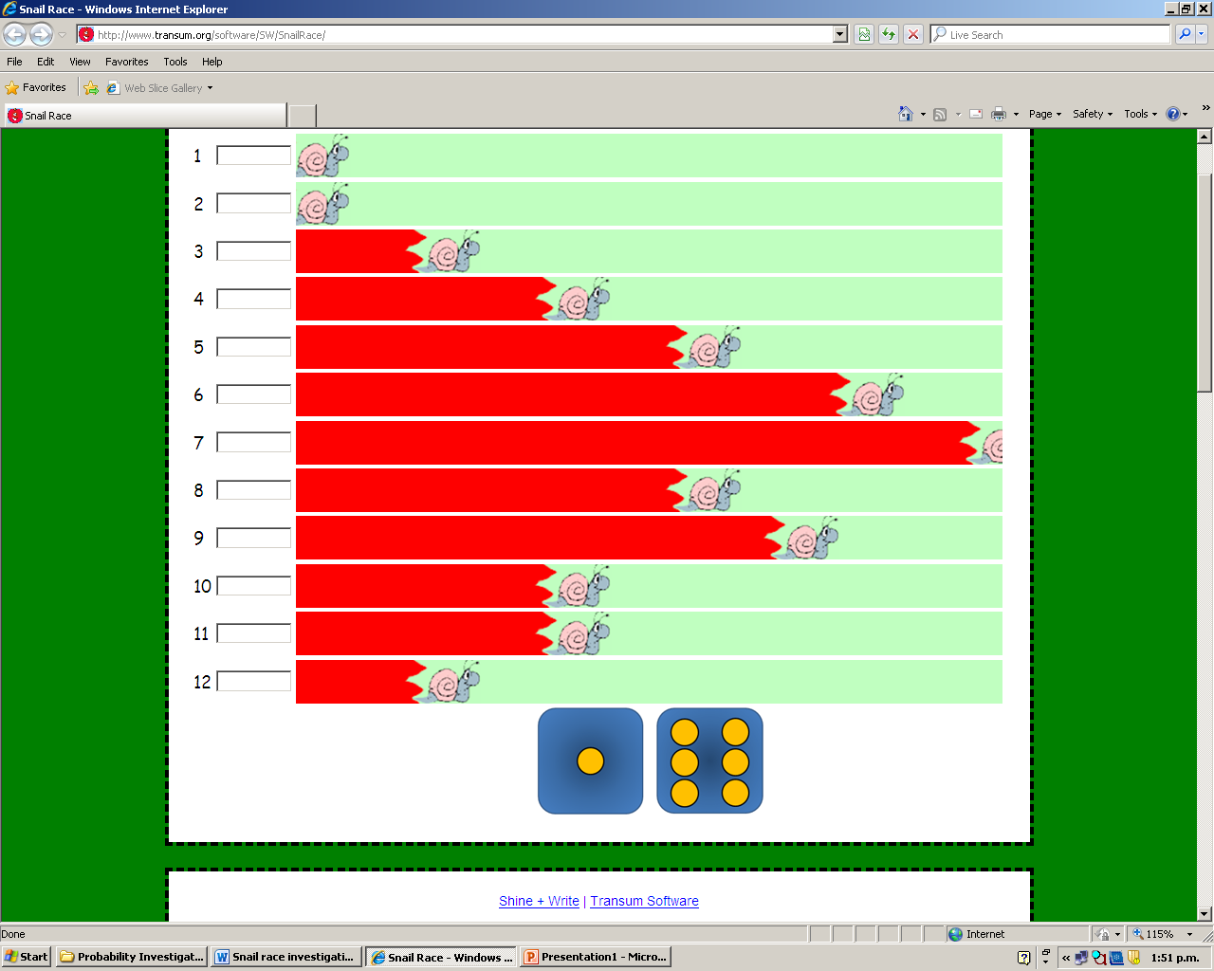
Snail Race
http://www.transum.org/software/SW/SnailRace/

Slide 26
PROBLEM
If I flip 6 coins, how many heads will I get?
Write down what you think the answer will be
Write down how you think we could investigate this problem
LO: Graph and describe a probability distribution

Slide 27
PROBLEM:
Jessica thinks she’s really good at archery and tells her friends that she can get a bull's-eye 4 out of 5 shots. Her friends want to find out the truth.
NOW YOU…
Write down an appropriate problem statement for this investigation
Write down how you think we could investigate this problem
LO: Write problem statements, analysis statements and conclusions

Slide 28
Progression from Y11
1.13 Probability Investigation
2.12 Probability
Discrete data
Experiment
‘Distoplot’
‘Rough shape’
Proportion
(Discrete and) continuous data
Experiment
Histogram
‘Rough shape’, skew, ‘peakedness’
Proportion, mean and sd

Slide 29
Making sense of standard deviation

Slide 30

Investigation: age estimation
Estimate the age of this gentleman at the time the picture was taken.
How good are we?
Justify your answer!!!

Slide 31
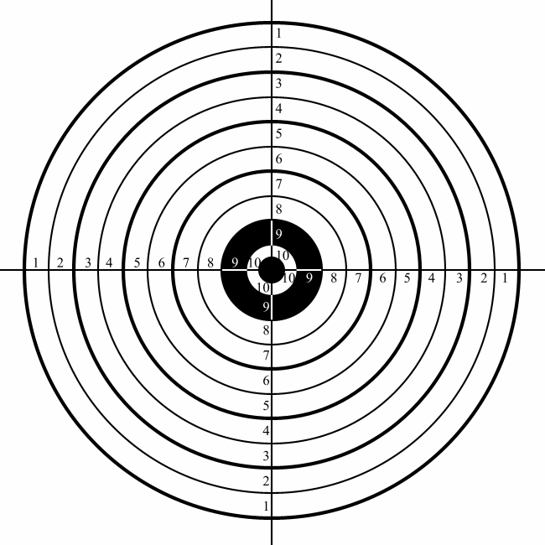
Accuracy or Consistency?
Which measures do describe the two?

Slide 32
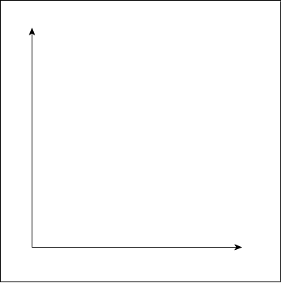
Accuracy or Consistency?
Add 10 shots for a shooter who is consistently bad.
Draw a histogram
Calculate mean and sd

Slide 33
Accuracy or Consistency?
Add 10 shots for a shooter who is inconsistently average.
Draw a histogram
Calculate mean and sd

Slide 34
Accuracy or Consistency?
Add 10 shots for a shooter who is consistently great.
Draw a histogram
Calculate mean and sd

Slide 35
Comparing experimental distributions with the normal distribution

Slide 36
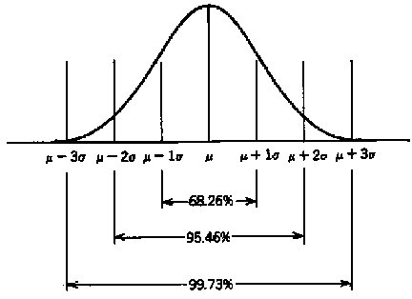
Features of the normal distribution
Continuous random variable
Bell shape
Symmetric about μ

Slide 37
How normal is normal?

Slide 38
How normal is normal?
Is the normal distribution an appropriate model for the data?
Symmetry (skew)
Bell shape
How can we justify this?

Slide 39
Rolling a die
mean: 3.5
sd: 1.7
mean ± 1 sd:
1.8 < x < 5.2
≈ 56%

Slide 40
Rolling two dice
mean: 7
sd: 2.4
mean ± 1 sd:
4.6 < x < 9.4
≈ 64%

Slide 41
How normal is normal?
Is the normal distribution an appropriate model for the data?
Symmetry (skew)
Bell shape
How can we justify this?

Slide 42
Some ideas for investigations

Slide 43
What do ‘good’ distributions look like?
Experimental not sampled
Not grouped (but perhaps rounded values)
Reasonable sample size
Histogram with frequency rather than relative frequency on vertical axis
Continuous?
THINK – PAIR – SHARE: ideas for experimental distributions

Slide 44

Mark the mid-point

Slide 45
Good shot?

Slide 46




Are you psychic?

Slide 57
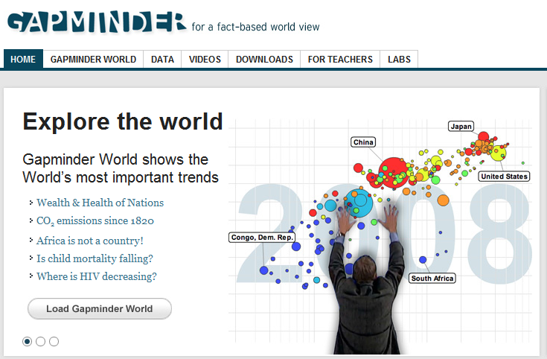

Slide 58
1.
Which country has today the lowest death rate during the 1st year of life (i.e. infant mortality): Singapore, Sweden or Venezuela?

Slide 59
2.
Which country has the lowest infant mortality today: Nicaragua, Sri Lanka or Turkey?

Slide 60
3.
In which country is the average income per person highest today: Botswana, Egypt or Moldova?

Slide 61
4.
In which country do people live the longest on average today: Botswana, Egypt or Moldova?

Slide 62
5.
In which country today do women on average marry at the oldest age: Algeria, Canada or the Philippines?

Slide 63
6.
Which country has the fewest number of children per woman today: Tunisia, Bangladesh or Argentina?

Slide 64
7.
Which country emits most tones of CO2 per person today: China, France or USA?

Slide 65
1.
Which country has today the lowest death rate during the 1st year of life (i.e. infant mortality): Singapore, Sweden or Venezuela?
Answer: Singapore

Slide 66
2.
Which country has the lowest infant mortality today: Nicaragua, Sri Lanka or Turkey?
Answer: Sri Lanka

Slide 67
3.
In which country is the average income per person highest today: Botswana, Egypt or Moldova?
Answer: Botswana

Slide 68
4.
In which country do people live the longest on average today: Botswana, Egypt or Moldova?
Answer: Egypt

Slide 69
5.
In which country today do women on average marry at the oldest age: Algeria, Canada or the Philippines?
Answer: Algeria

Slide 70
6.
Which country has the fewest number of children per woman today: Tunisia, Bangladesh or Argentina?
Answer: Tunisia

Slide 71
7.
Which country emits most tones of CO2 per person today: China, France or USA?
Answer: the USA

Slide 72
Two way tables
Asking meaningful questions

Slide 73
Two-Way Tables
39 of the 120 students in 12MAT failed the probability practice test. As it turns out, even of the 76 students who did do regular homework, 21 students failed the test.
Represent the data in a table.
Write down at least one stupid question.
Write down one question each relevant to the teacher, a lazy student and a student with other commitments.
Make a case for doing homework.

Slide 74
Two-Way Tables
 | passed | failed | total
homework | 55 | 21 | 76
no homework | 26 | 18 | 44
total | 81 | 39 | 120
Write down at least one stupid question.
Write down one question each relevant to the teacher, a lazy student and a student with other commitments.
Make a case for doing homework.

